Slide 1
Key Stage two
Stay and Learn
Helping your child with reading at home
October 2019 Mrs Boulton

Slide 2
Reading at KS2
As our children move on from the early stages of reading, reading at home can become a bit like flossing; we all know there are benefits – but life sometimes gets in the way.
AIMS OF STAY and LEARN for READING at KS2
To promote the importance of reading regularly at home
To gain an understanding of the reading skills we are developing in school at KS2 and how you can support your child at home.

Slide 3
WHY READING MATTERS
Not everyone agrees with this – we need to help them catch the reading bug
It is fun! You can meet new people; have adventures; lose yourself; go to all sorts of places; find out about the world and yourself. Laugh … and cry.
Reading is essential for children to broaden their communication skills, knowledge and understanding; if you don’t read, you limit your education and your future prospects.
But this hard hard to disagree with.
Reading improves concentration.
Reading is exercise for the brain (improves neural pathways)
Reading teaches children about language and helps them to communicate.
Reading can make children more empathetic.
Reading encourages creativity.
Reading at home improves parent-child relationships
This is what research tells us …..

Slide 4


Slide 5
READING IN SCHOOL at KS2: WHEN
Independent reading – usually at the beginning of the day or afternoon sessions.
Paired reading – reading and discussing information or passages with a partner in English, Creative Curriculum, Science etc.
Guided Reading – reading and discussing in a group with an adult.
Shared Reading – whole class reading a text together, often displayed on smartboard and whole class/paired discussion. Often in English.
Library Time – class library in every classroom. School library weekly – support with choosing books.
Reading Comprehension – discussion and written comprehension in English.

Slide 6
READING AT SCHOOL AT KS2: LEARNING
Not an Exhaustive LIst
Decoding (phonics, sounding out words)
Information retrieval
Personal response
Vocabulary – meanings ( synonyms, antonyms)
Development of ideas, themes, characterisation
Varied texts – forms, genres, purpose and audience
Structure and organisation of a text
Author’s intentions and purpose
Author’s choice of language and techniques
Retrieving information from a text
Inferential understanding
Links with social, historical and literary context

Slide 7
Reading SCHEME (#itsnotARACE)
The Reading Scheme helps create readers who will become …
Secure
Fluent
Confident
Independent
… readers in
Year 6
Important to provide a secure basis for confident reading in the future.
Continues to develop vital phonic skills particularly in Year 3 and 4
Can also read freely chosen books alongside the reading scheme/be read more challenging books
The highest reading scheme bands are often more challenging than freely chosen general books
Notes:
7

Slide 8
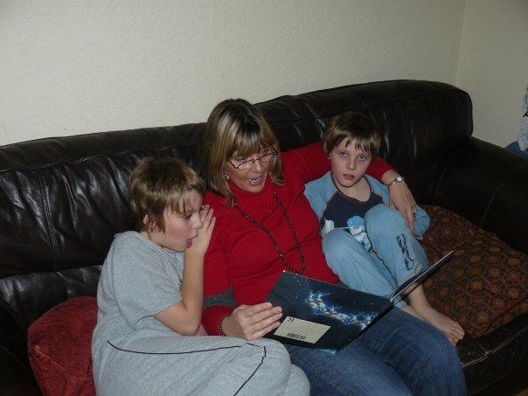
WHY READING AT HOME MATTERS

Slide 9
WHY READING AT HOME MATTERS
Reading is more than learning to decode or comprehend what is being read – there is an emotional context which reading at home nurtures.
In school we have many opportunities to read but the school day is busy and sometimes reading just needs a slower pace!
Becoming a good independent reader takes many, many hours of practise. You can’t read too much!
Reading with someone you love helps you to associate the emotion with reading – helps you learn to love reading.

Slide 10
READING AT HOME
Make it a regular activity in your home. All of us have different schedules – it must be something which works for you all.
Children can read to you. Help them with decoding tricky words/misconceptions but encourage their fluency.
Sharing the reading of a book. Good if they are beginning to develop reading stamina and read longer/more challenging books.
You reading to your child. Especially good for reading more challenging books which children can’t read confidently on their own yet.

Slide 11
READING AT HOME (Cont.)
Your child reading independently and talking to you about their reading. More flexible as you can talk at any time!
You talking about what you are reading with your child. There are obvious caveats here! But this is great for modelling how enjoyable reading can be.
Discussing stories, films, the news – all provide opportunities to understand vocabulary, plot, characters and ideas.

Slide 12
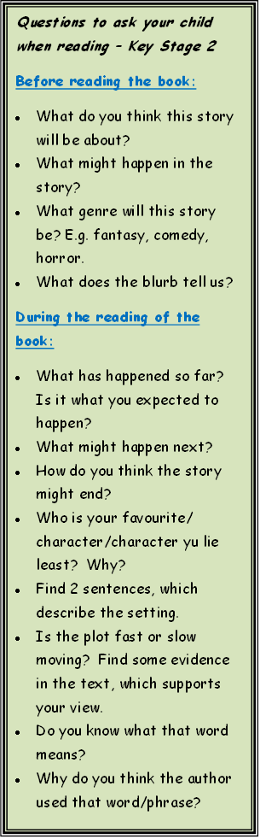
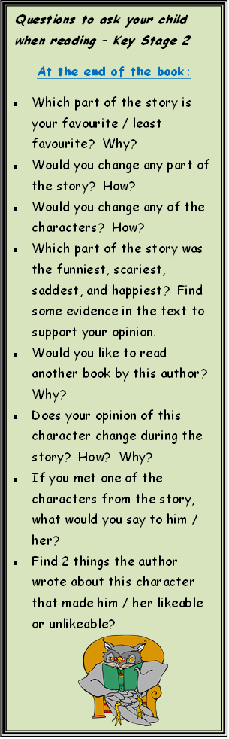
Discussing ReadING
There are no rules really.
Showing an interest in what children are reading is a huge part of this.
The more you do this, the more natural the conversation becomes.
The book marks to the right might give you some ideas.
Sign planners weekly and you are welcome to make any comments on reading or discussions here too.

Slide 13
VOCABULARY
Age related expectations for children are more challenging than a few years ago. They need use and understand a more rich and challenging vocabulary.
A focus for whole school development this year is to enrich and expand vocabulary.
We want children to be curious and aware of new words they encounter – and to try to use them in their spoken and written work.
Reading at home will primarily be about enjoyment, fluency and understanding. However, encouraging children to be curious and discover new vocabulary (in books and elsewhere) will help to support them across the range of activities in the curriculum.

Slide 14
WHAT CAN I READ NEXT?
https://www.lovereading4kids.co.uk/genre/7/7-plus-readers.html
https://www.goodreads.com/list/tag/childrens
Ask a librarian – in school or at local library
Use the internet
Apps

