Slide 1
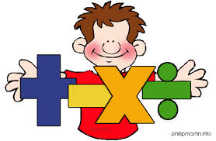
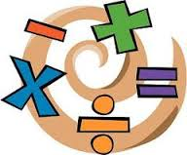

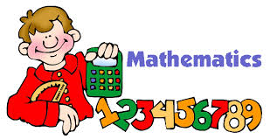
Thinking is at the heart of Mathematics and therefore should be at the heart of mathematical teaching and learning.
Please complete the evaluation forms – ‘at the beginning’ – there are two

Slide 2
Aims of today
An overview of how problem solving is taught at Applecroft. To take away some ideas to support your children at home.
To be in your child’s class and see how problem solving activities are taught and how children approach them.

Slide 3
Starter
Target Number
100 50 75 3 10 7
Target Number 423
+ x - ÷

Slide 4
The Maths Curriculum
Children should:
Become fluent in the fundamentals of mathematics, including through varied and frequent practice with increasingly complex problems over time, so that pupils develop conceptual understanding and the ability to recall and apply knowledge rapidly and accurately.
Reason mathematically by following a line of enquiry, conjecturing relationships and generalisations and developing an argument, justification or proof using mathematical language.
Solve problems by applying their mathematics to a variety of problems with increasing sophistication, including breaking down problems into a series of simpler steps and persevering in seeking solutions.

Slide 5
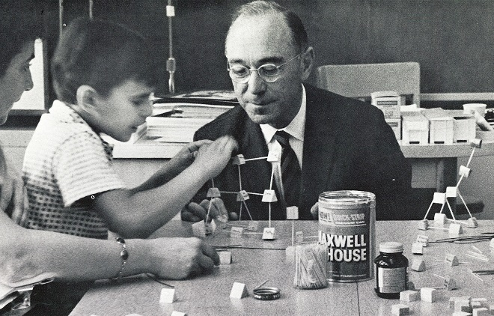
CPA – Jerome Bruner
He believed active learning builds mental structures – the learner has to be actively involved in their own learning process.
Concrete
Pictorial
Abstract
(Build, Draw, Say
Write, Re-Build)

Slide 6
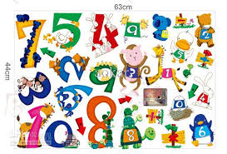
Number Sense!
Children need to understand our number system, starting with counting numbers, building an understanding of how our numbers work and fit together. This includes exploring place value and comparing and ordering numbers then
applying this understanding
in different contexts.

Slide 7
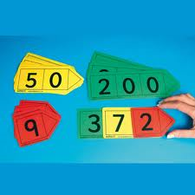
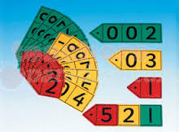
Place Value
Place value is at the heart of the number system. All digits have a value and a secure understanding of this will enable children to use and understand different calculation methods.

Slide 8
Pupil Talk / Speaking Frames

Slide 9
Example of Teacher Questioning
4SL1
5LS1
3SL1
6LS1

Slide 10
Talk and Reasoning

Slide 11
What can you do?
Promote a positive attitude towards maths
“I was never any good at maths”
Help children improve their tables and derived division facts
School’s do it so differently - Ask your child to teach you
Encourage them to be independent – avoid saying ‘wrong’ – why do you think it’s right? How can you sure it is right?
Use maths in everyday life – handling money, receiving money, pocket money, budget, journey time, distance, record of rainfall, temperature, cooking – weight, time

Slide 12
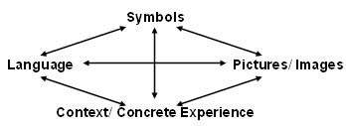
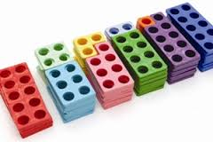
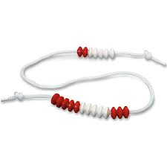
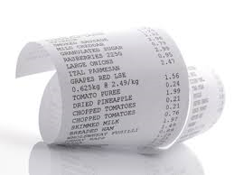
Maths at Applecroft
=
+
x
%
subtract
more
add
sum
factor
product
Here is a receipt for some shopping. How much did I spend? How much change did I get from £20?

Slide 13
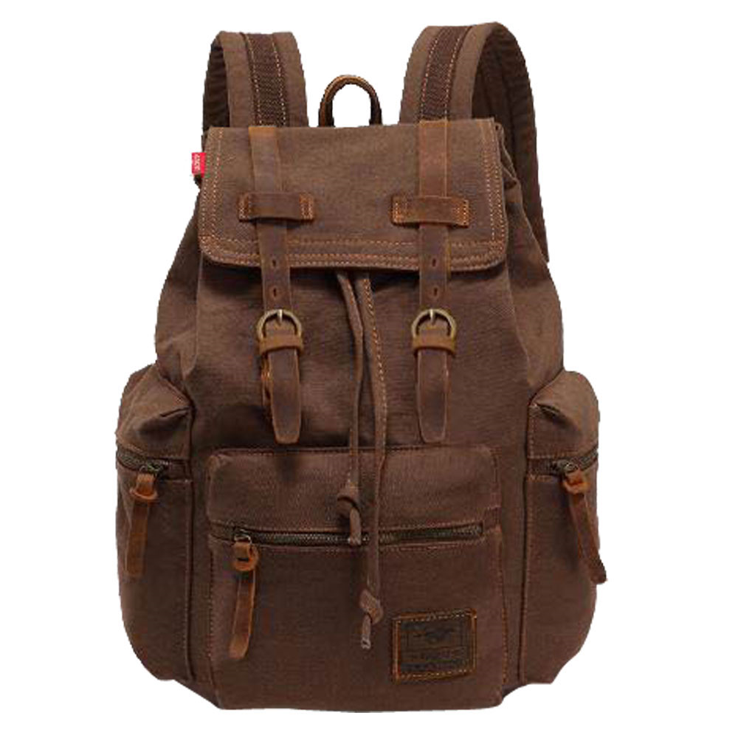
RUCSAC
Read
Understand
Calculate
Solve
Answer
Check

Slide 14



Bar Modelling
Bar Models are diagrams to represent quantities
Sam and Sally share £36. Sam has twice as much money as Sally. How much do they each have?
Sam
Sally
= £36
£36 ÷ 3 = £12
Sam
Sally
£12
£12
£12

Slide 15
A baker sold 125 pies on Saturday and 83 pies on Sunday. How many pies did the baker sell on the weekend?
125 83
125 + 83 = 208
Saturday
Sunday

Slide 16
Mary had 120 more beads than Jill, who had 68 beads. How many beads did Mary have? How many do they have altogether?
Mary
Jill 120
188 + 68 = 256
188
68

Slide 17




Lauren spent 20% of her money on a dress. She spent 2/5 of the remainder on a book and had £72 left. How much money did she have at first?
£120
£30 £30 £30 £30
spent (2/10 = 1/5) £120
book (2/5) £24 £24 £24
£72
5 x 24 =£120
£120 ÷ 4 = £30 5x £30 = £150
1/5
1/5
1/5
1/5
1/5
1/5
1/5

Slide 18
Thinking is at the heart of Mathematics and therefore should be at the heart of mathematical teaching and learning.

