Slide 1
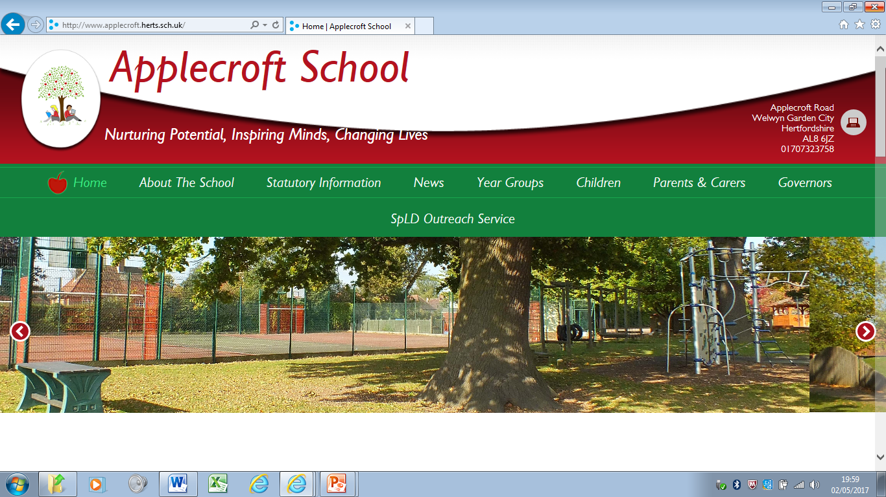
EYFS Stay and Learn Maths - Number
Number 31st January 2019
Mr Andrew Rebanks

Slide 2



How do you feel about Maths?

Slide 3
Objectives for the session
Maths Curriculum
  Early Years Foundation Stage (EYFS) Maths Curriculum
Maths in School
  Daily Opportunities for Maths in Nursery
  Daily Opportunities for Maths in Reception
  Maths Resources
  Recording Maths
  How Maths is Taught
  Maths Language
Maths Outside of School
  Maths at Home
  Maths Out and About
  Maths in Stories and Songs
Top 5
Maths in Action

Slide 4
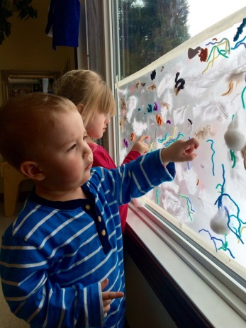

Characteristics of Effective Learning
Engagement - Playing and Exploring
  Finding out and exploring
  Playing with what they know
  Being willing to ‘have a go’
Motivation - Active learning
  Being involved and concentrating
  Keeping trying
  Enjoying achieving what they set out to do
Thinking - Creating and Thinking critically
  Having their own ideas
  Making links
  Choosing ways to do things
What are the implications for Maths learning?

Slide 5
Maths Objectives (number) - in Nursery
22 to 36 months
Selects a small number of objects from a group when asked, for example, ‘please give me one’, ‘please give me two’.
Recites some number names in sequence.
Creates and experiments with symbols and marks representing ideas of number.
Begins to make comparisons between quantities.
Uses some language of quantities, such as ‘more’ and ‘a lot’.
Knows that a group of things changes in quantity when something is added or taken away.
30 to 50 months
Uses some number names and number language spontaneously.
Uses some number names accurately in play.
Recites numbers in order to 10.
Knows that numbers identify how many objects are in a set.
Beginning to represent numbers using fingers, marks on paper or pictures.
Sometimes matches numeral and quantity correctly.
Shows curiosity about numbers by offering comments or asking questions.
Compares two groups of objects, saying when they have the same number.
Shows an interest in number problems.
Separates a group of three or four objects in different ways, beginning to recognise that the total is still the same.
Shows an interest in numerals in the environment.
Shows an interest in representing numbers.
Realises not only objects, but anything can be counted, including steps, claps or jumps.

Slide 6
Maths Objectives (number) in Reception
40 to 60+ months
Recognise some numerals of personal significance.
Recognises numerals 1 to 5.
Counts up to three or four objects by saying one number name for each item.
Counts actions or objects which cannot be moved.
Counts objects to 10, and beginning to count beyond 10.
Counts out up to six objects from a larger group.
Selects the correct numeral to represent 1 to 5, then 1 to 10 objects.
Counts an irregular arrangement of up to ten objects.
Estimates how many objects they can see and checks by counting them.
Uses the language of ‘more’ and ‘fewer’ to compare two sets of objects.
Finds the total number of items in two groups by counting all of them.
Says the number that is one more than a given number.
Finds one more or one less from a group of up to five objects, then ten objects.
In practical activities and discussion, beginning to use the vocabulary involved in adding and subtracting.
Records, using marks that they can interpret and explain.
Begins to identify own mathematical problems based on own interests and fascinations.
Early learning goal
Children count reliably with numbers from one to 20, place them in order and say which number is one more or one less than a given number. Using quantities and objects, they add and subtract two single-digit numbers and count on or back to find the answer. They solve problems, including doubling, halving and sharing.
Exceeding Early Learning Goal
Children estimate a number of objects and check quantities by counting up to 20. They solve practical problems that involve combining groups of 2, 5 or 10, or sharing into equal groups.

Slide 7

Challenge
Learning Objective: To place numbers in order.
On your table is an envelope.
In the envelope are numbers 0 – 10.
Arrange the numbers in order from 0 - 10

Slide 8
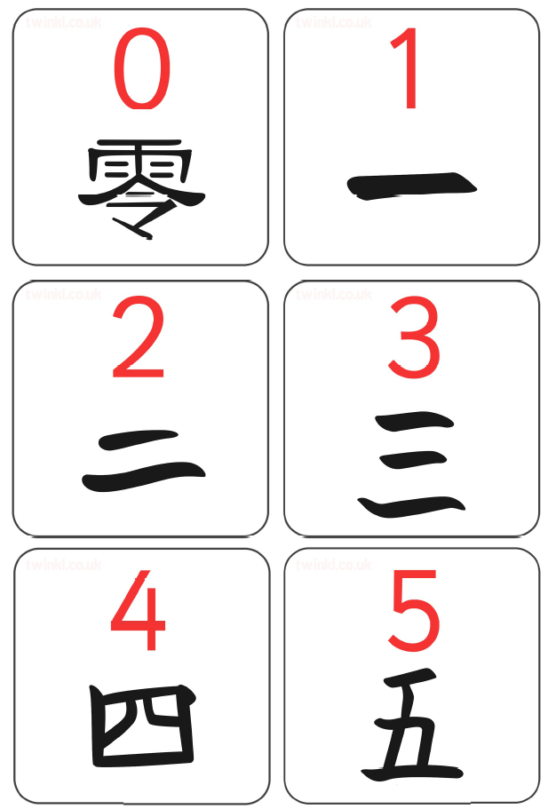
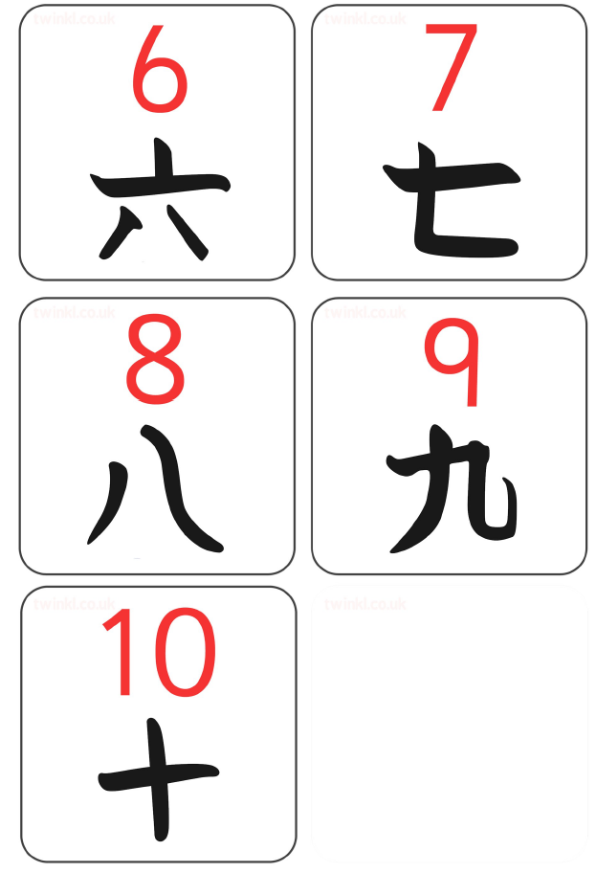
Mandarin Chinese Numbers

Slide 9
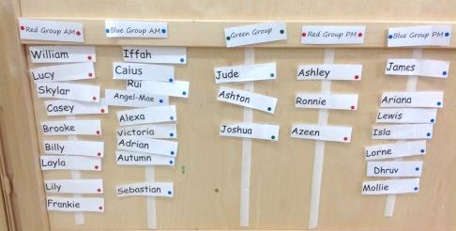
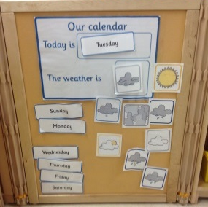
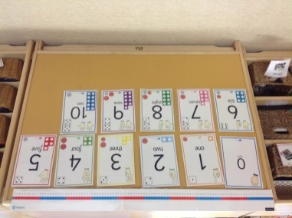
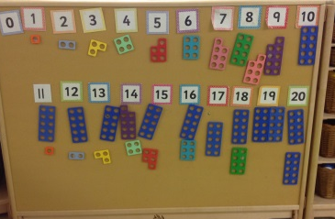
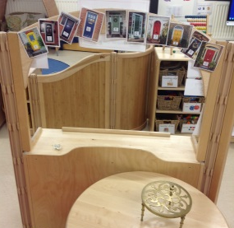
Daily Opportunities for Maths in Nursery
Self register - group totals
Daily calendar
Number songs and rhymes
Adult directed activities
Numicon
Sorting, patterns
Preparing snack time
Fun, hands on and in a meaningful context

Slide 10
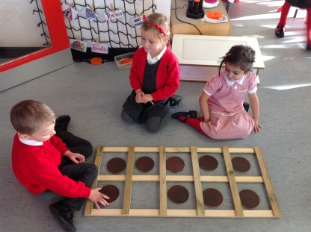
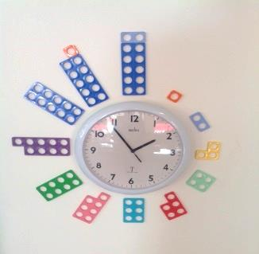
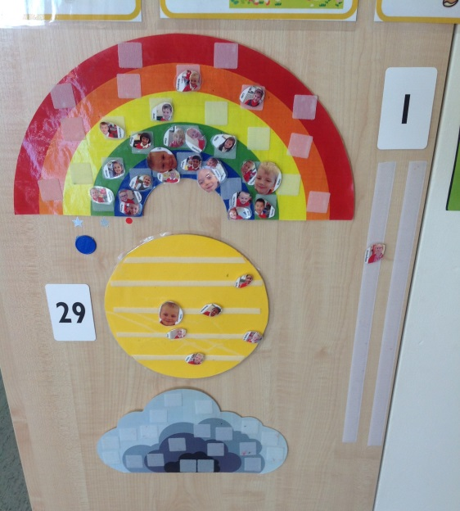
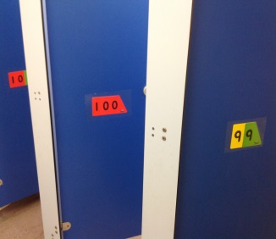
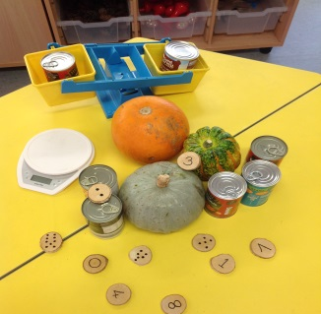
Daily Opportunities for Maths in Reception
Adult directed activities
Learning choices
  maths apparatus in number rich environment
Number rhymes and songs
Daily routine
Self register

Slide 11
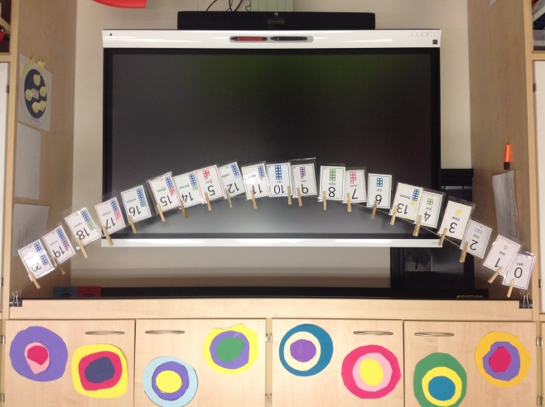
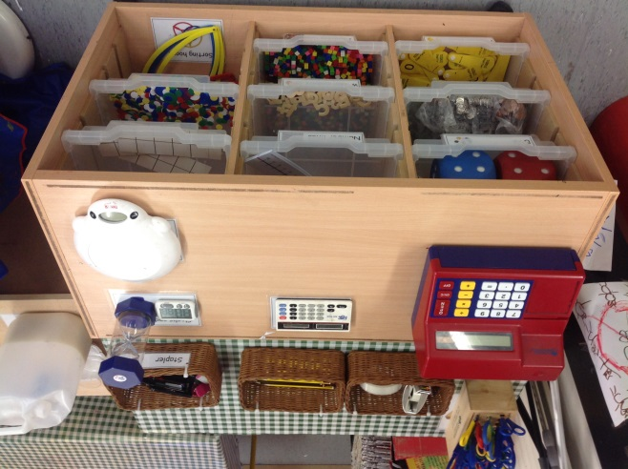
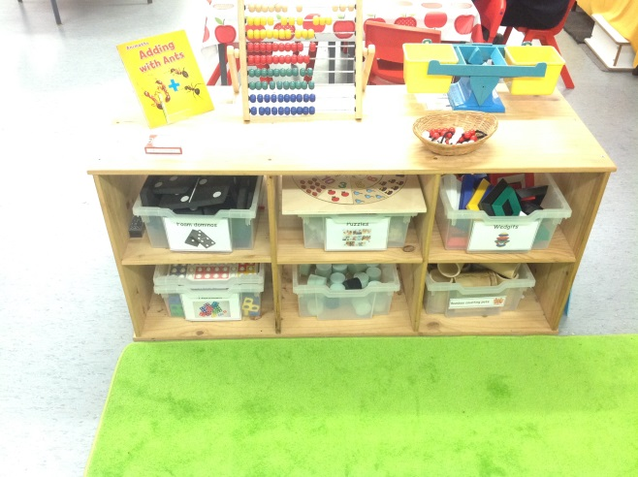
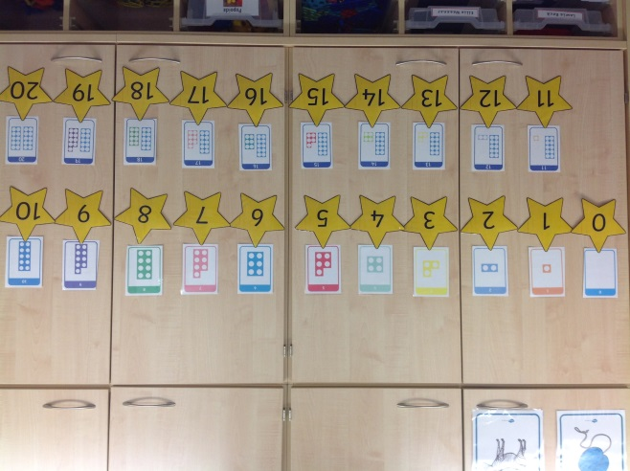
Daily Opportunities for Maths in Reception

Slide 12


Maths Resources
Maths resources are not confined to one space
Everyday objects
  cotton balls, pompoms, lolly sticks, corks etc
Numicon
Counters, dominos, dice
Number lines, static and moveable
Real money

Slide 13
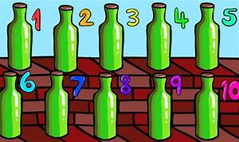
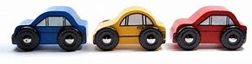
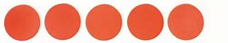


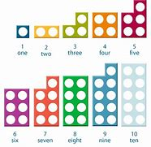
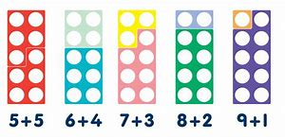
How Maths is Taught
Learning number names
  Songs, nursery rhymes
Using concrete objects
  One to one correspondence
Counting fingers
Numicon

Slide 14
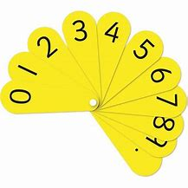
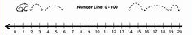
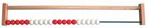
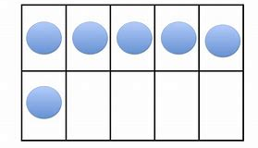
How Maths is Taught
Number fans
Number line
Bead bar
Tens frame

Slide 15
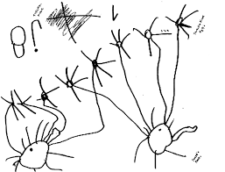
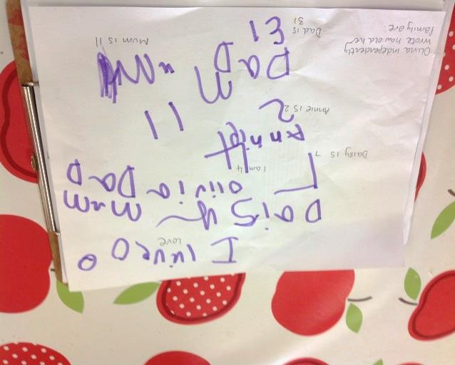
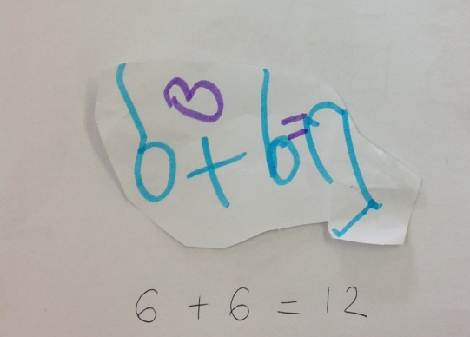
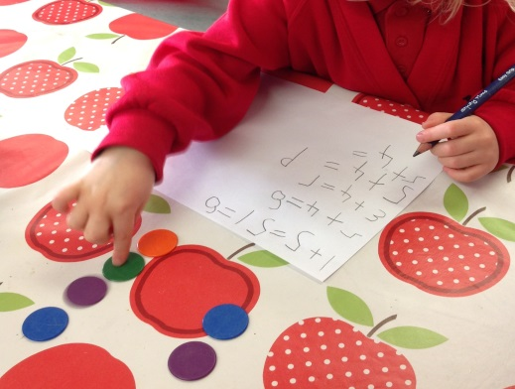
Recording Maths
Emergent marks
Tally
Pictures
Photographs
End of Reception
  Writing numerals

Slide 16
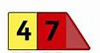
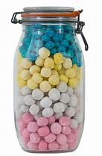
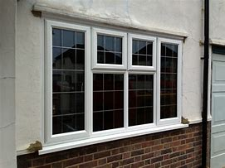
Maths Language
Number
  Digit and number/numeral
  More, less for addition and subtraction
  1 more, 2 more etc
  1 less, 2 less etc
  More, fewer for comparison of amounts
  Same as, equal to
  Estimate – Have your best guess
Shape, Space and Measure
  2D and 3D shape names
  Bigger, smaller, biggest, smallest
  More, less for comparison of measure
  Before, after, next (Time)

Slide 17
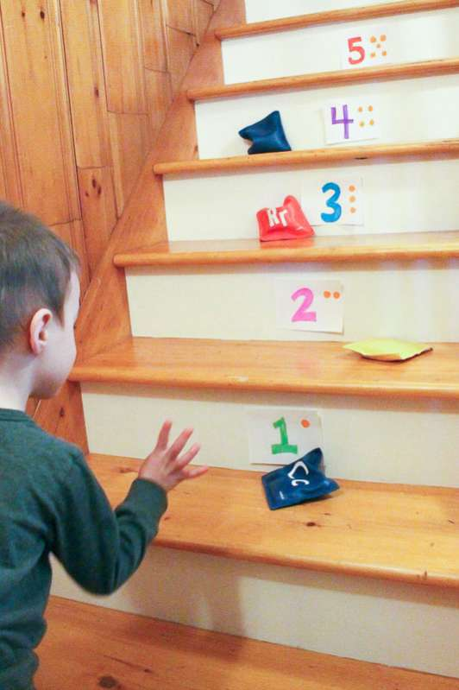
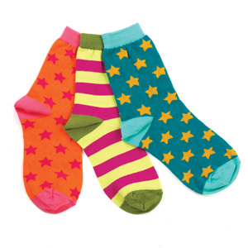
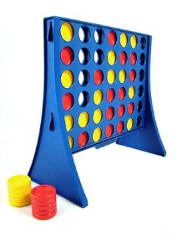
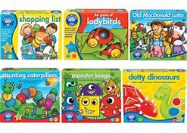
Maths at Home
Count everything! You can not count enough.
  Stairs, steps (estimate), doors, people etc
Comparison at mealtimes
  More/less/the same, shapes, temperature, time
Sorting washing
  Socks, counting in pairs
Games - (Orchard toys)
Number songs

Slide 18




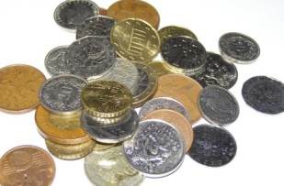
Maths Out and About
Recognising door numbers or numerals on registration plates
Recognising numbers on road signs
Going shopping
  Following a list (Order, 1st, 2nd, 3rd)
  Recognising numerals on price labels
  Comparing sizes
  Exploring coins and money

Slide 19
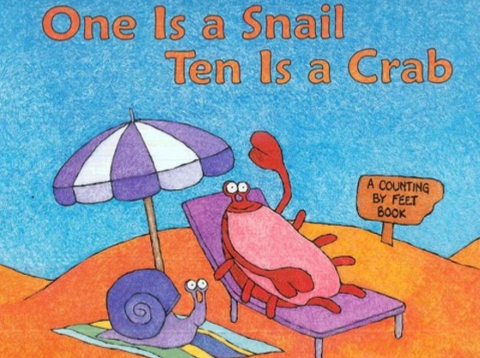
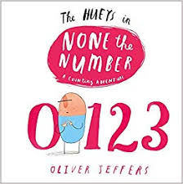
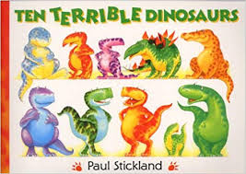
Maths in Stories
1 is a snail, 10 is a crab - April Pulley Sayre
None the number - Oliver Jeffries
10 terrible dinosaurs - Paul Stickland
How many legs?- Kes Gray

Slide 20
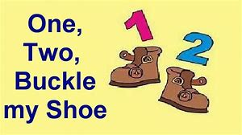
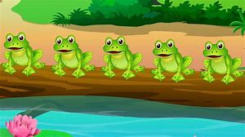
Maths in Songs
1,2, buckle my shoe
5 currant buns in a bakers shop
5 green and speckled frogs
5 little men in a flying saucer
10 green bottles
Babies in their Cots
Notes:
Twinkl songs on website, with babies in their cots

Slide 21
Useful websites
http://amathsdictionaryforkids.com
http://www.bbc.co.uk/bitesize/ks1/maths
http://www.bbc.co.uk/bitesize/ks2/maths
http://www.ictgames.com
http://www.ilovemathsgames.com
http://www.mathsisfun.com
http://www.mathszone.co.uk/
http://www.multiplication.com/
http://www.primarygames.co.uk
http://resources.woodlands-junior.kent.sch.uk/maths
http://www.topmarks.co.uk
http://www.twinkl.co.uk

Slide 22


The Top 5
Maths is EVERYWHERE!
  Count things around you
  Cut vegetables in half
  Share out fruit
  Have one more sweet
  Find shapes in your home and town
  Maths in the car
Practice counting daily.
Use concrete resources for counting, addition, subtraction, sharing and grouping.
Use their interests to motivate and inspire.
Maths is fun. Make it into a game.

Slide 23
How do you feel about Maths now?

Slide 24

Thank you for Listening
Lets see Maths in action

Slide 25
Objectives for the session
Maths Curriculum
  Characteristics of Effective Learning
  Early Years Foundation Stage (EYFS) Maths Curriculum
Maths in School
  Maths in Nursery
  Maths in Reception
  Maths Resources
  Recording Maths
  How Maths is Taught
  Maths Language
Maths Outside of School
  Maths at Home
  Maths Out and About
  Maths in Stories and Songs
Top 5
Maths in Action

