Slide 1
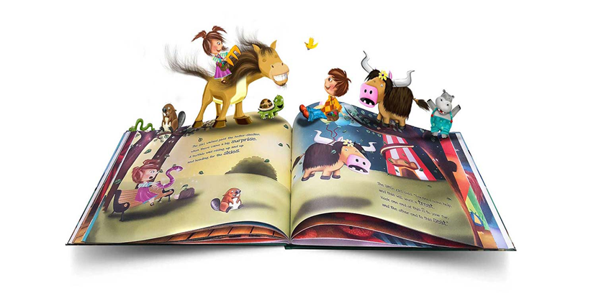
Reading at Applecroft PART 1
Introducing the Little Wandle
Letters and Sounds Revised Scheme
SEPTEMBER 2023

Slide 2
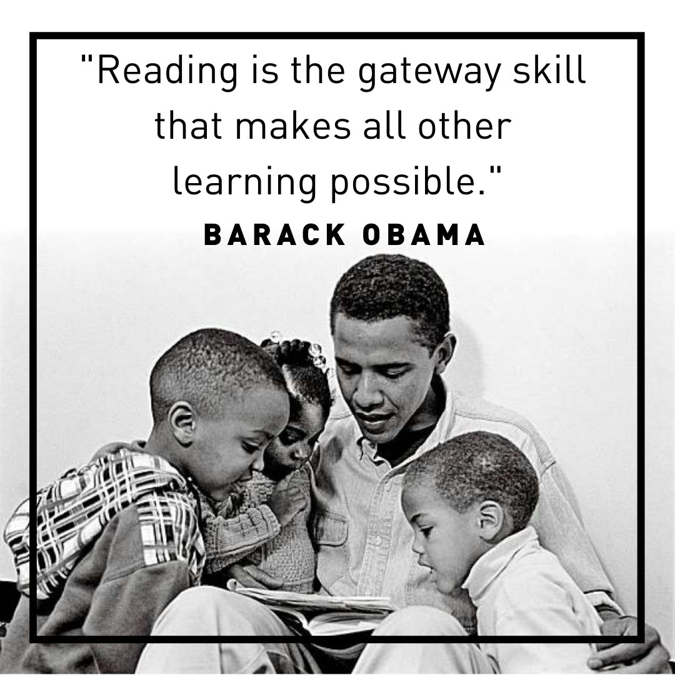

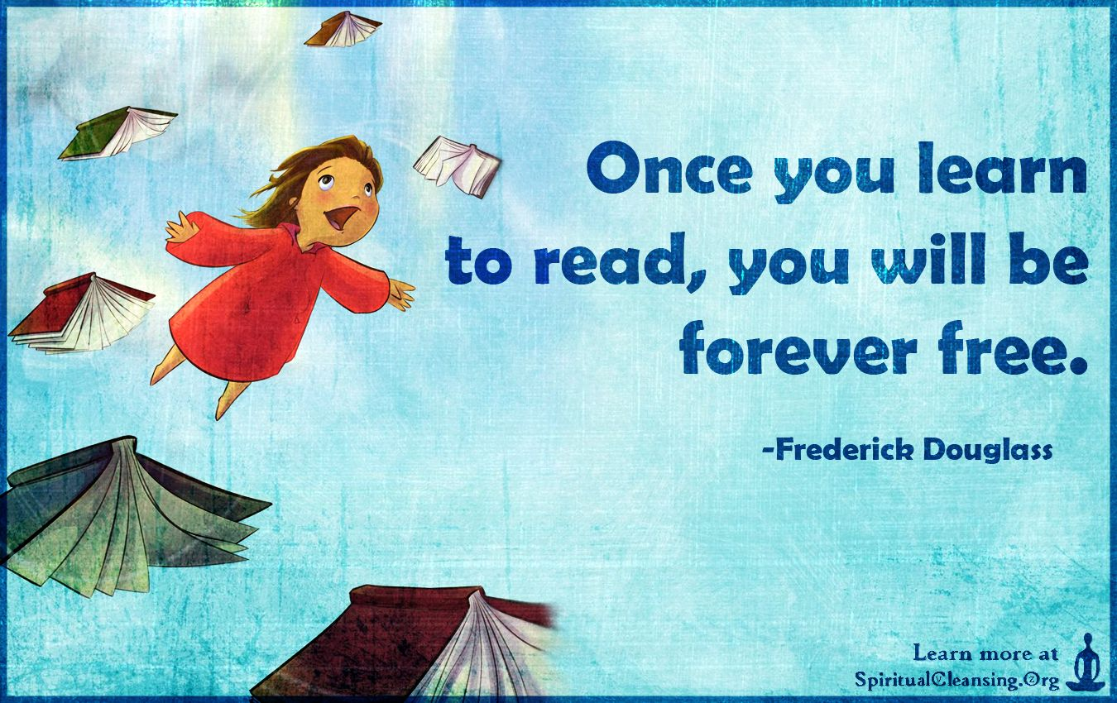
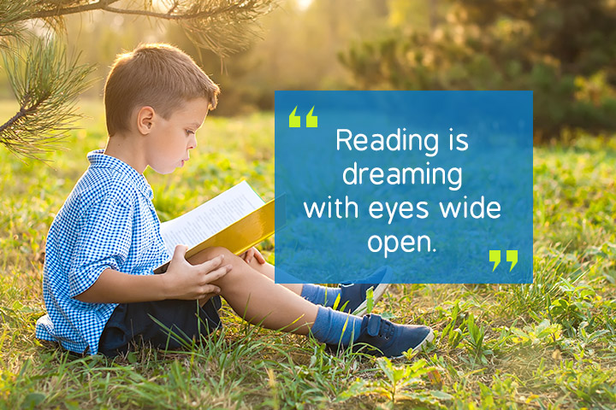

Slide 3

English at Applecroft
Reading is at the heart of the curriculum in our school: it opens doors to lifelong learning and brings great pleasure.
Our determination is to ensure that our pupils become successful readers early in their school journey and leave us able to read fluently, with understanding and enjoyment, to enrich their knowledge and experience. It is our intention that our children develop a love of reading… and to ensure they are empowered both personally and in society, without barriers to their aspirations.

Slide 4

How do children learn to be fluent readers?
The Simple View of Reading
Language Comprehension
Meaning
Decoding
(word recognition)
Code
Reading Comprehension
Understand, Engage, Enjoy
+
=

Slide 5

Developing Fluent Readers – EARLY READING
https://www.applecroft.herts.sch.uk/early-reading/
It is crucial for children to develop a life-long love of reading. Reading consists of two dimensions: language comprehension and word reading. Language comprehension (necessary for both reading and writing) starts from birth. It only develops when adults talk with children about the world around them and the books (stories and non-fiction) they read with them, and enjoy rhymes, poems and songs together. Skilled word reading, taught later, involves both the speedy working out of the pronunciation of unfamiliar printed words (decoding) and the speedy recognition of familiar printed words.
EYFS Statutory Document

Slide 6
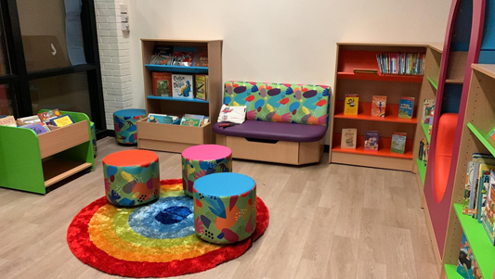
How we support Reading For pleasure
Reading Spine
Class read alouds
Class libraries
School libraries
World Book Day
Book Fair
Reading Challenge – Local Library

Slide 7
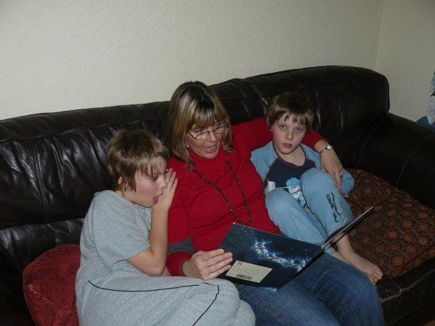
WHY READING AT HOME MATTERS
Reading is more than learning to decode or comprehend what is being read – there is an emotional context which reading at home nurtures.
Reading with someone you love helps you to associate the emotion with reading – helps you learn to love reading
Becoming a successful independent reader takes many, many hours of practise. You can’t read too much!
Snuggle up with a book!

Slide 8
Teach reading: change lives
Parent workshop: Phonics and early reading

Slide 9
A love of reading is the biggest indicator of future academic success.
OECD (The Organisation for Economic Co-operation and Development)

Slide 10




How many times have you already read today?
Notes:
Just think about how many times you have already read things today. It really is a vital skill.

Slide 11

Phonics

Slide 12

Little Wandle Letters and Sounds Revised
Our school has chosen
Little Wandle Letters and Sounds Revised as our systematic, synthetic phonics (SSP) programme to teach early reading and spelling.

Slide 13
Phonics is:
making connections between the sounds of our spoken words and the letters that are used to write them down.
Notes:
It sounds complicated but it really isn’t!

Slide 14

Blending to read words
Notes:
Some children learn to blend really quickly, and others take a little longer. If your child is finding it difficult, ask your child’s teacher for ways to help at home – playing blending games at home is so helpful!
Show parents this video from the website: https://www.littlewandlelettersandsounds.org.uk/resources/for-parents/

Slide 15
Terminology
Phoneme
Split vowel digraph
Grapheme
Blend
Digraph
Segment
Trigraph
Notes:
Explain what each word means – use our glossary to help: https://www.littlewandlelettersandsounds.org.uk/resources/my-letters-and-sounds/getting-started/

Slide 16


Teaching order
Notes:
We usually teach four new sounds a week and have a review lesson on a Friday. You will get a list of the sounds that we are learning to have at home. This will help you with formation and pronunciation.

Slide 17


Gradually your child learns the entire alphabetic code:
Notes:
We will work our way through the whole Little Wandle Programme until your child can read fluently.

Slide 18


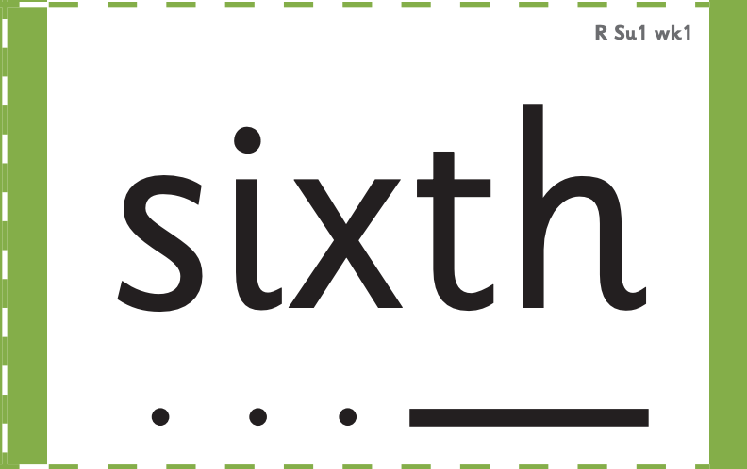



How we make learning stick
Notes:
There are specific resources for the Little Wandle Programme which the children will be very familiar with. Each sound that we teach to begin with has either a mnemonic (like the astronaut that you can see here) or a phrase like boing-boing for ‘oi’. This helps the children recognise and remember the graphemes. Every time we teach a new sound, we also read words during the phonics lesson that contain that new sound so that the children practise what they have learned. We then go on to reading a sentence containing some of those words. We have displays in the classroom and on the tables to support the children throughout the day.

Slide 19
Reading and spelling

Slide 20
Reading and spelling
Notes:
This is an example of what the children learn in Year 1.
Children learn that there are graphemes that can have different sounds and sounds that can be made with different letters.
Use the backs and fronts of Phase 5 cards to show ‘ea’ and ‘ow’.

Slide 21
And all the different ways to write the phoneme sh:
shell
chef
special
caption
mansion
passion

Slide 22
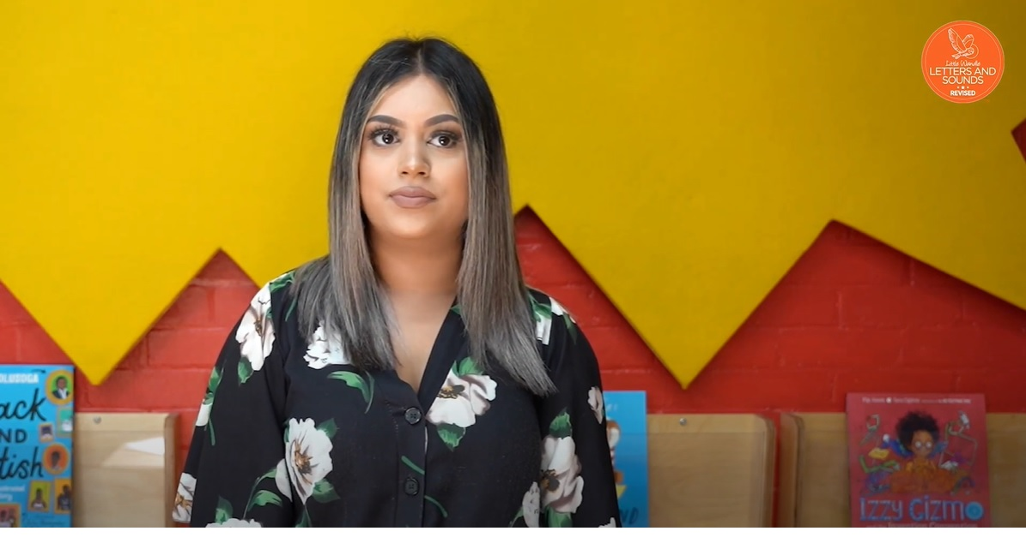
Tricky words
Notes:
Have a look at this video on the website: https://www.littlewandlelettersandsounds.org.uk/resources/for-parents/

Slide 23

Spelling
Say the word.
Segment the sounds.
Count the sounds.
Write them down.
Notes:
Model the process on a flipchart for the parents to see.

Slide 24
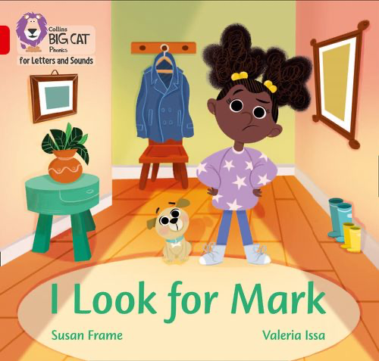
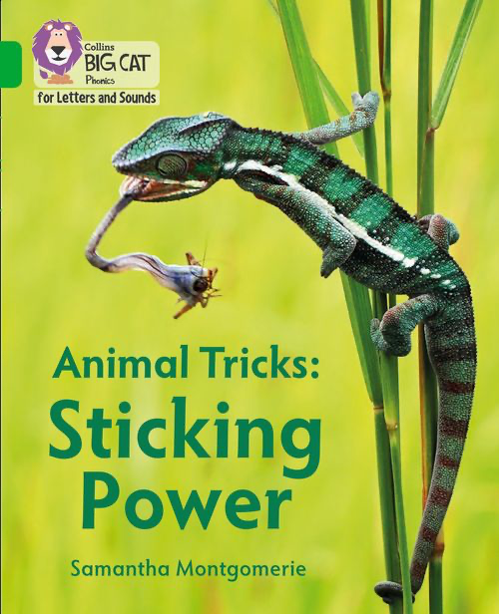
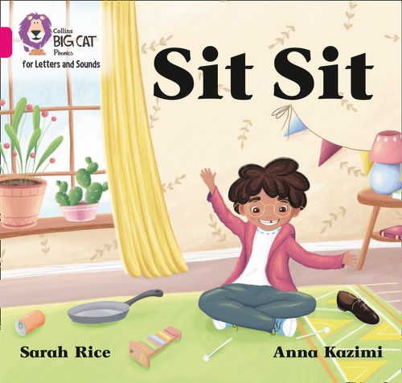
How do we teach reading in books?
Reading practice sessions are:
timetabled three times a week
taught by a trained teacher/teaching assistant
taught in small groups.
Notes:
The children read the same book three times in a week. The first time we work on decoding (sounding out) the words, the second time we work on prosody which is reading with expression – making the book sound more interesting with our story-teller voice or our David Attenborough voice – and the third time we look at comprehension. We read the books three times at school because we want to develop the fluency. The more they see words the more they begin to read them automatically without having to sound them out.

Slide 25


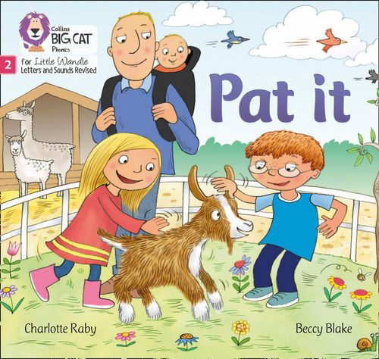

We use assessment to match your child the right level of book
Notes:
We assess your child every six weeks to check progress. Any child who needs extra support has daily keep-up sessions planned for them.

Slide 26

Reading a book at the right level
This means that your child should:
Know all the sounds and tricky words in their phonics book well
Read many of the words by silent blending (in their head) – their reading will be automatic
Only need to stop and sound out about 5% of the words by the time they bring the book home – but they should be able to do this on their own.

