Slide 1
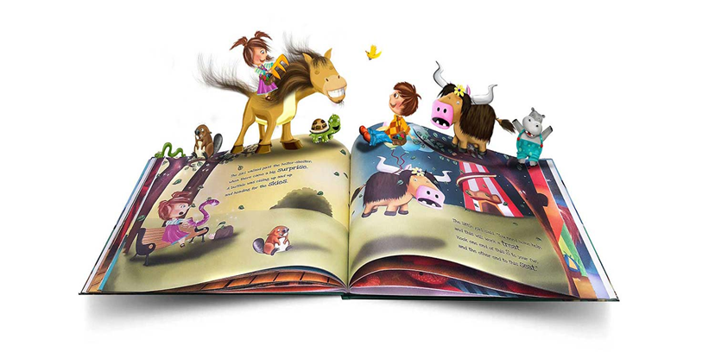
Reading at Applecroft PART 2
Introducing the Little Wandle
Letters and Sounds Revised Scheme
SEPTEMBER 2023

Slide 2

Reading and spelling

Slide 3


Reading and spelling
Notes:
This is an example of what the children learn in Year 1.
Children learn that there are graphemes that can have different sounds and sounds that can be made with different letters.
Use the backs and fronts of Phase 5 cards to show ‘ea’ and ‘ow’.

Slide 4
And all the different ways to write the phoneme sh:
shell
chef
special
caption
mansion
passion

Slide 5
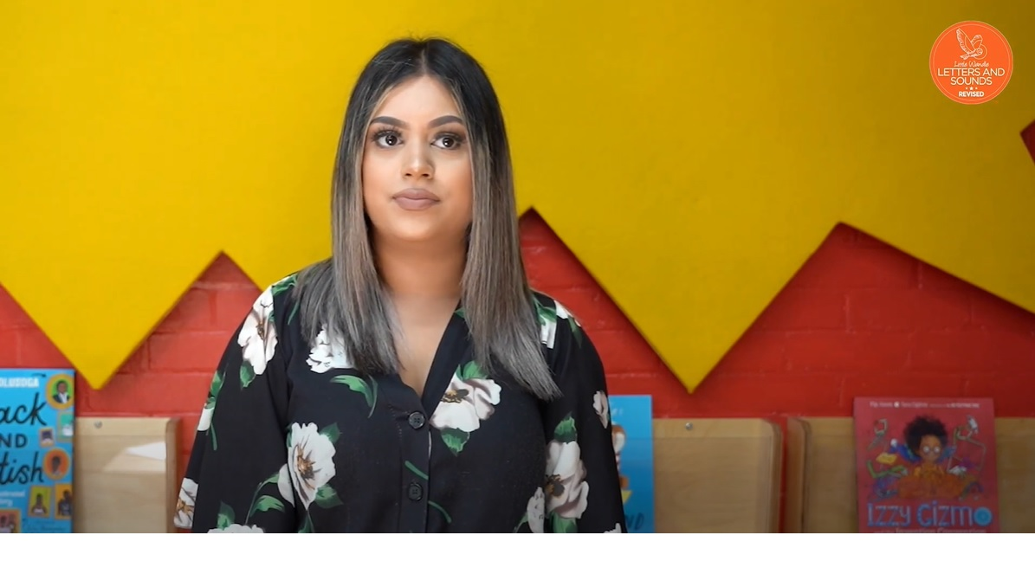
Tricky words
Notes:
Have a look at this video on the website: https://www.littlewandlelettersandsounds.org.uk/resources/for-parents/

Slide 6
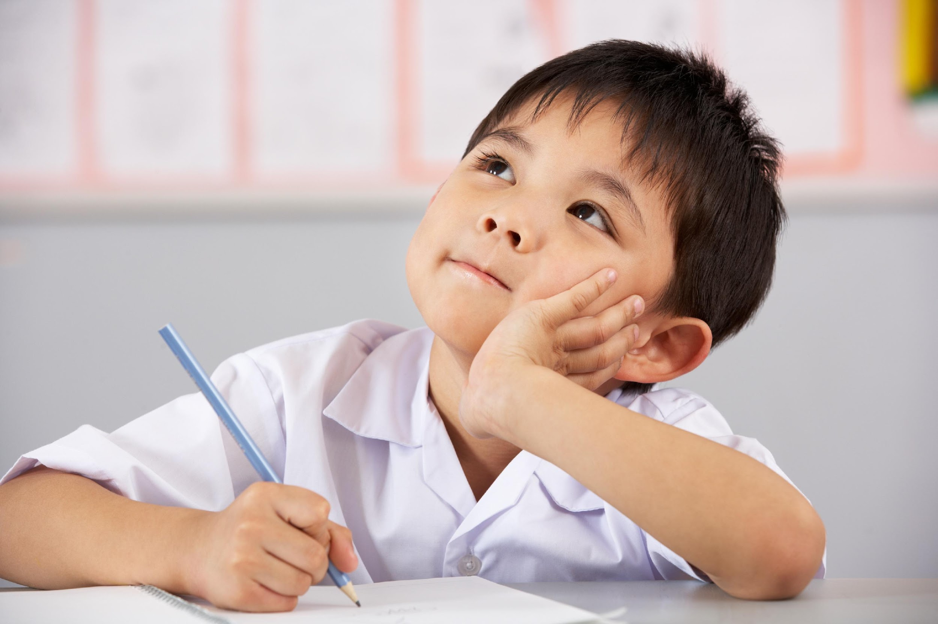
Spelling
Say the word.
Segment the sounds.
Count the sounds.
Write them down.
Notes:
Model the process on a flipchart for the parents to see.

Slide 7
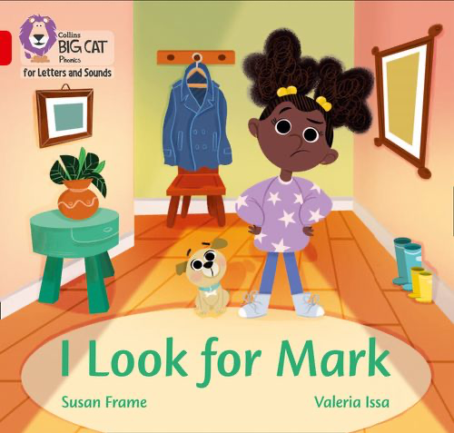
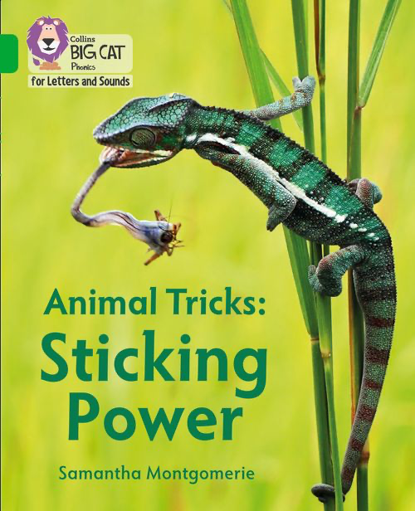
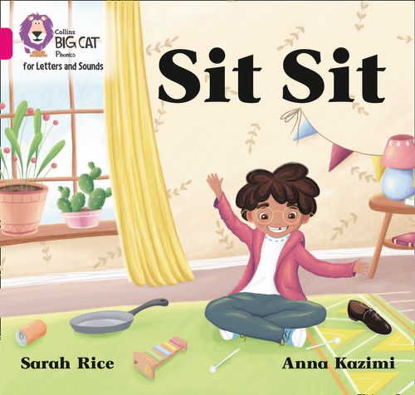
How do we teach reading in books?
Reading practice sessions are:
timetabled three times a week
taught by a trained teacher/teaching assistant
taught in small groups.
Notes:
The children read the same book three times in a week. The first time we work on decoding (sounding out) the words, the second time we work on prosody which is reading with expression – making the book sound more interesting with our story-teller voice or our David Attenborough voice – and the third time we look at comprehension. We read the books three times at school because we want to develop the fluency. The more they see words the more they begin to read them automatically without having to sound them out.

Slide 8

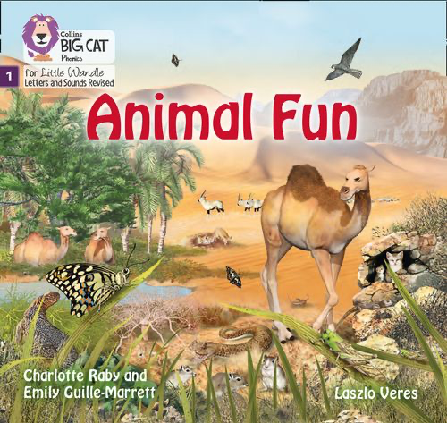
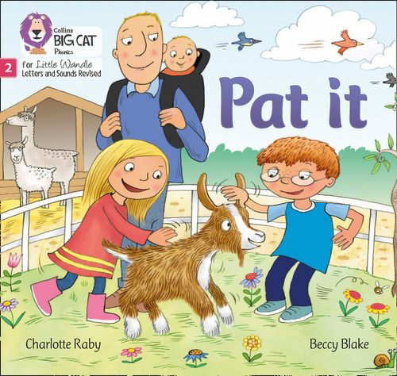

We use assessment to match your child the right level of book
Notes:
We assess your child every six weeks to check progress. Any child who needs extra support has daily keep-up sessions planned for them.

Slide 9

Reading a book at the right level
This means that your child should:
Know all the sounds and tricky words in their phonics book well
Read many of the words by silent blending (in their head) – their reading will be automatic
Only need to stop and sound out about 5% of the words by the time they bring the book home – but they should be able to do this on their own.

Slide 10
Reading at home

Slide 11
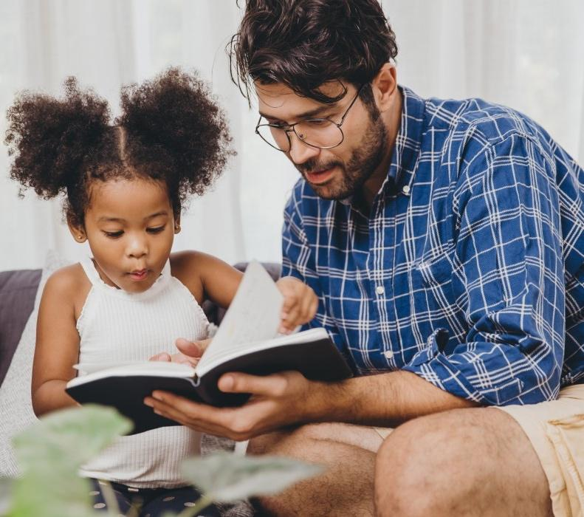
The most important thing you can do is read with your child
Reading a book and chatting had a positive impact a year later on children’s ability to…
understand words and sentences
use a wide range of vocabulary
develop listening comprehension skills.
The amount of books children were exposed to by age 6 was a positive predictor of their reading ability two years later.
Parental involvement in the development of children’s reading skills: A five-year longitudinal study (2002) Senechal, M. and Lefvre, J
Notes:
Celebrate child’s success at school, make time for reading at home!

Slide 12

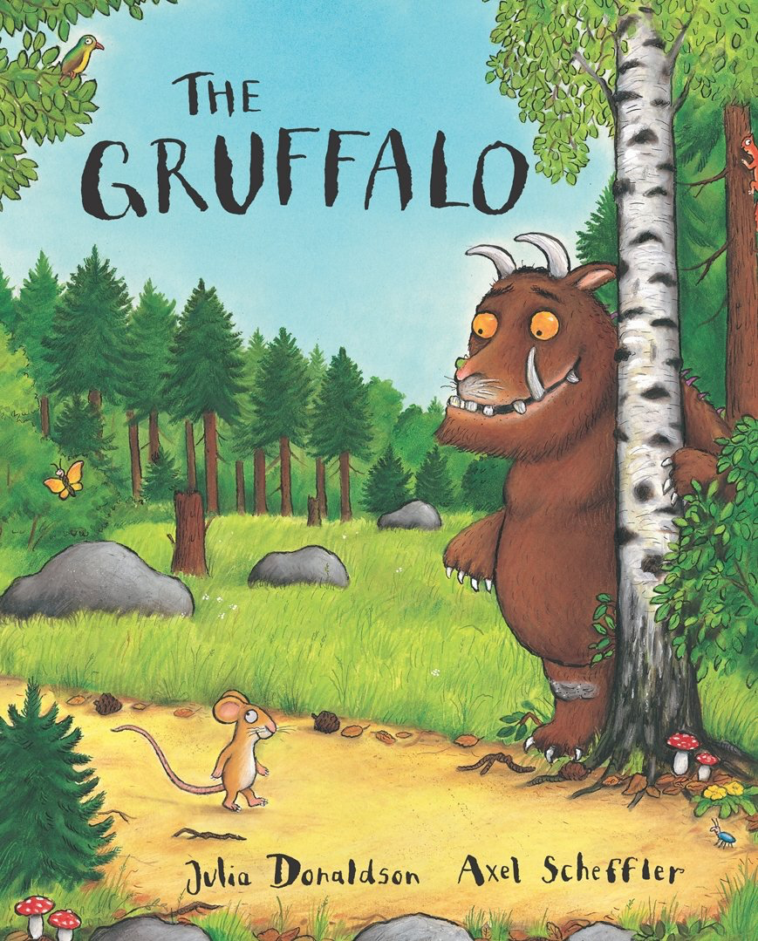
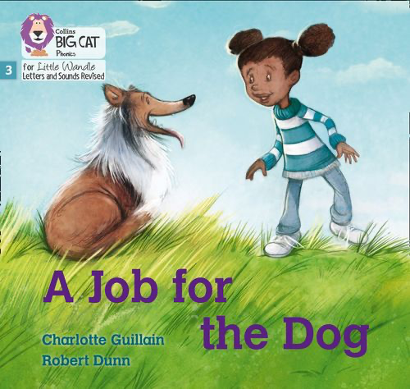


Books going home
Notes:
As well as the ‘learning to read’ book that your child will bring home they will also bring home a book for sharing with you. This book is SO important. This is how we are going to give them the WILL to read. Please read with your child as often as you can – at least once a day if possible.

Slide 13
Listening to your child read their phonics book
Your child should be able to read their book without your help.
If they can’t read a word read it to them.
Talk about the book and celebrate their success.

Slide 14

Supporting your child with phonics
Notes:
It is really important that you pronounce the sounds correctly at home if you are supporting your child. These videos are on the website for you to refer to and if you are unsure, please ask your child’s teacher.
Show the parents where to access the videos on the website and play them!
https://www.littlewandlelettersandsounds.org.uk/resources/for-parents/

Slide 15

Read to your child
The shared book is for YOU to read:
Make the story sound as exciting as you can by changing your voice.
Talk with your child as much as you can:
  Introduce new and exciting language
  Encourage your child to use new vocabulary
  Make up sentences together
  Find different words to use
  Describe things you see.

Slide 16
One of the greatest gifts adults can give is to read to children
Carl Sagan

Slide 17
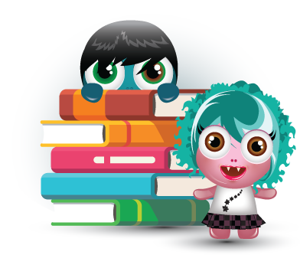

PARENT OVERVIEW

Slide 18


Introduction
BoomReader is the way we log reading.
It has been used by hundreds of schools and thousands of parents, children and teachers since 2020.

Slide 19
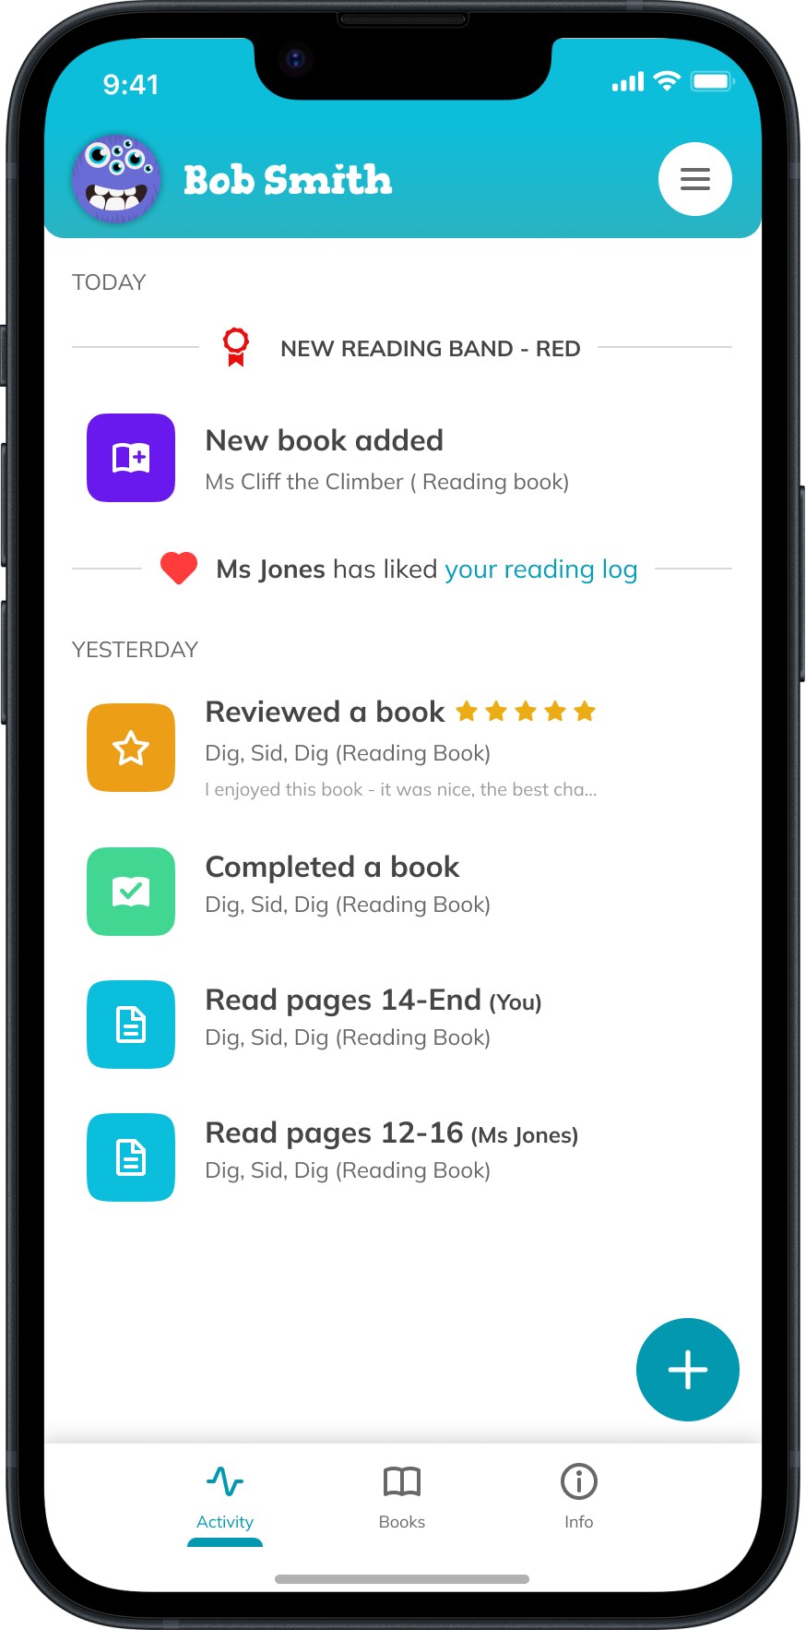
Benefits
No more lost paper reading diaries!
No more damaged paper reading
diaries- the ‘water bottle leaked in the bag’ diaries are gone forever!
All reading you log will be saved for the entire time your child is in school so no logs are lost.
Only one parent account needed for your family

Slide 20
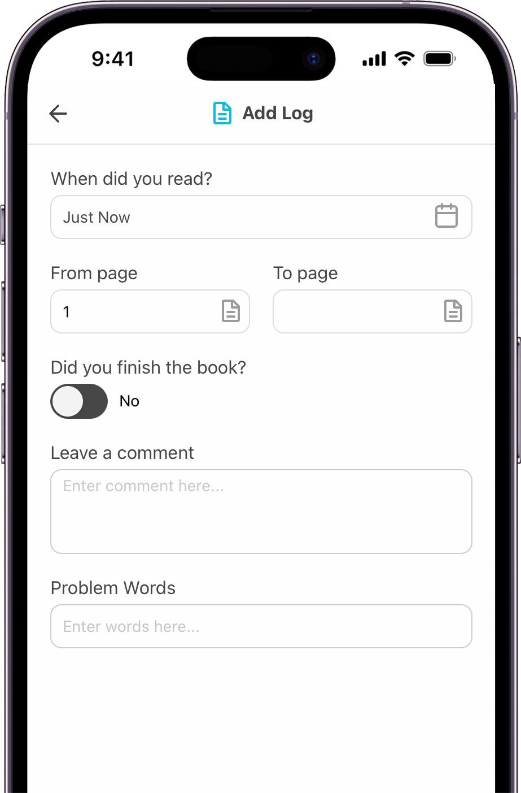
Benefits
Parents/carers can log reading separately
School gains valuable insight into reading across school
You can add reading books and any others from home
The app is free to download
There is a website version too
Reduce use of paper for schools
Motivational for children as they earn gems and collect cards!

Slide 21
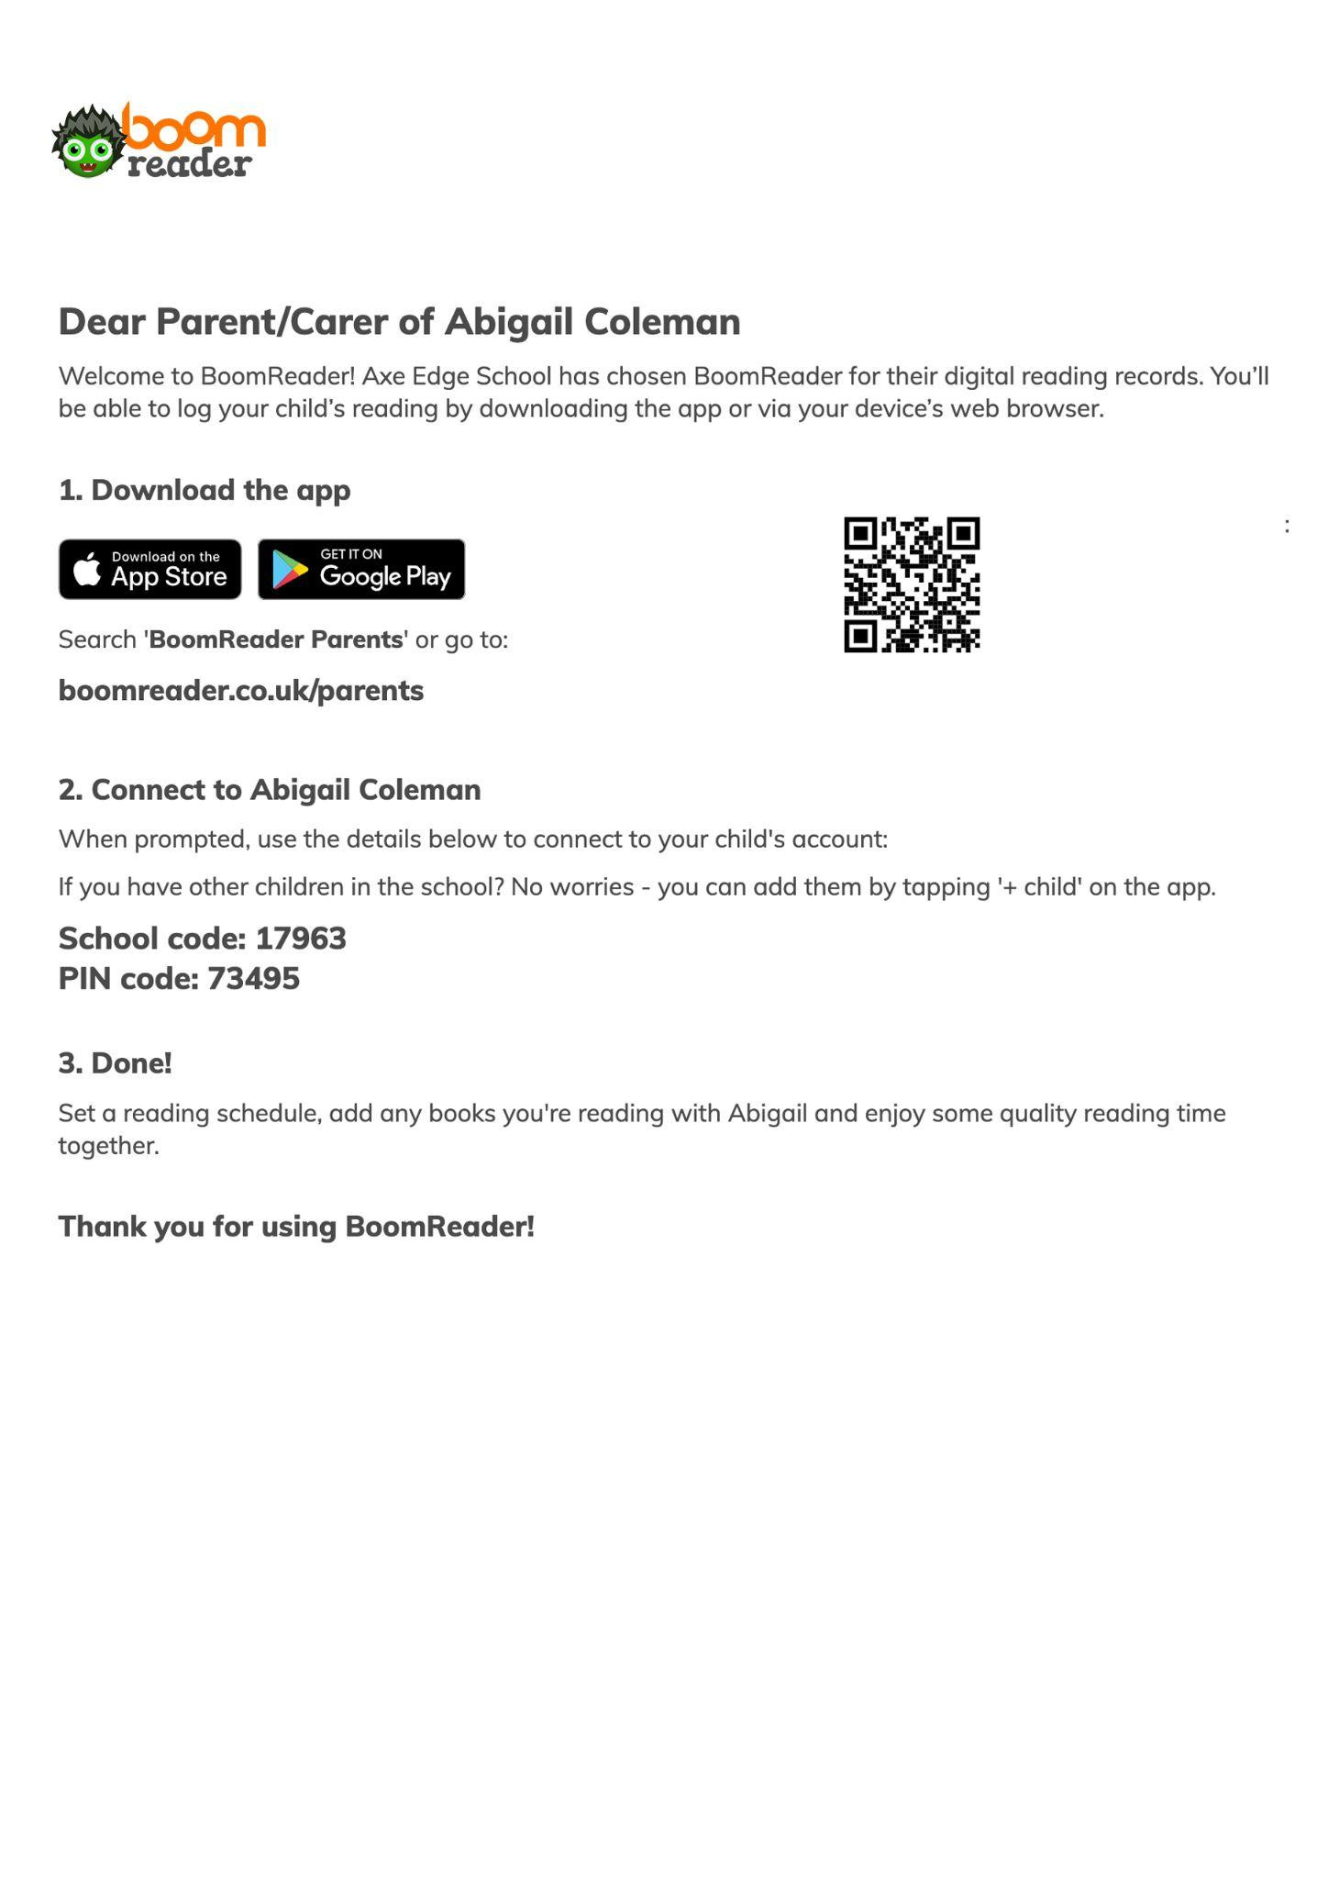
Getting started
Please use the login details letter sent home by your child’s teacher
Follow the instructions to download the app
Create an account quickly and easily
Connect to your child (with the school code/login code on the letter)
That’s it - you’re all set!
Please use the one page guide for help as needed.

Slide 22
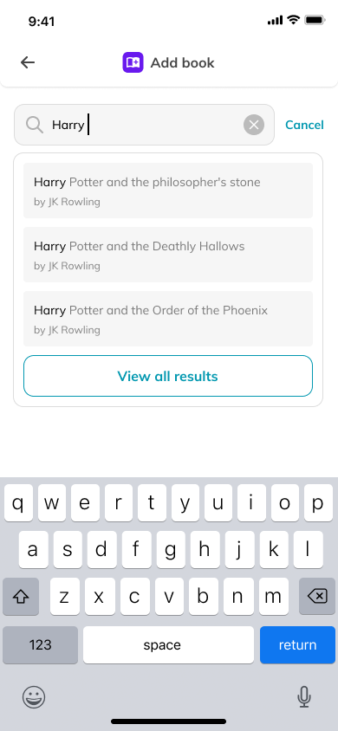
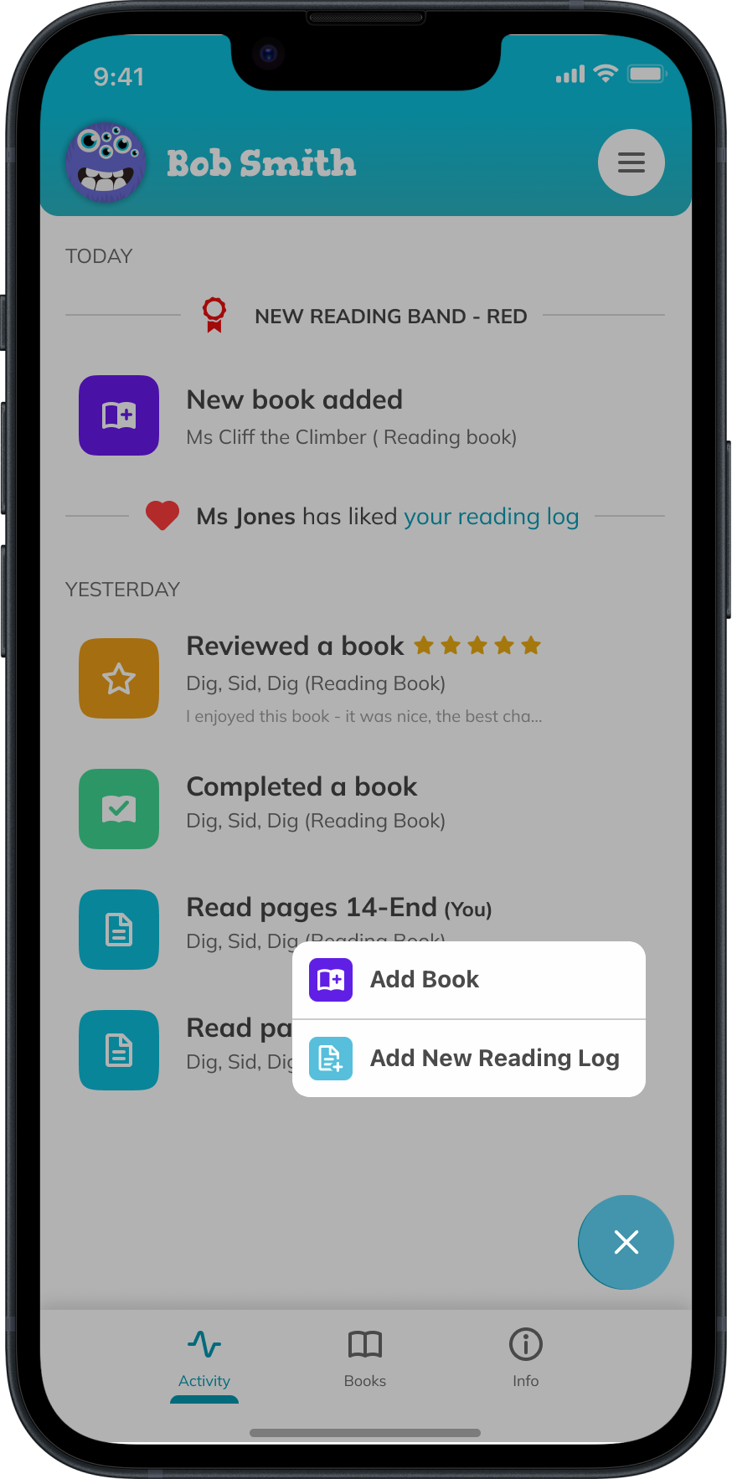

Guide
Add Book
Simply start typing the book title to find your book. You can also add the book title yourself.

Slide 23
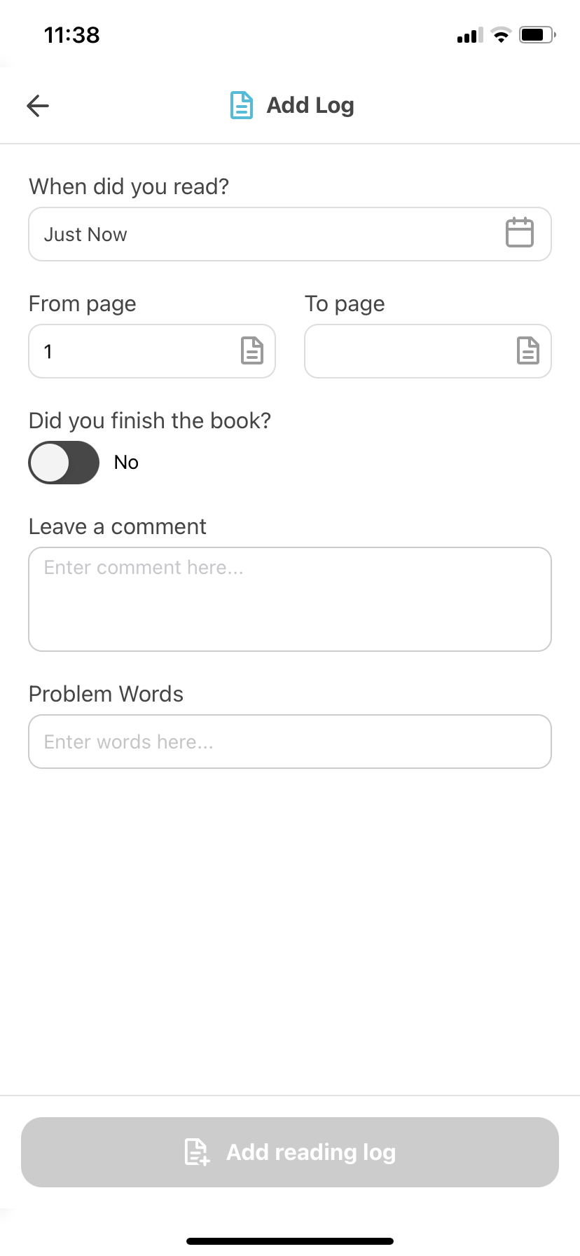
Guide
Add Reading Log
Choose the book and then fill in the log. Minimum requirement is the page number your child read to.
Tap edit log to make make
any changes.

Slide 24

Guide
Activity
You can view and tap
on any activity here to see more detail, add logs etc.

Slide 25
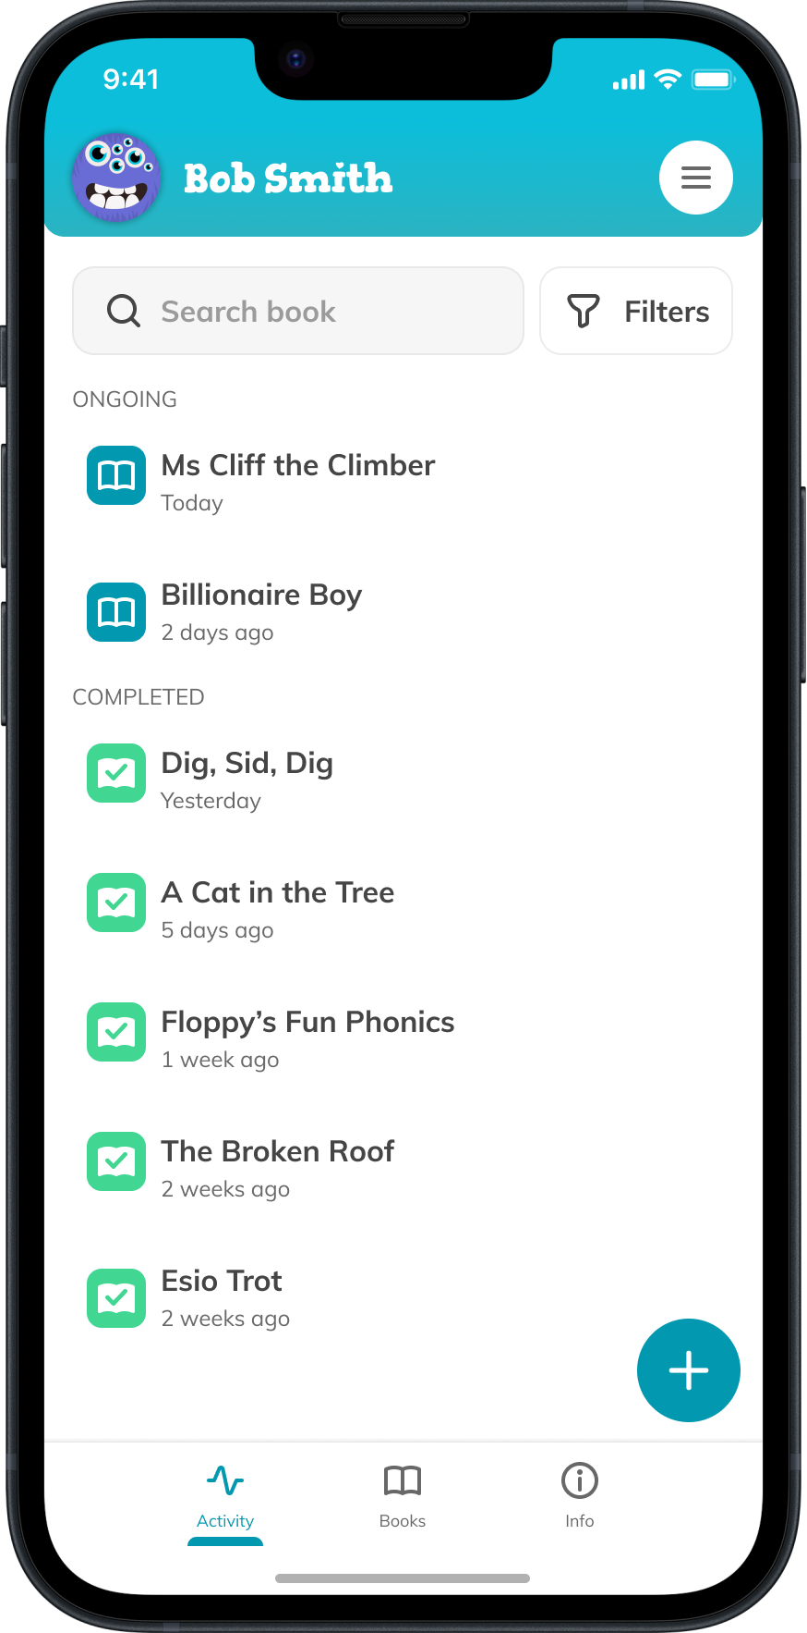
Guide
Books
All current and completed books are listed here.
Tap a book to view the reading history.

Slide 26
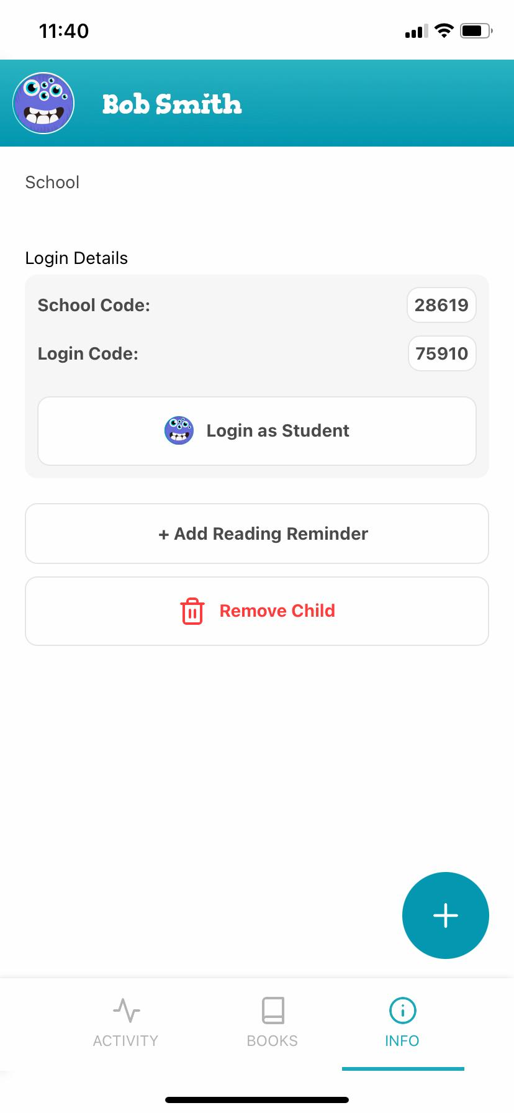

Guide
Info
View your child’s account, add a reading reminder and login as your child to see their avatar and spend their gems.

Slide 27
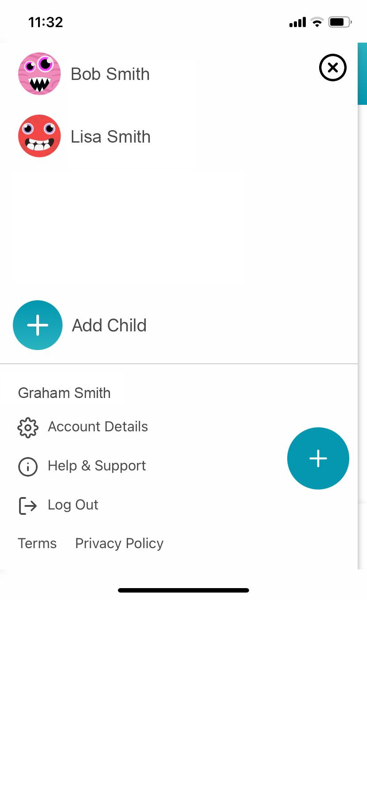
Guide
Menu
Switch quickly between your children and see other account details.

Slide 28
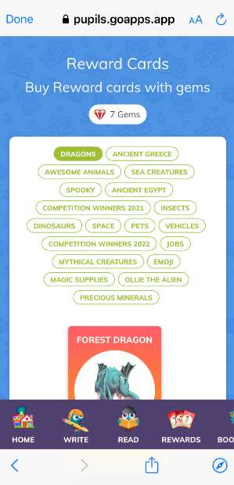
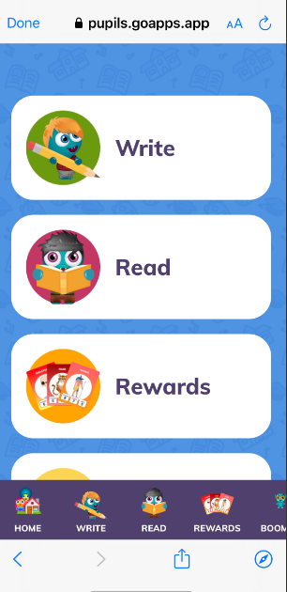
Viewing Gems and Collecting Cards
Click on ‘info’
Click on ‘Login as Student’
Click on ‘Rewards’

Slide 29
Viewing Gems and Collecting Cards
The gems are awarded up to twice a day for any reading logs.
Gems are also awarded randomly between 1-3 each time, just to keep it a little more interesting for the children than just one each time.

Slide 30
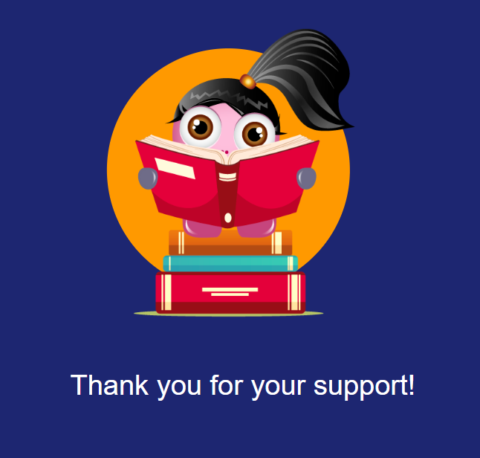
Any Problems…
Please email parents@boomhub.app for support

