Slide 1
EARLY YEARS & KEY STAGE ONE
STAY AND LEARN
Reading
NOVEMBER 2023

Slide 2
READING IN THE EYFS AND KS1
Nurturing a love of reading from a young age builds the foundations for every child’s development, giving them a head start in their learning journey.
‘A love of reading is the biggest indicator of future academic success’ ( OECD)
AIMS OF STAY and LEARN for READING in EYFS and KS1
To gain an understanding of how we develop reading in school
To promote the importance of reading regularly at home.

Slide 3
DEVELOPING A LOVE OF READING AT APPLECROFT -
Reading to children
Class libraries
Secret storyteller
Phonics
and fluency
Engaging and diverse texts as spine of reading curriculum
EY KS1 Library
Discussing books together
Campus West Library Links
Birthday Books
Reading Events e.g.World Book Day
Notes:
‹#›

Slide 4
Develop
a love of Reading
Language Comprehension
(vocabulary)
Word Reading (phonics decoding)
Fluency - Reading Comprehension

Slide 5

READING IN SCHOOL - PHONICS
Applecroft has chosen Little Wandle Letters and Sounds as our systematic, synthetic phonics (SSP) programme to teach early reading and spelling.

Slide 6
READING IN SCHOOL - EYFS
Little Wandle Foundations
Structured Story Time

Slide 7

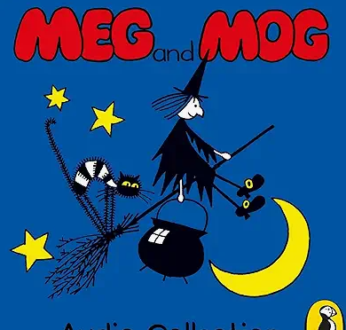


STRUCTURED STORYTIME- CORE LITERATURE SPINE (25 TEXTS)
Revisiting Authors
Heritage texts/traditional tales
Diversity of representation
Strong female role model
Social Ethical and moral issues
Curriculum Links

Slide 8


STRUCTURED STORYTIME – 25 TEXTS
Importance of all pupils having access to rich language from the earliest possible stage.
CUSP EYFS Core Literature Spine sets out twenty-five core texts with key themes, ideas to lay strong foundations in the EYFS and beyond.
This leaves space in the academic year for us to select key texts based on the cohorts we are teaching.
Each core text has a Structured Story Time plan, including vocabulary instruction, fluency and oracy opportunities and ‘thinking hard’ questions.

Slide 9
READING IN SCHOOL - KS1
Phonics & Reading Practice – Little Wandle: phonics and fluency
Whole Class Reading – CUSP shared text, vocabulary, fluency and reading comprehension skills.
Library Time – Reading for pleasure
Class Read Aloud – Daily reading to children
Additional Reading – 1:1 or in groups e.g. phonics, fluency

Slide 10
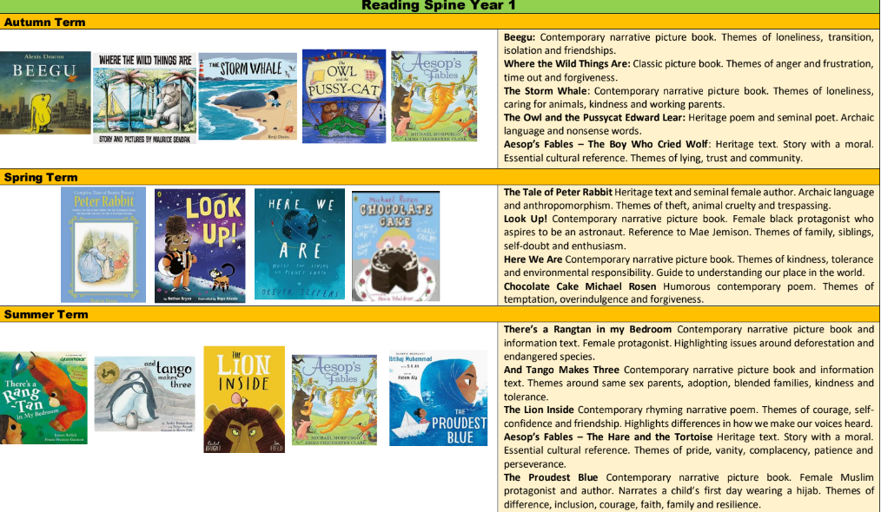
READING SPINE Y1

Slide 11
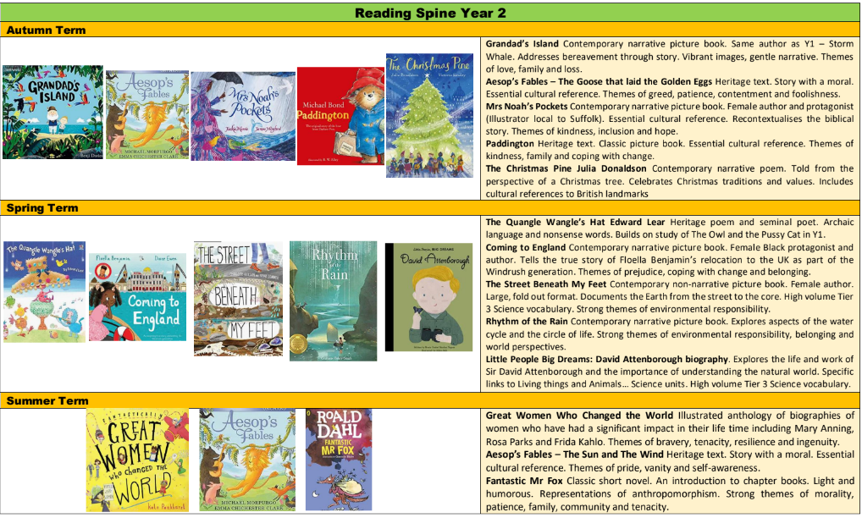
READING SPINE Y2

Slide 12
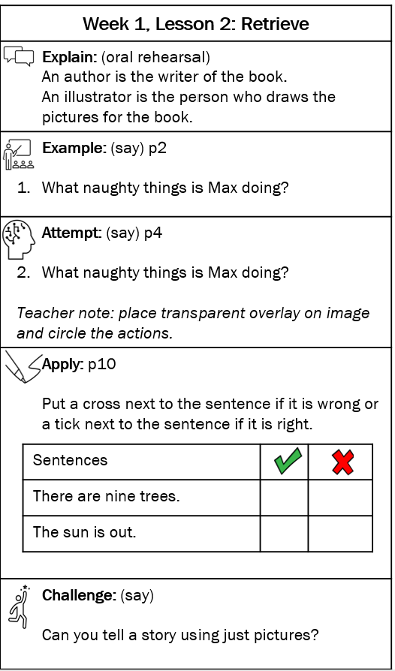
WHOLE CLASS READING KS1
High Quality Texts – classic texts, contemporary, diverse
Reading Fluency – modelled, children read aloud, repeated reading
Vocabulary
Reading Comprehension Skills e.g. retrieve, compare
Explain – Key skills
Knowledge Note
Follows the same sequence in all lessons
Example – Modelled by teacher
Attempt – Teacher guides pupils
Apply – Pupils apply skill using model
Challenge

Slide 13

WHOLE CLASS READING EXAMPLE LESSON Y1
Teacher models reading. Children read the text together, perhaps using echo reading.
Response to the text is based around a comprehension skill.
In Y1 children's responses are collectively recorded in a large class floor book.
In Y2 teacher’s model written responses and children have their own book for recording

Slide 14
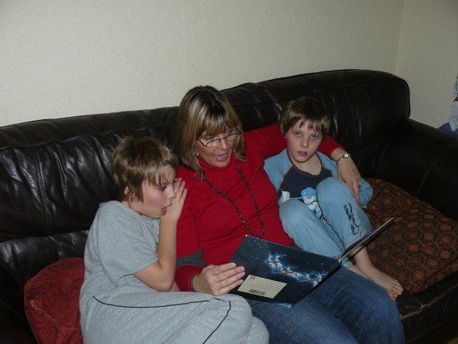
READING AT HOME – OUR PARTNERSHIP
Reading is more than learning to decode or comprehend what is being read – there is an emotional context which reading at home nurtures.
In school we have many opportunities to read but the school day is busy and sometimes reading just needs a slower pace!
Reading with someone you love helps you to associate the emotion with reading – helps you learn to love reading.
Becoming a good independent reader takes many, many hours of practise. You can’t read too much!

Slide 15

READING AT HOME (CONT.)
Record reading at home – 5 times a week on
Boom Reader
You will also see reading in school logged on
Boom Reader

