Slide 1
KEY STAGE TWO
STAY AND LEARN
Reading
NOVEMBER 2023

Slide 2
READING
Nurturing a love of reading from a young age builds the foundations for every child’s development, giving them a head start in their learning journey.
‘A love of reading is the biggest indicator of future academic success’ ( OECD)
AIMS OF STAY and LEARN for READING in KS2
To gain an understanding of how we develop reading in school
To promote the importance of reading regularly at home.

Slide 3
DEVELOPING A LOVE OF READING AT APPLECROFT -
Reading to children
Class libraries
Phonics
and fluency
Discussing books together
Engaging and diverse texts as spine of reading curriculum
KS2 Library
Reading Events e.g.World Book Day
Campus West Library Links
Notes:
‹#›

Slide 4
Develop
a love of Reading
Word Reading (phonics decoding)
Accuracy
Automaticity
Comprehension
Vocabulary
Meaning of a text
Prosody
Intonation, emphasis, pauses
Fluency
Readers are fluent when they read with automaticity and accuracy.
They show comprehension of a text, reading with intonation and expression

Slide 5


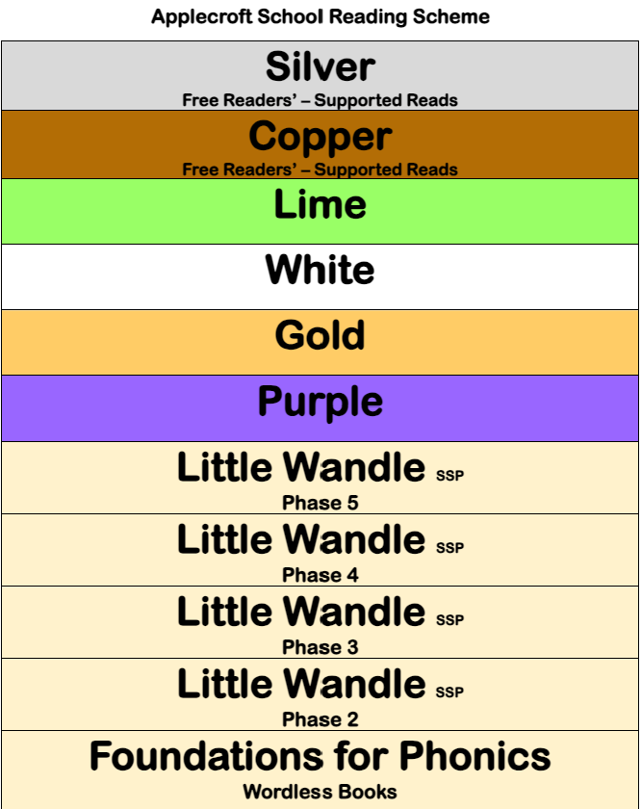
READING IN SCHOOL – PHONICS AND READING SCHEME
Applecroft uses Little Wandle Letters and Sounds as our systematic, synthetic phonics (SSP) programme to teach early reading and spelling. From here children progress to fleucny books and upper bands of the reading scheme. Some children in KS2 may have additional phonics and fluency teaching to secure this understanding.

Slide 6
READING IN SCHOOL – KS2
Phonics Rapid Catch Up, Reading Fluency, Upper levels of reading scheme.
Whole Class Reading – CUSP shared text, vocabulary, fluency and reading comprehension skills.
Libraries – Reading for pleasure
Class Read Aloud – Daily reading to children
Additional Reading – 1:1, Read Every Minute independent reading, reading across the curriculum

Slide 7
CORE LITERATURE SPINE THROUGHOUT SCHOOL FOR WHOLE CLASS READING LESSONS
Revisiting Authors
Heritage texts/traditional tales
Diversity of representation
Strong female role models
Social ethical and moral issues
Curriculum Links

Slide 8
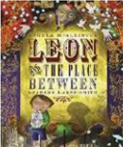







LITERATURE SPINE
Importance of all having access to rich language throughout a pupil’s school journey.
Each year has a selection of core texts.
These texts ensure that a breadth of experiences, authors, texts and themes is addressed across the Primary years.
In addition, there are core poems that each year group will study in detail. Other short extract texts, including varied non-fiction forms, are studied alongside the core text.
The literature spine links with the wider curriculum, where appropriate.

Slide 9
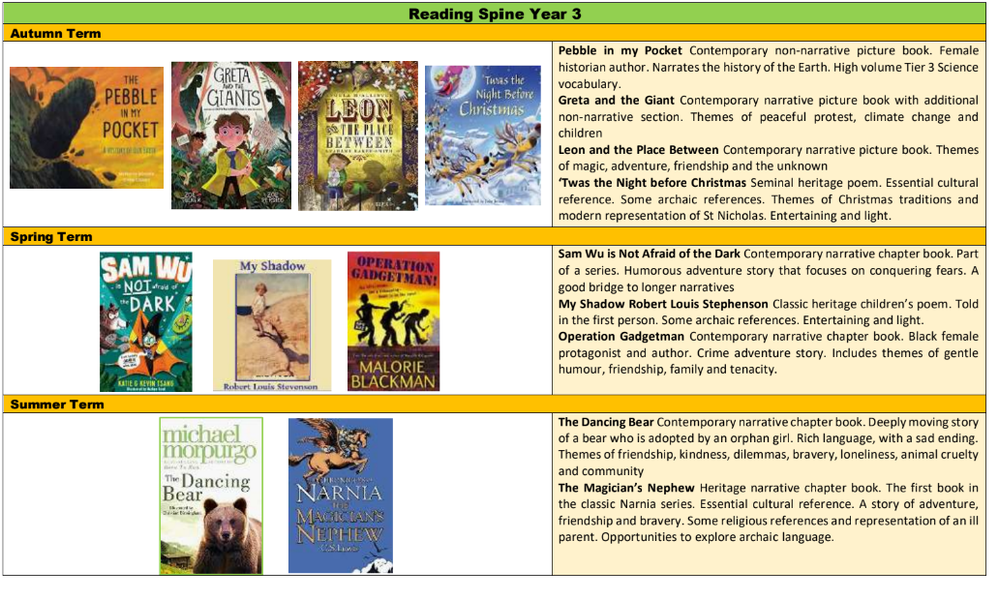
READING SPINE Y3

Slide 10
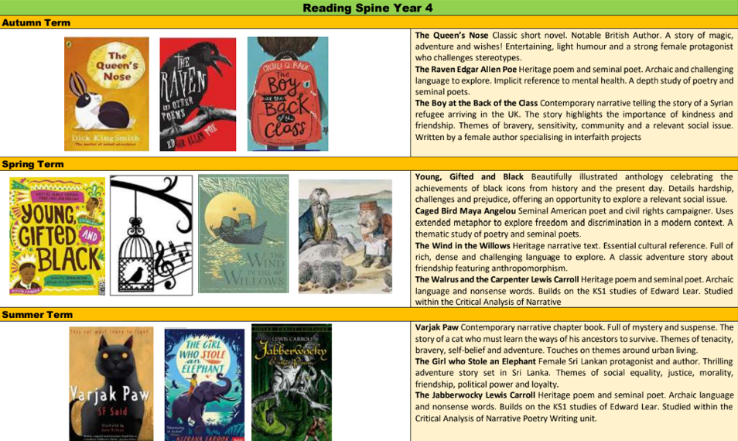
READING SPINE Y4

Slide 11
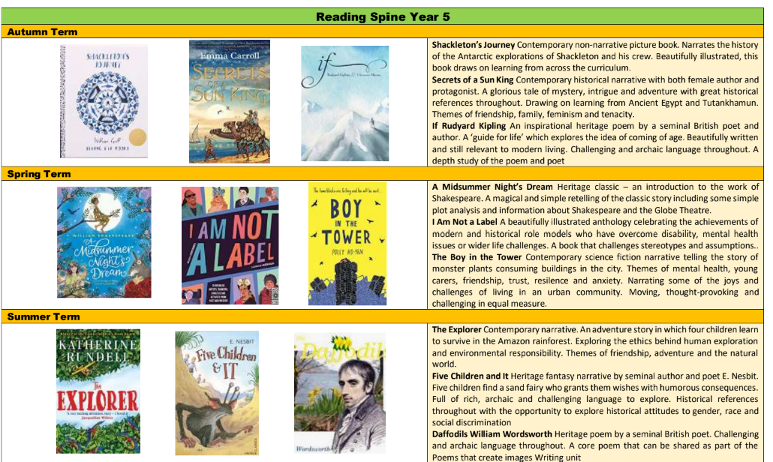
READING SPINE – Y5

Slide 12
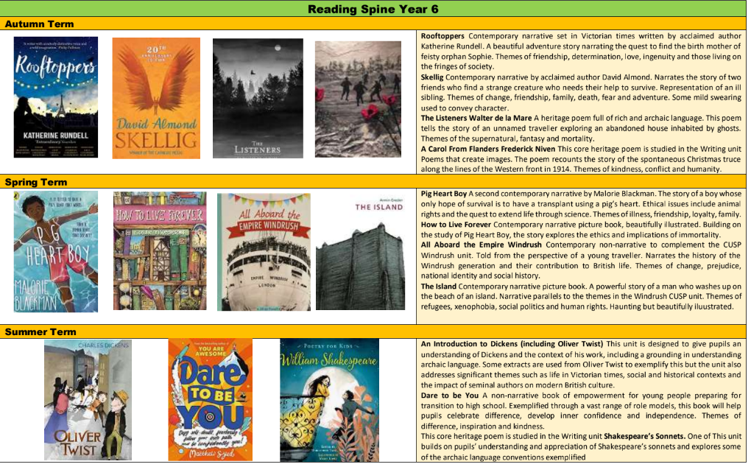
READING SPINE Y6

Slide 13
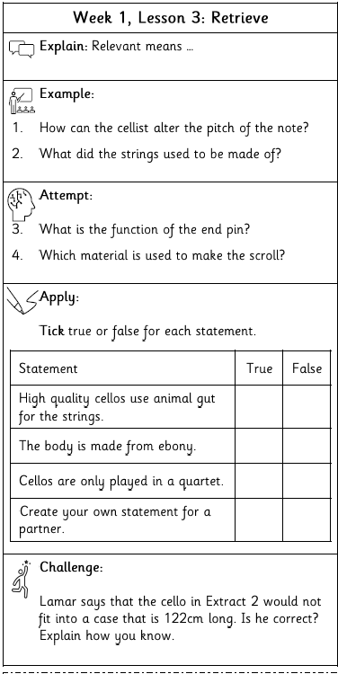
WHOLE CLASS READING
High Quality Core Texts and Supplementary Extracts
Reading Fluency
Vocabulary
Reading Comprehension Skills
Explain – Key skills
Knowledge Note
Follows the same sequence in all lessons
Example – Modelled by teacher
Attempt – Teacher guides pupils
Apply – Pupils apply skill using model
Challenge

Slide 14
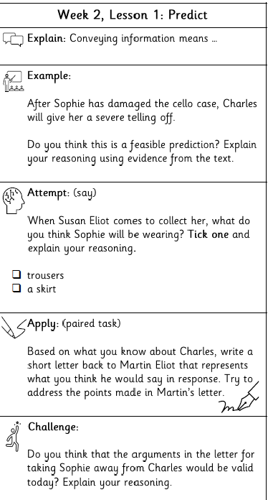

WHOLE CLASS READING LESSON
A text will be age appropriate and provide challenge.
Response to the text is based around a comprehension skill e.g. prediction.
Teacher models reading aloud and all children read aloud to develop fluency.
Vocabulary is explicitly taught.
Examples are used to model using the reading comprehension skill focus.
Children apply this skill independently and record in their books.

Slide 15
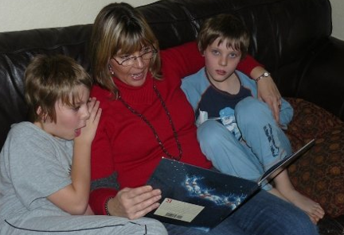
READING AT HOME – OUR PARTNERSHIP
Sometimes reading just needs a slower pace than when we are learning in school!
Reading is more than learning to decode and comprehend – there is an emotional context which reading at home nurtures.
Becoming a good independent reader takes many, many hours of practise. You can’t read too much!
Reading with someone you love helps you learn to love reading.

Slide 16


WHAT HAPPENS WHEN THEY NO LONGER WANT YOU TO READ TO THEM?
Keep it going as long as possible – share reading, read a more challenging text to them.
Tell them about what you are reading.
Be interested and ask them to talk about what they are reading.

Slide 17

READING AT HOME (CONT.)
Record reading at home
5 times a week on
Boom Reader App
Record whenever you read with your child
Record reading whenever your child reads on their own

