Slide 1



Slide 2

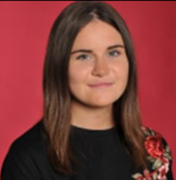
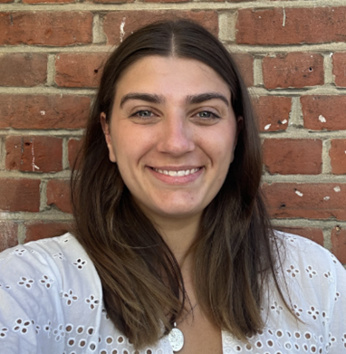
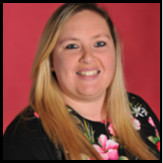
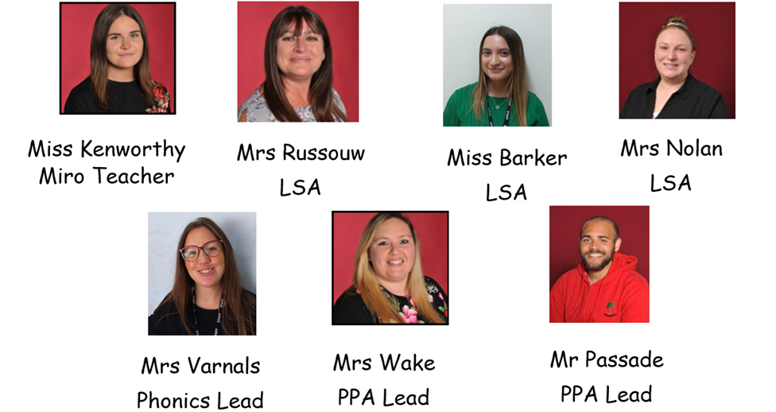
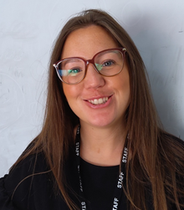
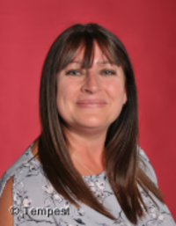
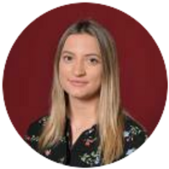
Mrs Vikki Wake
PPA Lead for RE
Mr Bradley Passade
PPA Lead for PE
Miss Hannah Kenworthy
Y1 Miro Class Teacher
Miss Felicity Ryall
Y1 O’Keeffe Class Teacher
Mrs Rachel Varnals-Scrace
Early Reading Teacher
Mrs Michelle Russouw
LSA
Miss Skye Barker
LSA
(Learning Support Assistants)
Mrs Sarah Nolan
LSA

Slide 3
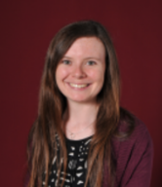
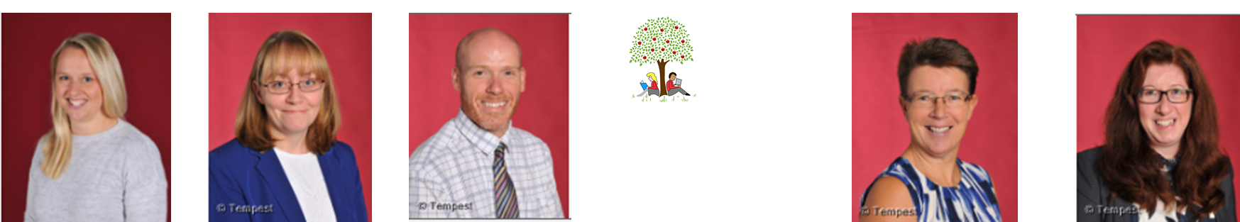
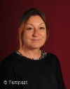
Staffing
Other Important Staff:
Natalie Clementson - Phase Leader
Lisa Withe - Headteacher
Paul Wyatt – Deputy Headteacher
Ruth Johnson – Assistant Headteacher for
Inclusion & Well-Being (also our SENDCo)
Jale Apicella - Family Link Support Worker
Odette Coe & Gill Williams - Lead First Aiders

Slide 4
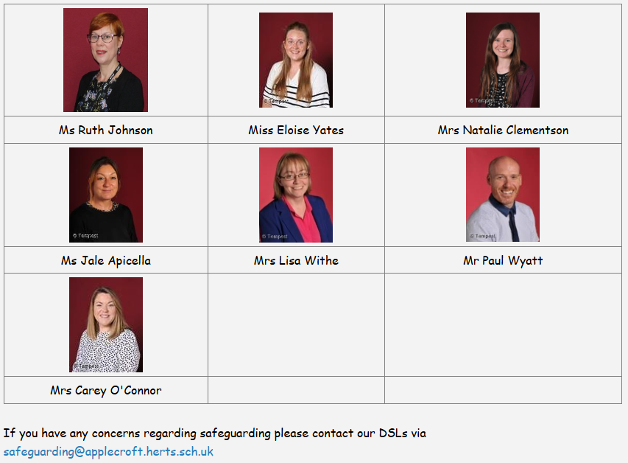
Safeguarding

Slide 5


Safeguarding
Evacuation - when fire alarm sounds
Exit via nearest fire exit and walk calmly & silently to the Fire Evacuation Point at the bottom of the school field
Invacuation- sound from telephones
Move calmly & silently to the nearest room, secure yourself inside (staff will undertake procedures) then wait until further instruction

Slide 6
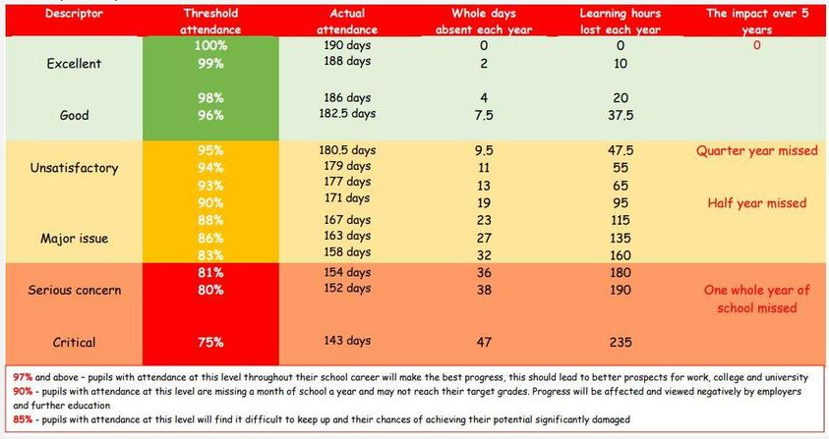
Attendance
Good Attendance – 96% or above
We won’t authorise holidays during the term. We ask that routine dentist & doctor appointments take place out of the school day whenever possible
We are here to support - contact Jale Apicela (Family Link Support Worker) or your child’s class teacher

Slide 7
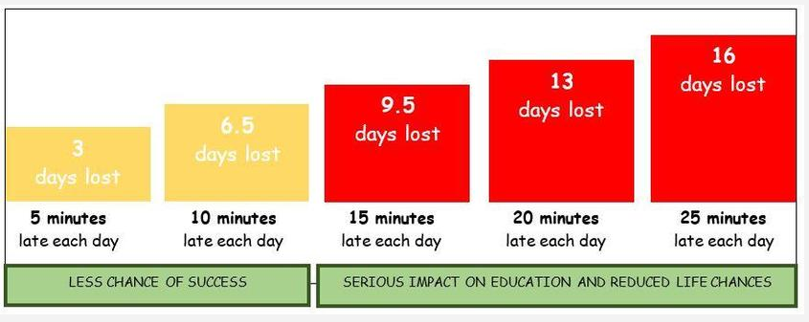
Punctuality
The school day begins at 8:45am sharp with the first lesson
Gates open at 8:30am and doors to the school building at 8:35am
The Registration period is 8:35-8:45am - children should be in their classroom by 8:45am when the register closes.
Children don’t like arriving late - it’s embarrassing, interrupts the lesson and does not evoke positive emotions in your child - they also miss key messages and learning
We are here to support - contact Jale Apicela (Family Link Support Worker) or your child’s class teacher

Slide 8
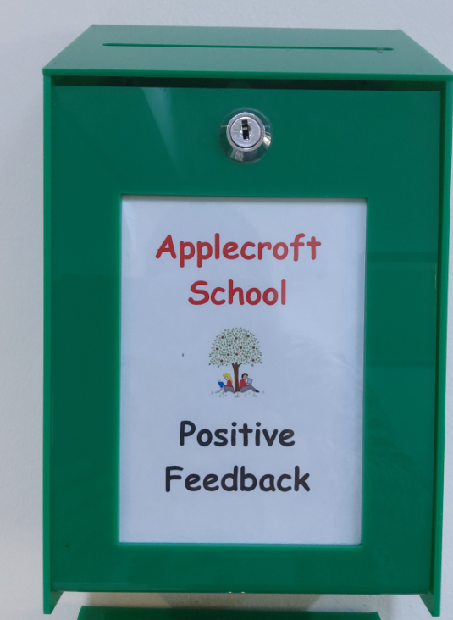




Important Reminders
Positive Feedback & Suggestion boxes/emails
The use of mobile phones by adults are NOT permitted on the school site (hands-free is) but all phones must be out of site and not being actively used on the school site for safeguarding reasons
Please order school lunches online at home
Are are excited to relaunch The Secret Story Teller this year.
A sign-up sheet will be emailed out to parents to sign up next Friday.
KS1 children have daily snack provided at school so do not need to bring a snack in

Slide 9
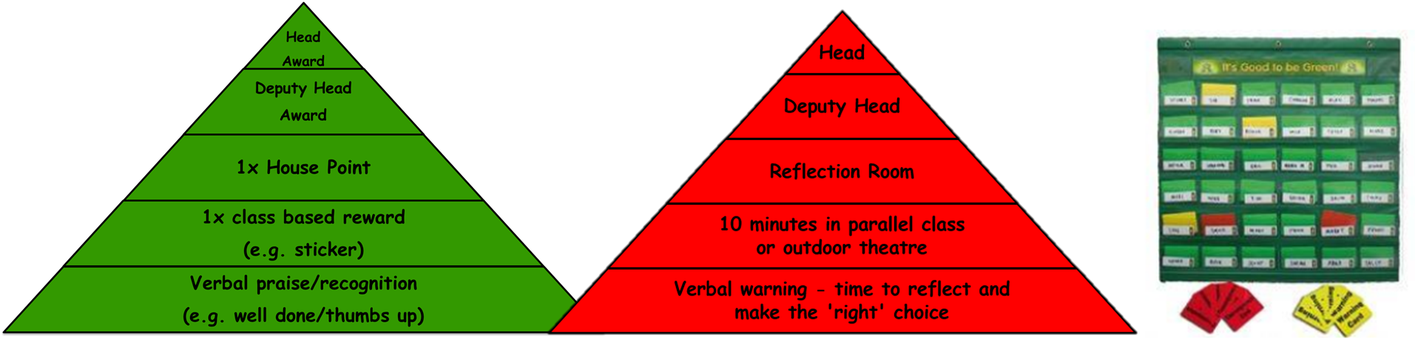
Behaviour and Discipline Policy
At Applecroft School we have clear ‘Expectations of Behaviour’ that we expect all members of our community to abide by. These expectations are:
•Be responsible for yourself and your actions
• Be honest, open and reflective
•Be kind and supportive
• Be respectful and well-mannered
Senso software now monitors school devices and alerts DSLs if anything is searched on computers that shouldn’t be.

Slide 10
School Uniform
School Uniform (Tuesdays, Thursday, Friday):
Red jumper/cardigan
Grey trousers, skirts, shorts or pinafore dress.
White polo shirts, shirt/blouse.
Reminders:
Long hair should be tied back
Red hair accessories only
Stud earrings only
No nail varnish or motifs in hair
Black school shoes - not boots
PE Uniform (Mondays & Wednesdays):
White t-shirt
Black shorts or jogging bottoms
Black hoodie
Black trainers

Slide 11





Communication between home and school
Admin email- admin@applecroft.herts.sch.uk
Google Classroom
Website
Instagram

Slide 12
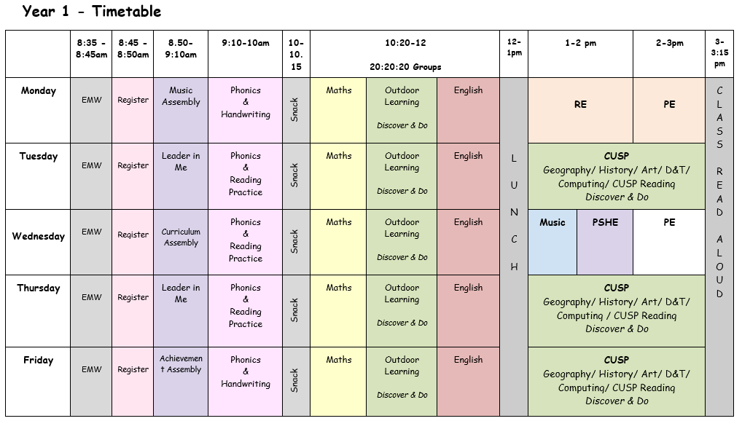
The School Day

Slide 13
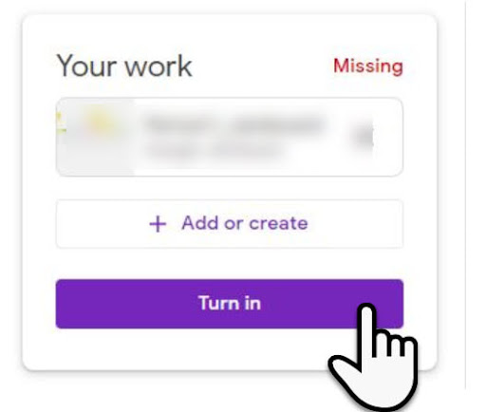
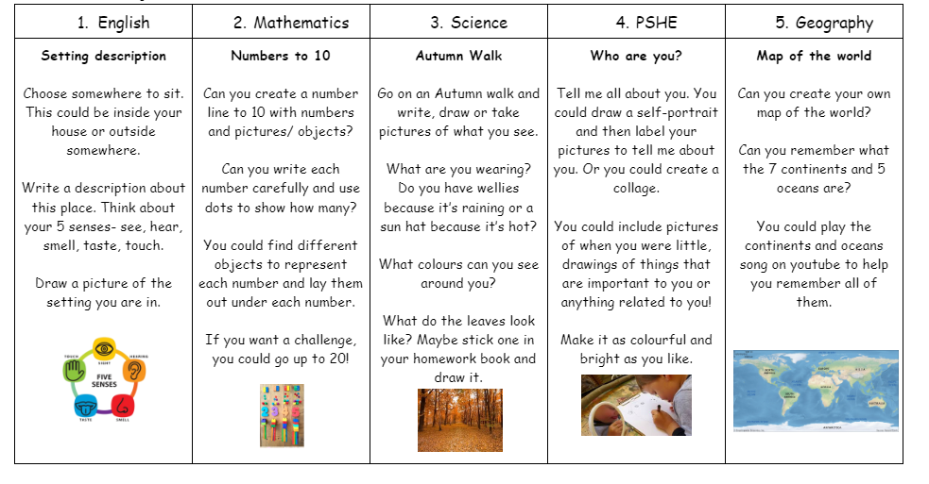
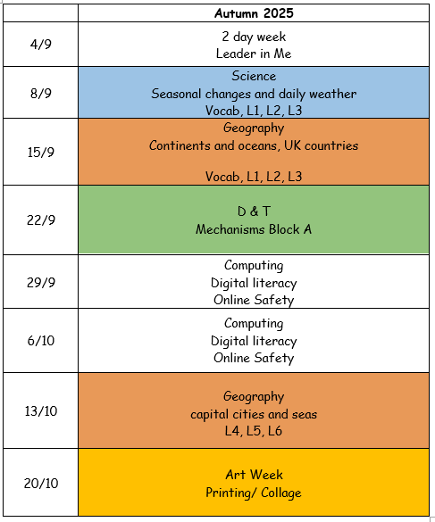
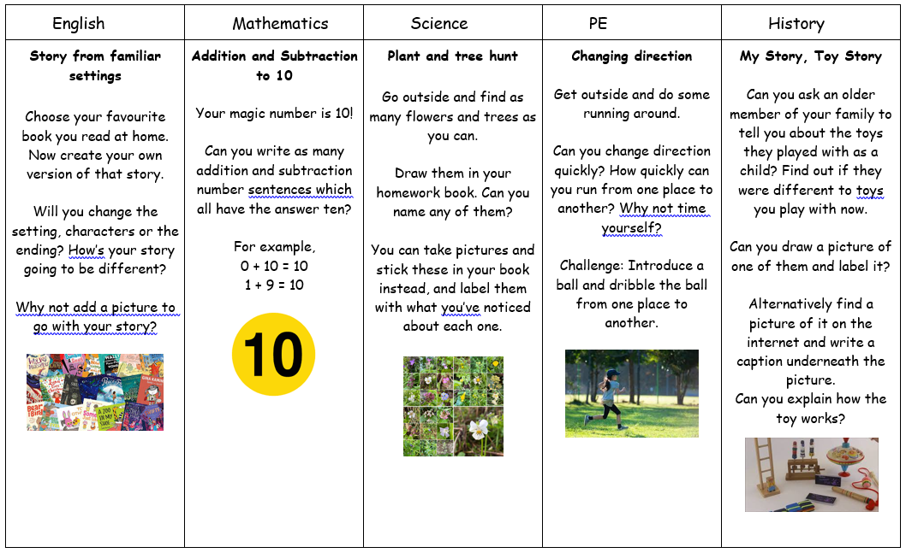
Home Learning
Due in on Fridays
Notes:
Each term, we will provide a Home Learning Grid containing a variety of tasks. Each week, your child can choose one activity from the grid to complete. These activities are linked to what your child has been learning in school, so they will already have some background knowledge of each topic.
The grid will be uploaded to Google Classroom each week, and there will be an option to ‘hand in’ completed work online. Children can either submit their work on Google Classroom or complete written tasks in their Home Learning Book.
Home learning will be set every Friday and will be due in by the following Friday.

Slide 14
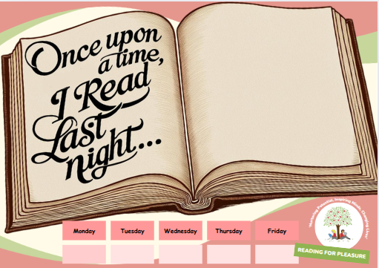
New for September 2025:
No longer using Boom Reader
Still striving for every child to read for pleasure at home every day
Moving to an ‘in house’ child led approach, linking to leadership skills
Using the document to the left, children will ‘self register’ their name onto the open book, if they read the previous night
Reading Society members will add up the scores daily and at the end of the week, weekly totals for each class will be displayed in the main corridor
A love of reading is the single biggest indicator of future academic success (OECD)

Slide 15



Slide 16

Reading

Slide 17
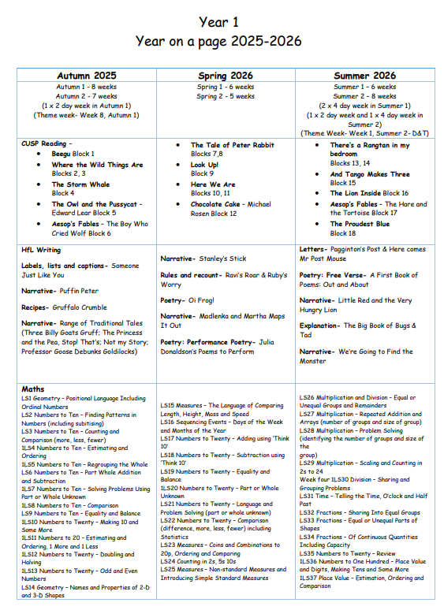
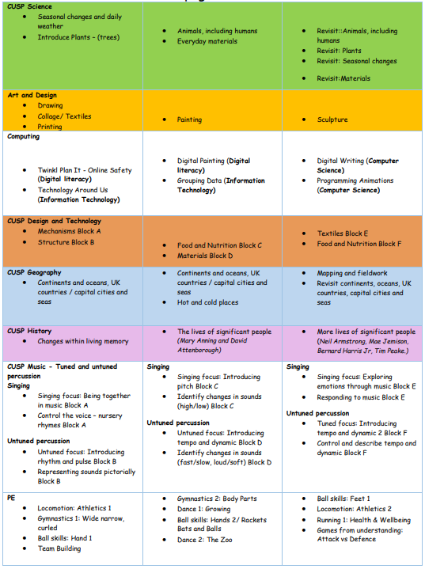
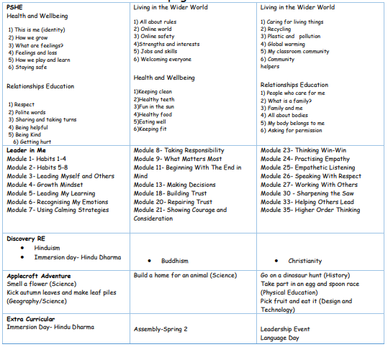
The Curriculum
This is available on the year group page on the website for you to access.
Year on a page

Slide 18
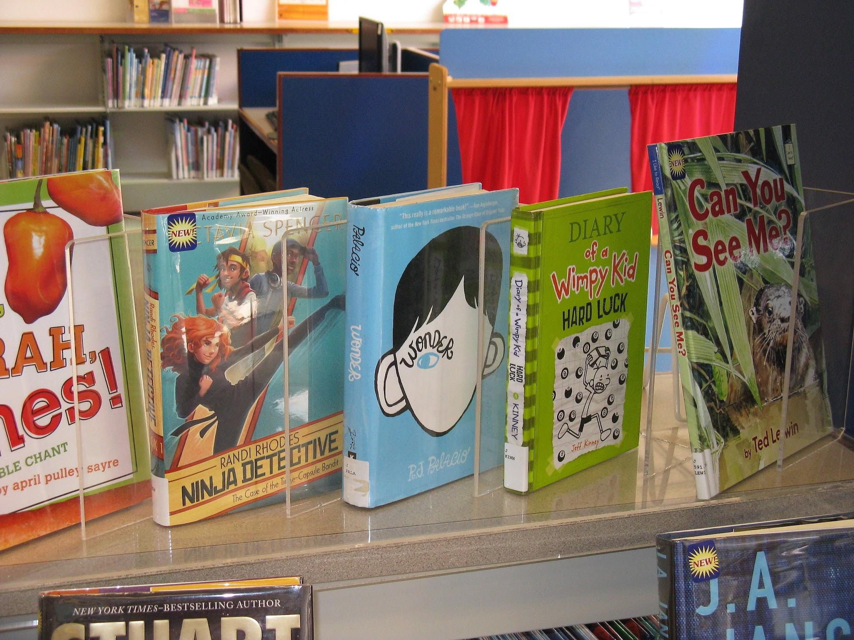
Updates
Books:
The school has invested thousands of pounds in books over the past few years including resourcing the Little Wandle scheme, reading curriculum and libraries
If a book is returned to school damaged or not returned at all, the school will write to parents/carers requesting payment for a replacement book.
Thank you for your support and understanding.

Slide 19
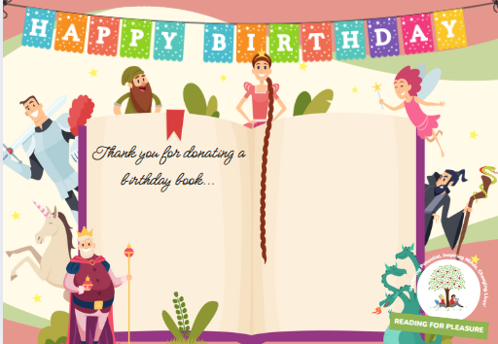
Relaunch
Birthday Books:
For children’s birthdays/special events sweets are no longer permitted and from now on will not be distributed to the children.
However, we would still like the opportunity for your child to celebrate their birthday in a special way at school, by donating a birthday book.
There is no expectation that anything needs to be purchased. However, if your child would like to celebrate in this way each class has a ‘Birthday Book Wishlist’ which can be found on your google classroom.
Each ‘Birthday Book’ received will have a special sticker on the inside cover displaying who donated it and on which birthday. The book will then be added to your child’s class library.
Why a book makes the perfect gift…

Slide 20

Parent Volunteers
If you are interested in supporting the children in school you will need to attend one of the two planned volunteer meetings
Friday 12th September @ 9am
or
Monday 15th September @ 2:30pm

Slide 21
Important Dates
Friday 12th September @ 9am / Monday 15th September @ 2:30pm - Volunteer Meeting & Safeguarding Training
Tuesday 23rd September - Individual/Sibling School Photos
Monday 29th September-Thursday 2nd October - Book Fair in school
Thursday 2nd October - Opal Parents Play Date (1:30-3pm) – more details to follow
Monday 20th – Friday 24th October - Art & Design Themed Week
Monday 24th November- Friday 28th November - Year 1 Parent Consultations (more details to follow)
Monday 1st December- INSET Y2- Y6 Parent Consultations (virtual)
Friday 5th December - Open Afternoon for parents/carers (2:15-3:05pm)
Tuesday 9th December - Christmas Show Matinee & Evening Performance
Thursday 11th December - Christmas Show Evening Performance
Friday 12th December - Panto Day
Notes:
Notice board by the Year 1 Miro gate

Slide 22

Thank You
We are looking forward to working with you and your child.
Any questions?

