Slide 1
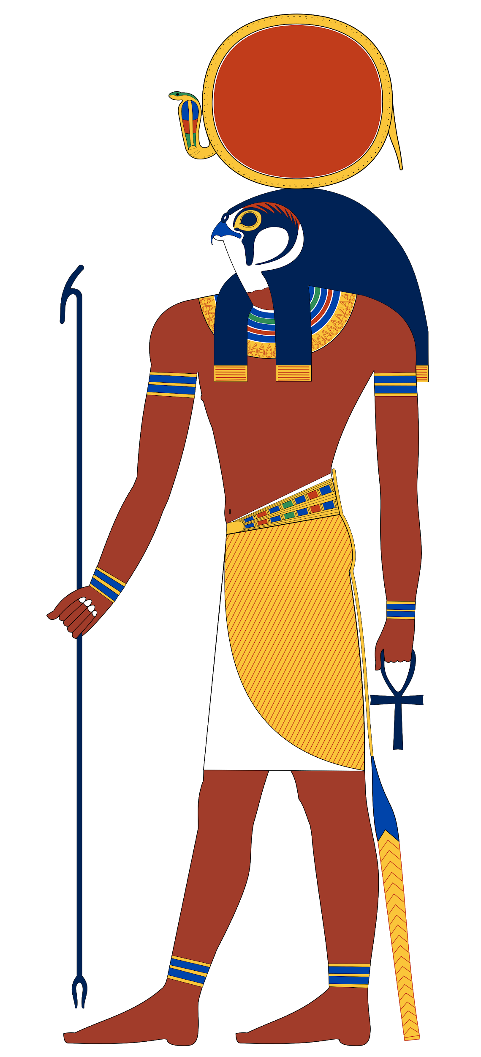
Egyptian Gods and Goddesses
Isabelle Lofthouse

Slide 2
Ra
God of the Sun, Lord of all Egyptian Gods
He was usually shown in human form with a falcon head, crowned with the sun disc encircled by the a sacred cobra. Ra was the greatest god and he kept his power hidden in his secret name, which only he knew. There’s a myth about him and his secret name: it began as he started to grow old. Isis was jealous of Ra’s powers as she wanted them for herself but the only way she could do this was to find out his secret name; she cunningly organised a plan. She collected some of his saliva and made it into a snake, hiding it where Ra would walk that day. When Ra trod on it, it bit him, and Ra screamed in pain. All the gods gathered round, but none could heal him. Isis said, "If you tell me your secret name, this will give me enough magic power to heal you." Ra didn't want to do this because he knew then she would have his power, but eventually the pain was so bad that he had to. Isis healed him, and ever since then she has the magic powers that Ra had.

Slide 3
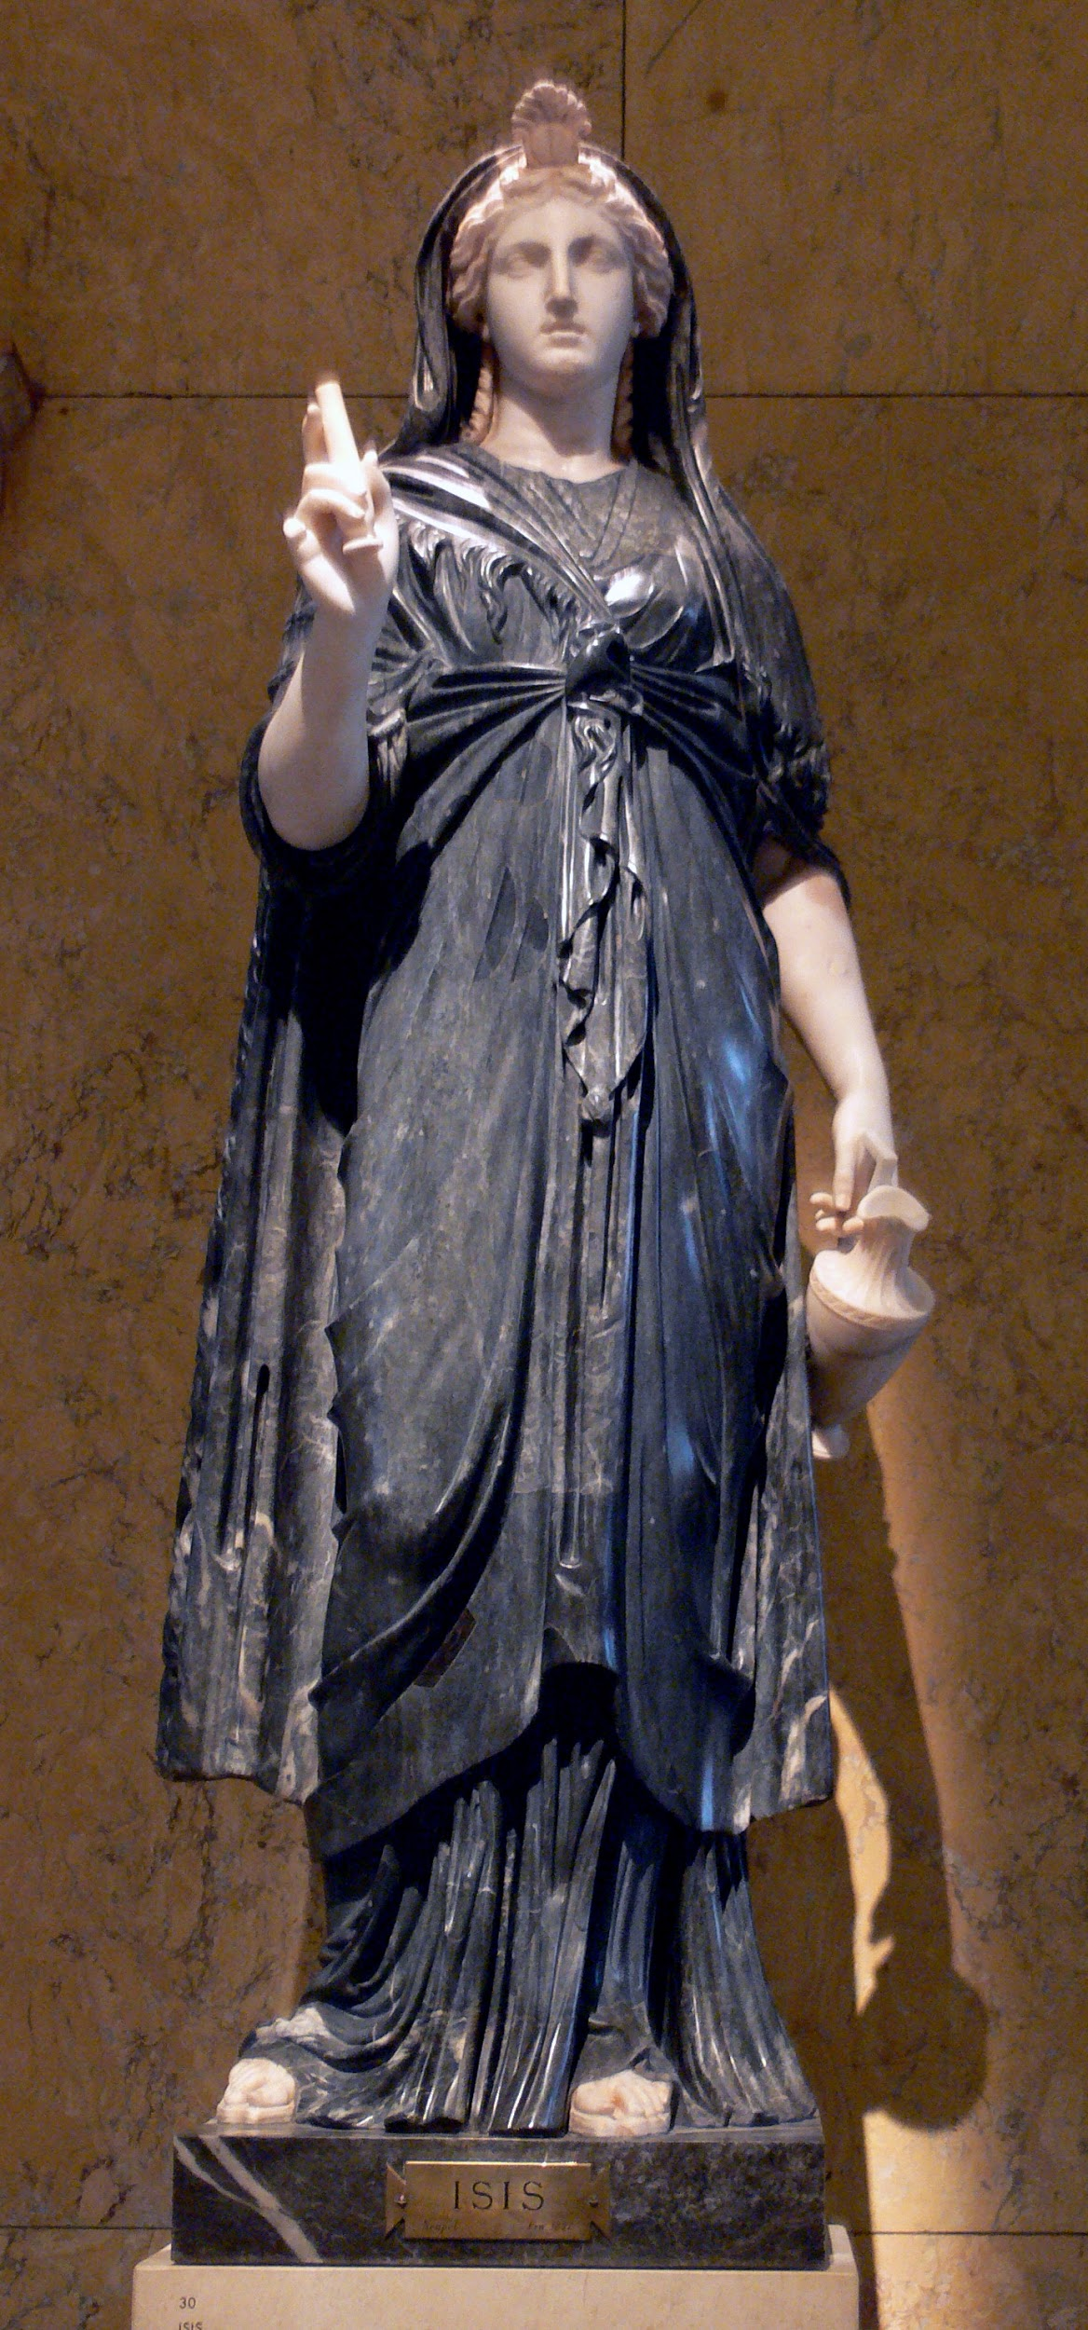
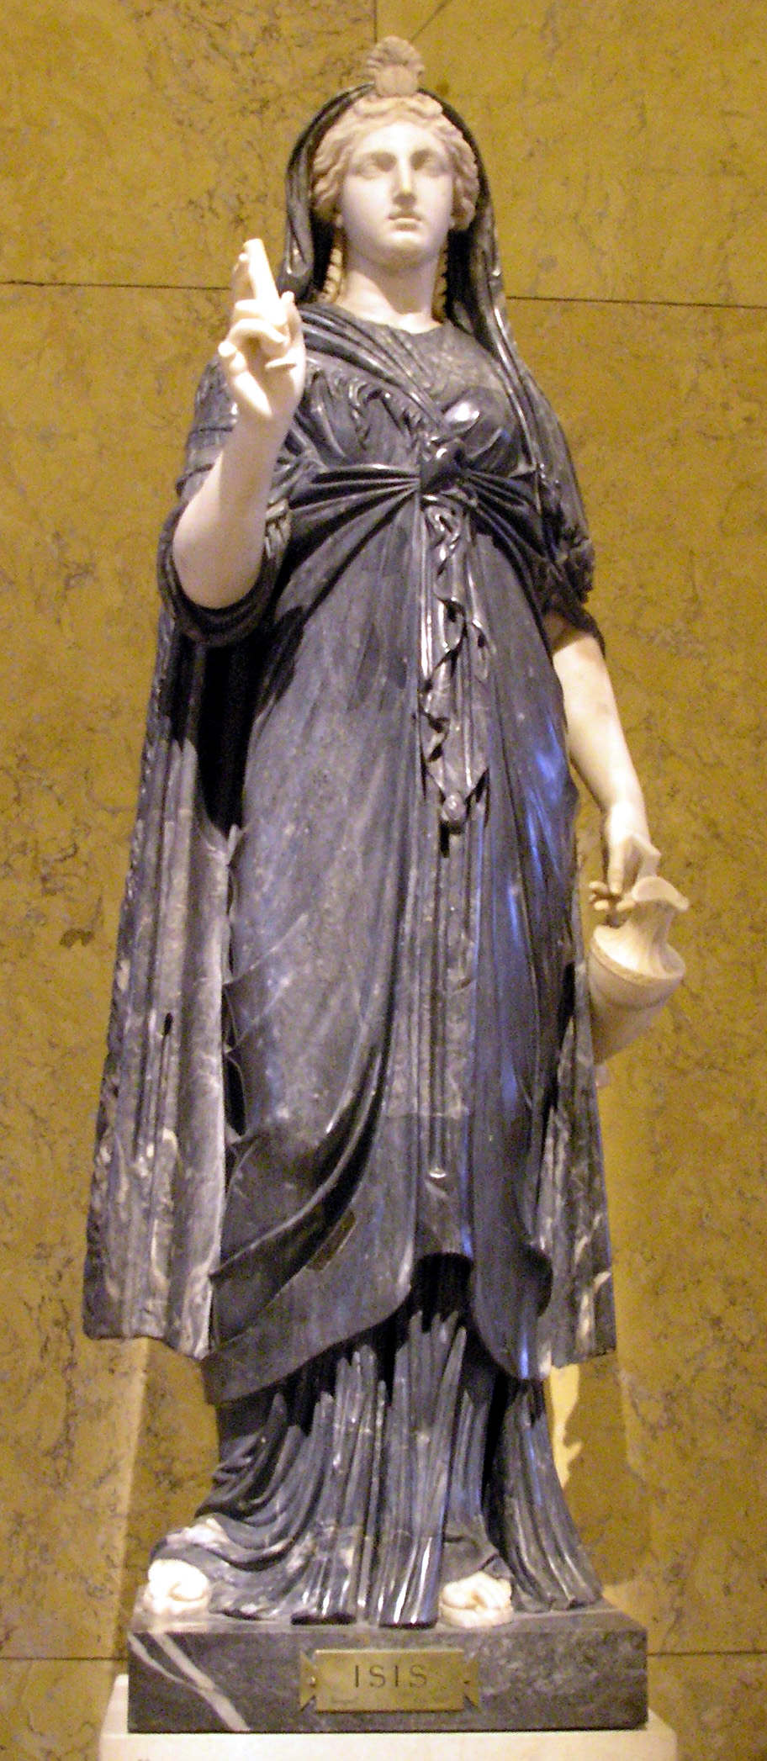
Isis
Isis was the daughter of the earth god Geb and the sky goddess Nut and the sister of the deities Osiris, Seth, and Nephthys. She was also married to Osiris [her brother], king of Egypt. Isis was a good queen who supported her husband and taught the women of Egypt how to weave, bake, and brew beer. But Seth was jealous of his brother Osiris, and he hatched a plot to kill him. Seth decided to trap Osiris in a decorated wooden chest, which he coated in lead and threw it into the Nile. Seth’s plan had worked. With his brother supposedly vanished, Seth became king of Egypt. Isis was still faithful to her husband she could not forget him, so she searched everywhere for him until she eventually discovered Osiris, still trapped in his chest, in Byblos. She brought his body back to Egypt, where Seth discovered the chest and, he furiously, hacked his brother into pieces, which he scattered far and wide. Transforming into a bird, helped by her husband’s sister, Nephthys, Isis was able to discover and reunite the parts of her dead husband’s body. Using her magical powers [which she had tricked Ra the sun god into giving her], she was able to make Osiris whole, though he was neither dead or alive. Osiris had become a mummy. Nine months later Isis bore him a son, Horus. Osiris was then forced to live in the underworld, where he became king of the dead.

Slide 4
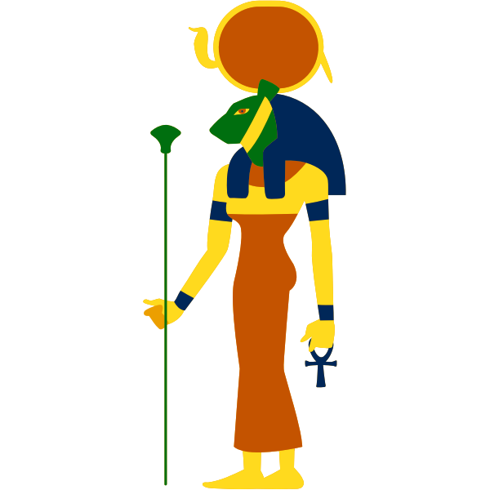
Sakhmet
Sakhmet is a warrior goddess as well as goddess of healing, she is shown as a lioness. She was seen as the protector of the pharaohs, and she led them in warfare. Sekhmet was said to breathe fire.

Slide 5
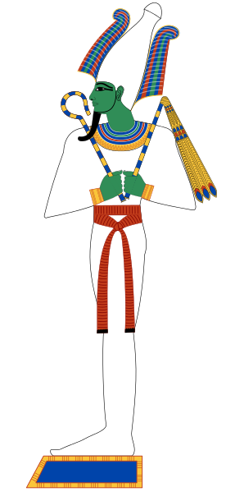
Osiris
Osiris was the Ancient Egyptian god of the dead. Osiris ruled the world of men/women after Ra left the world to rule the heavens. He was murdered by his brother Set, who later dismembered his body and scattered the remains. The grieving Isis reassembled the parts and magically brought him back to life. Since he was the first living thing to die, he subsequently became the lord of the dead. His death was avenged by his son Horus, who defeated Set and cast him out into the Western Desert.

