Slide 1
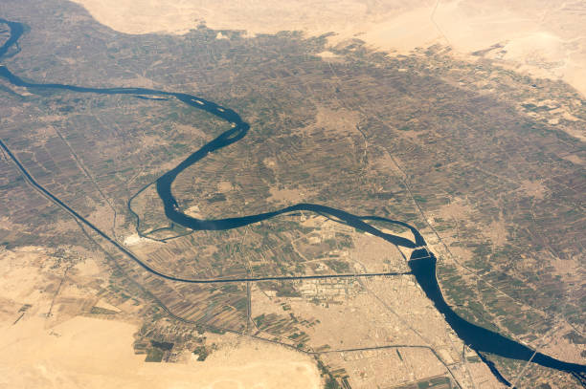
The River Nile Past And Present
The river Nile Past And Present

Slide 2
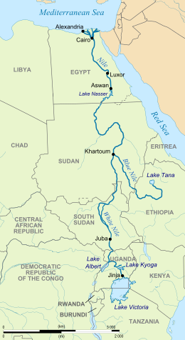
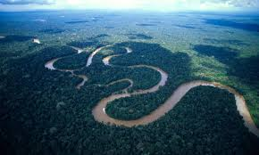
Map of the Nile/Location
Fun facts:
Did you know the Nile can be seen from space because of the street light near it!☺
The source of the Nile can be found in Lake Victoria.
The mouth of the Nile is in the Mediterranean Sea.
The Nile is at least 30 million years old!☺
The average depth of the Nile is 8-11 meters.
The Nile is in Africa.

Slide 3
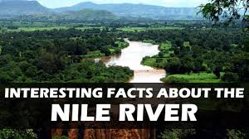
Facts about the River Nile
The Nile River is the longest river in the world.
The River Nile is also the longest river in Africa.
It is sometimes called The Father of all African rivers.
Although it is generally associated with Egypt, only 22% of the Nile’s course runs through Egypt.
It rises south of the Equator and flows north
through northeastern Africa and ends up in the Mediterranean Sea.
The Nile river is at least 30 million years old.
The Nile receives its name from the Greek Neilos, which means a valley or river valley.

Slide 4
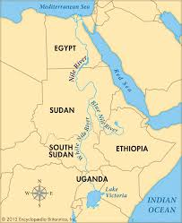
Where does it travel – map
The River Nile is in Africa. It originates in Burundi, south of the equator, and flows northward through north-eastern Africa, eventually flowing through Egypt and finally draining into the Mediterranean Sea.
It also flows through Uganda and Ethiopia.
It’s mouth is in Egypt were it enters the Mediterranean Sea
It’s source is in Burundi, central Africa

Slide 5
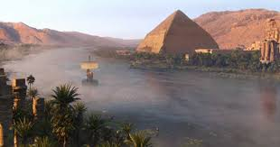
What was the Nile like in ancient times?
The Nile has played an important part in the creation of Egypt, a process which started about five million years ago when the river began to flow northwards into Egypt.
The Milky Way was considered a mirror of the Nile and it was believed the sun god Ra drove his ship across it.
Besides swimming, the people enjoyed water jousting, in which two-man teams in canoes, a fighter and a rower, would compete trying to knock each other's fighter out of the boat.
Another popular river sport was boat racing.
The Nile River has nourished the fertile valleys of Africa for millions of years, and is still important for transportation.

Slide 6
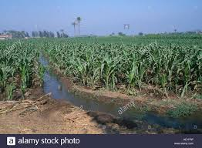
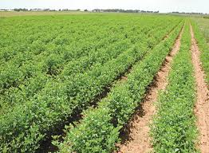
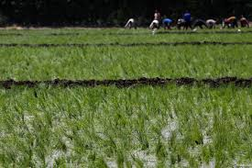
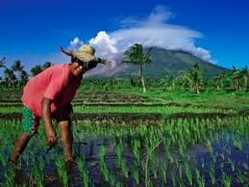
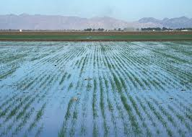
Physical features and human effects
The most important thing the Nile provided to the Ancient Egyptians was fertile land. Most of Egypt is desert, but along the Nile River the soil is rich and good for growing crops. This meant that the Nile was the source of life for the Egyptians. They planted different crops such as wheat, flax and others along its banks and in the delta as well.
Today, the river continues to serve as a source of irrigation, as well as an important transportation and trade route.
.
One human impact today, on the Nile River is that of pollution. Sewage has been dumped into the river by local residents as a result of poor sanitation. The food surrounding the area is treated by different chemicals which have great impact on the river’s level of water pollution.

Slide 7
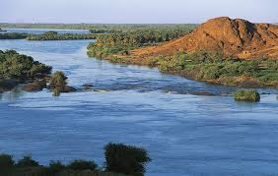
Characteristics of the River
The Nile River is the reason that the ancient Egyptians developed their civilization. The surrounding areas of Egypt are desert and the Nile River brought water and rich soil that could be used to grow crops.
The Nile river is filled with narrow cliffs, boulders, and wild rapids . It runs through a narrow, green valley of Egypt and then branches out over an area of soil at the Mediterranean Sea.
.
In Egypt, the River Nile creates a fertile green valley across the desert.
The average depth of the Nile is between 8 and11m. Large ships cannot use it as it is not deep enough, however smaller cruise boats I can.

Slide 8
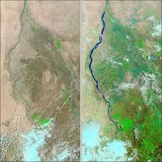
How has the land use/patterns changed over time?
In Egypt, the River Nile creates a fertile green valley across the desert. It was by the banks of the river that one of the oldest civilizations in the world began. The ancient Egyptians lived and farmed along the Nile, using the soil to produce food for themselves and their animals.
In ancient times, the Nile protected Egypt from outside armies. The cataracts blocked enemy boats from reaching Egypt since large ships could only travel the last 650 miles. The delta marshes offered no harbours for invaders. The deserts also kept armies away because of the heat.
Before
After

Slide 9
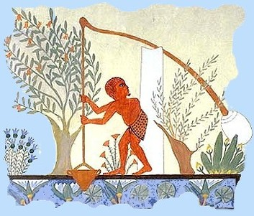
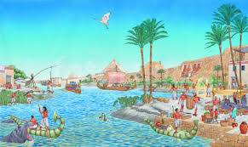
Who and how do people use the Nile and its surrounding areas?
Ancient Egyptians used to live near the Nile but now ordinary people live near it.
People use the river Nile in many different ways such as: fishing [a food source], drinking, swimming [a leisure use], a trade route, growing crops [a farming use].

Slide 10
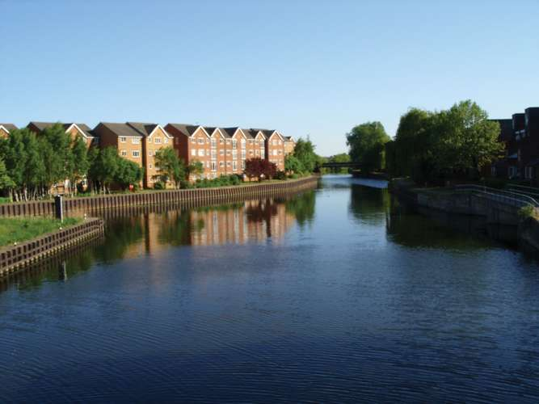
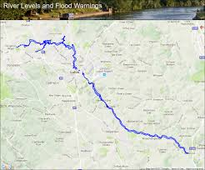
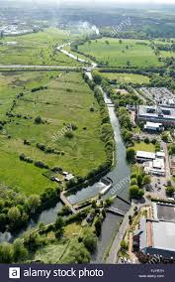
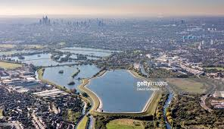
Facts about the River Lea
The River Lea is a river in England.
The River Lea starts in the Chiltern Hills and ends in the Celtic Sea It flows for 46 miles (74 km) east.
In comparison, the Nile is l6,650 kilometers long.
The Lea Valley was for years the industrial centre of London and home to many inventions.

