Slide 1
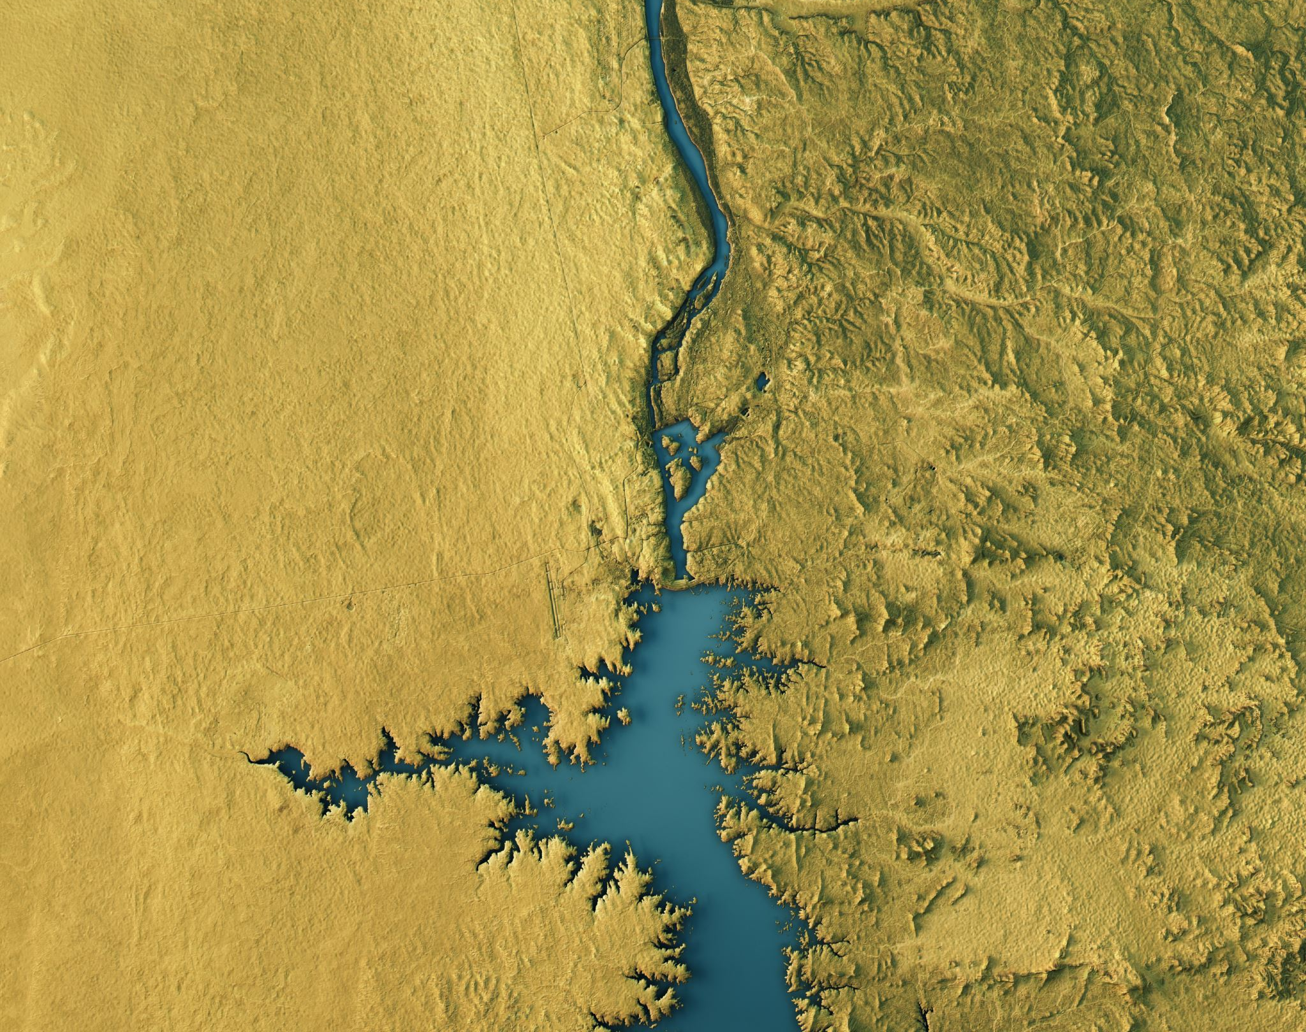
The Nile
Have you ever wondered how the Egyptians survived in a scorching desert? The history behind the world’s longest river? Well wonder no more! This short PowerPoint Presentation is the key to unlocking almost endless knowledge!

Slide 2
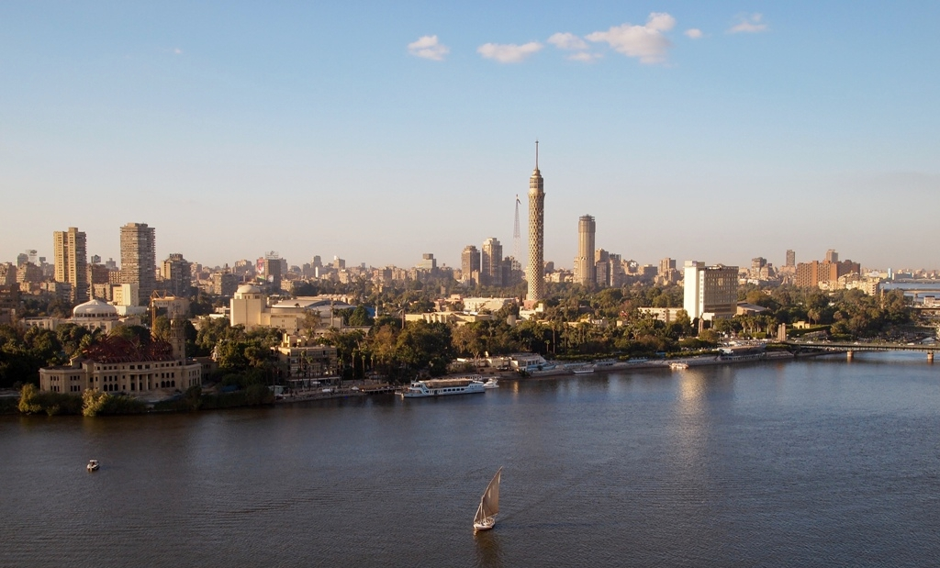
The Nile: How it is used today
The Nile today is used as a settlement. It is a perfect place to live as the river provides food, water and transport. Of Egypt’s estimated population of 102million, ninety-five percent live on the banks of the Nile.

Slide 3

The Nile: How it was used long ago
Around 5000 years ago, during the Egyptian era, the Nile was used to grow crops. The land in Egypt was not suitable for farming as it was too dry, but when the yearly floods came, they left a rich black soil, also known as kemet, which the Egyptians used to fertilize their crops. The Nile served as a source of food, water and transport. As well as that, the granite on the riverbanks provided material for the building of pyramids. The Egyptians couldn’t have survived without the nile.

Slide 4
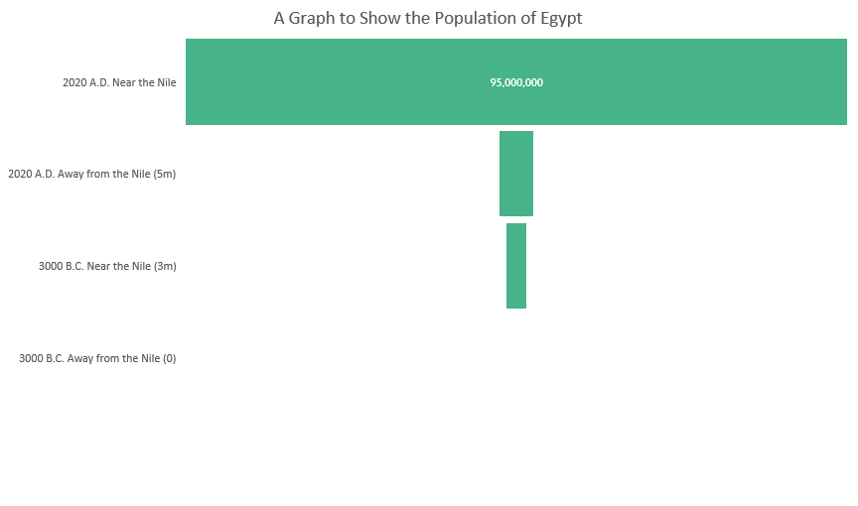
The Nile: Population
The population away from the Nile in Egypt has never been great, look at the graph to the right if you don’t believe it!

Slide 5
The Nile: Countries
Although the Nile is usually associated with Egypt, it travels through eleven countries, Sudan, South Sudan, Eritrea Kenya, Ethiopia, Burundi, Rwanda, The Democratic Republic of the Congo, Uganda, Tanzania and Egypt. The graph shows the percentage of the Nile Basin in each of these countries.

Slide 6
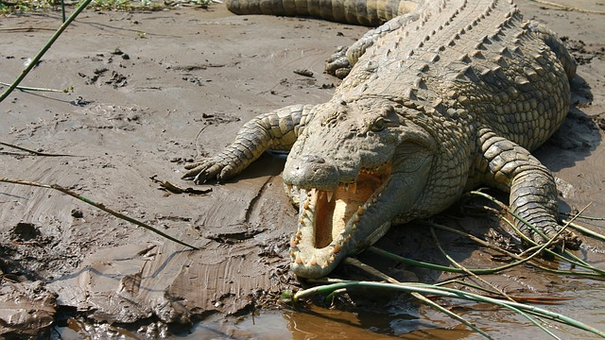
The Nile: Wildlife
The Nile is home to vast numbers of creatures, with most of these being reptiles and fish. The Nile is also home to many other creatures, including hippos, rhino and small birds.

Slide 7
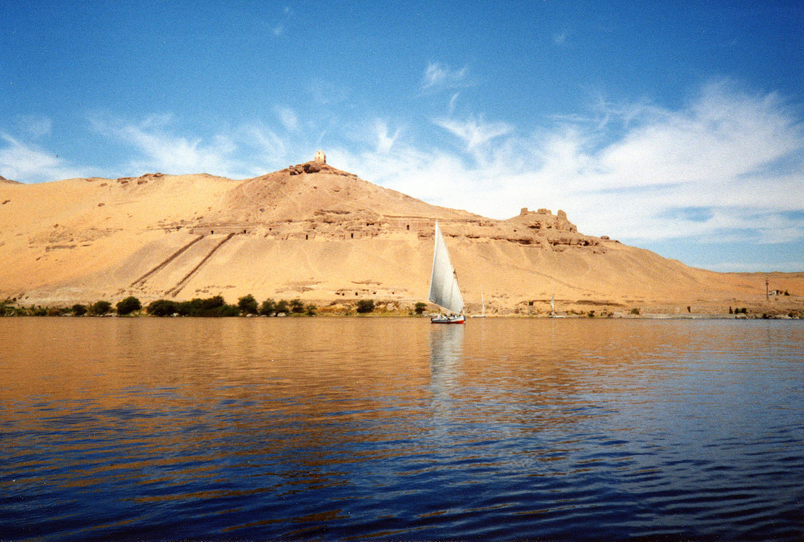

Thank you for watching this PowerPoint and I hope I have taught you something new.

