Slide 1
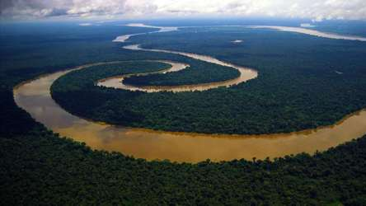
THE RIVER
NILE

Slide 2
How long and wide is the river Nile?
The Nile is 4132 miles long.
The Nile is 150 miles wide!
The Thames is 215 miles long which is 3917 miles shorter than the Nile.

Slide 3
How old is the river Nile?
The river Nile is over 30 million years old!
The Thames is 7000 years old.
😮

Slide 4
Where is the mouth and source of the Nile?
The mouth of the river Nile is in Egypt and the source is in Ethiopia.
People debate where the source is.
Did you know that there are two rivers that join up to make the river Nile, the Blue Nile which is in Ethiopia and the White Nile is in North Sudan.

Slide 5
What does the landscape look like around the Nile?
Around the Nile there are lots of plants and houses because the Nile floods every year. This means the soil is good for farmers crops to grow. There is lots of sand where the Nile does not flood to.

Slide 6
Where did the river Nile get its name from?
The Nile got its name from the Latin word Nilus, which means river valley.

Slide 7
What was it like In ancient times around the Nile?
They used a plant called Papyrus which grows by the Nile that they made into boats.

Slide 8
What are the key features of the upper, middle and lower course of the Nile?
In the upper course of the Nile there is a lake called Lake Victoria, which people say is the source.
In the middle course of the Nile it is quite small and is surrounded by desert.
At Cairo, which is in the lower course, the Nile splits into three distributaries which flow across the wide Delta into the Mediterranean Sea.

Slide 9
HOW IS THE RIVER USED TODAY?
Humans use it as their water supply and they also use it to grow their crops as they don’t have much rainfall.
The Nile provides drinking water for animals.

Slide 10
How did the ancient Egyptian use the Nile differently from today?
The Egyptians are getting less of the Nile because other countries like Ethiopia are using it more.
But overall they don’t use it much differently from ancient times.

Slide 11
How did the ancient Egyptians use the Nile to help build pyramids and other buildings?
The Nile helped because people could use it to bring stones to build the pyramids by boat. That’s why they built them close to the Nile.

