Slide 1
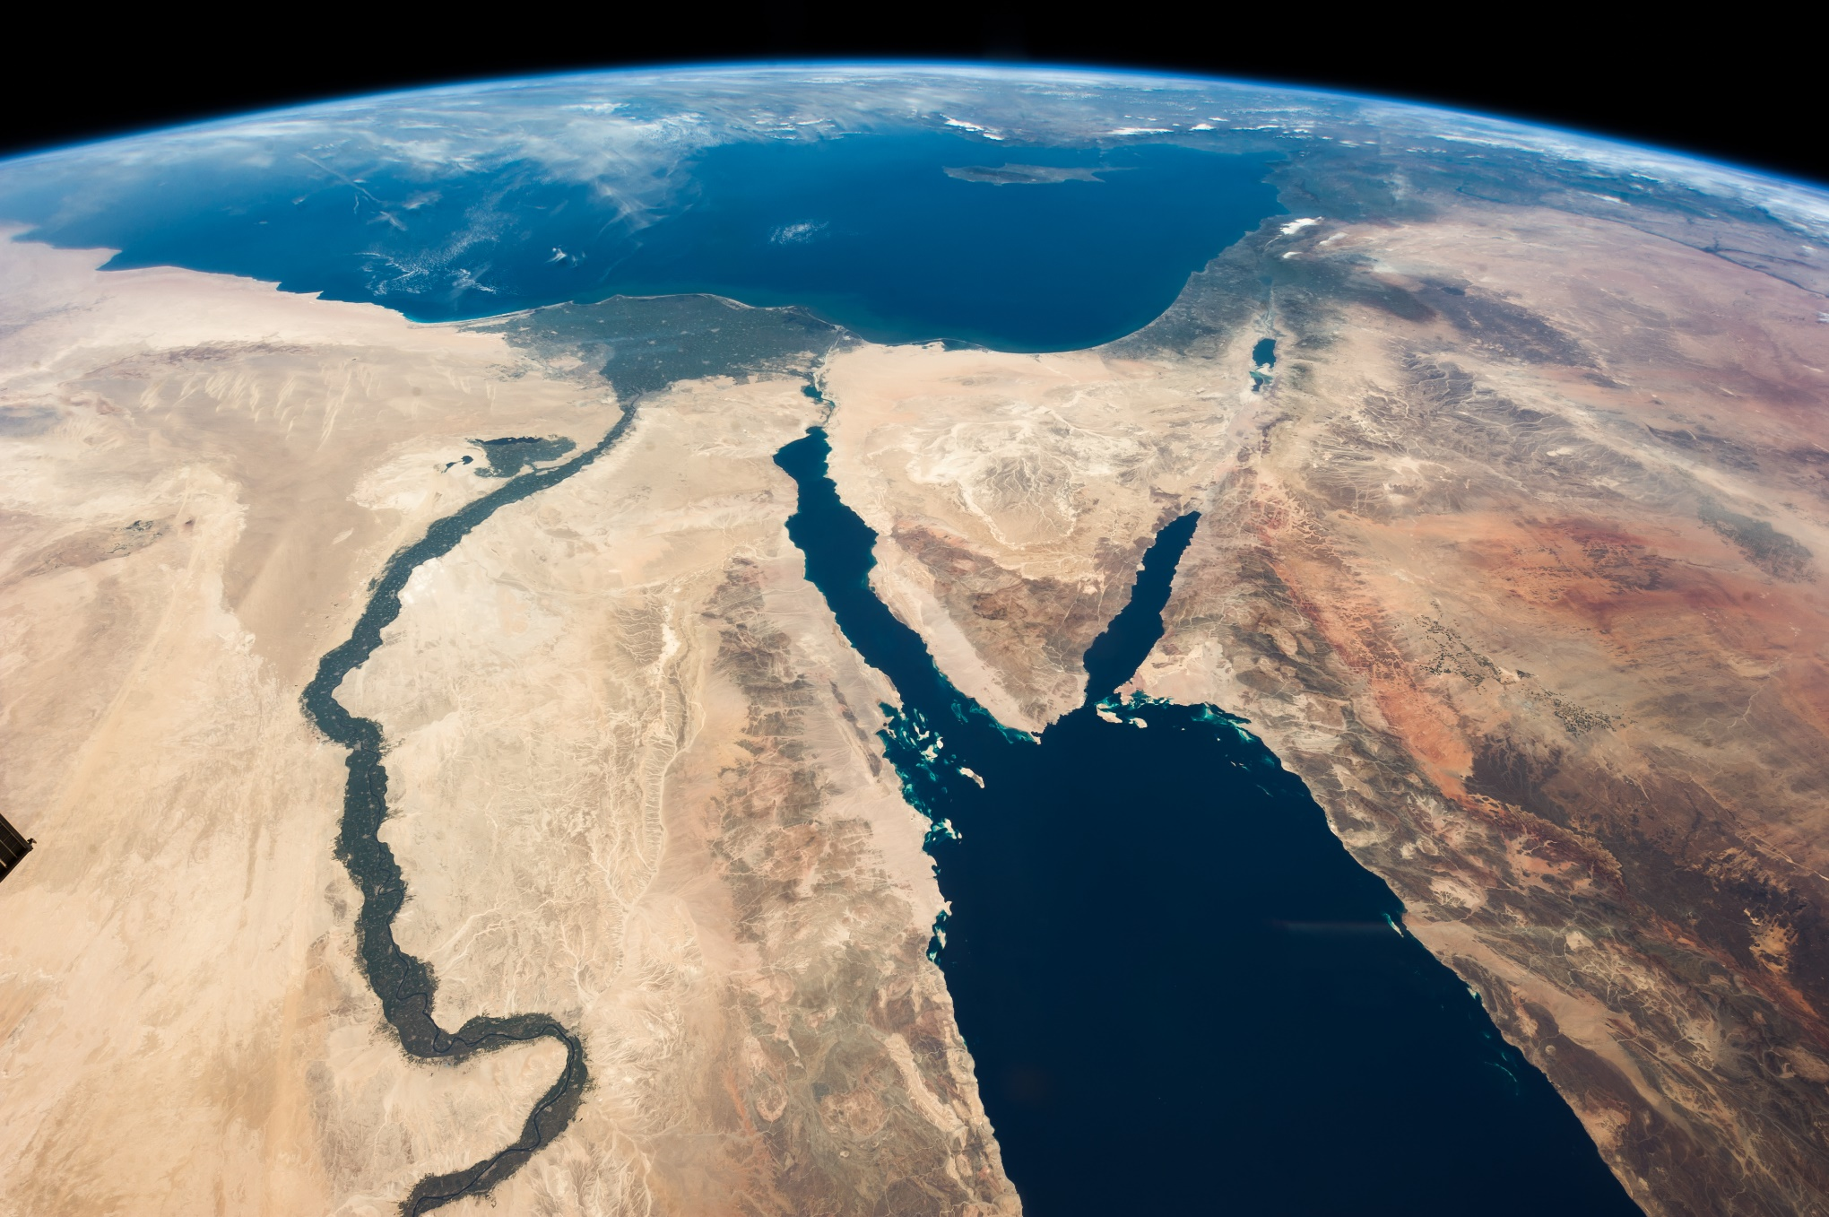
The Nile
Serkan Savasci

Slide 2
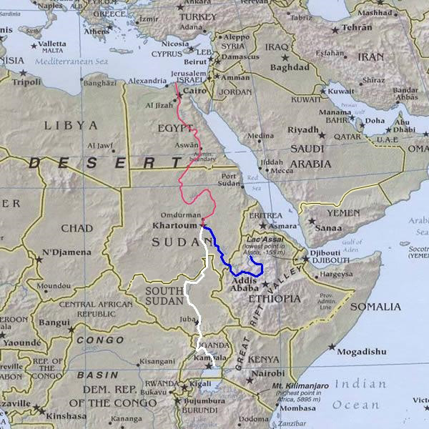
Introduction
The Nile is a river that runs through the African countries of Egypt, Sudan, Tanzania, South Sudan, Eritrea, Ethiopia, Kenya, The Democratic Republic of Congo (DRC), Burundi, Rwanda and Zimbabwe.
An unusual fact about the Nile is that it has two main tributaries, each with its own source; the Blue Nile which starts in the mountains of Ethiopia and the White Nile which flows from Lake Victoria.
There have been debates about which is the true source but neither has been proven so both are considered sources of the Nile.
Many ancient civilisations were created along its banks like the Nubians but no civilisation that developed on the Nile would be as advanced or as famous as the Ancient Egyptians…

Slide 3
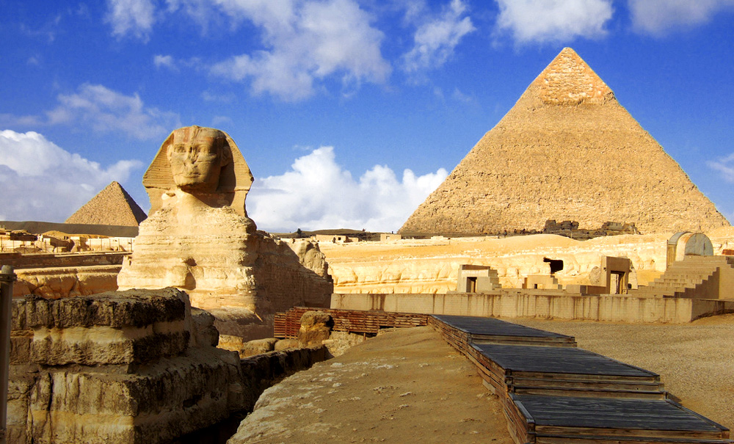
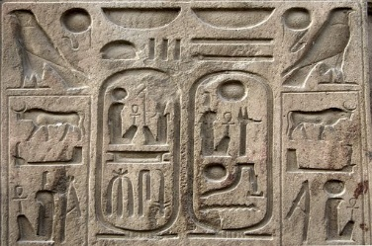
Who Were The Ancient Egyptians?
The Ancient Egyptians were a civilisation that existed for 3000 years, from 3000 BC to 44 BC. They were arguably the most advanced civilisation up until that time, even going as far as creating their own written system, called Hieroglyphics.
One of the reasons we know so much about their world is as a result of their expert engineering and building skills, as their breath-taking monuments, temples and tombs which are covered in writing and images that depict daily and ceremonial life still survive to this day.
Ancient Greeks recorded what all of the symbols that made up the Egyptian language meant on a rock named the Rosetta Stone. Little did they know that current civilisations would discover and use it to find out more about the ancient society.
The Ancient Egyptians also invented things we still use today, such as:
Boats
Wigs
Mirrors
Shaving razors

Slide 4
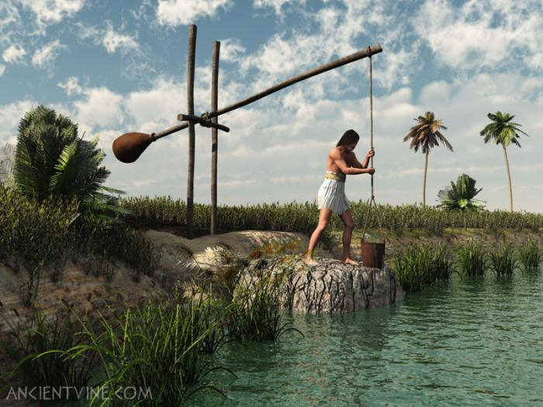
How Did The Ancient Egyptians Benefit From The Nile?
The Ancient Egyptians couldn't have existed without the Nile. As Ancient Egypt was a dry place with barely any rainfall, the Nile provided them with a permanent source of water to bathe, wash clothes with and drink. It also gifted the Egyptians with fish that they caught with nets and spears and papyrus which they made paper from. The Egyptians also used the river for trading and transport as it was the fastest way to get from place to place. The Nile was also key to the construction of the pyramids and many of the temples and statues built throughout Egypt, as the great limestone blocks were quarried from Aswan, in the south of the country and had to be transported north which would have been impossible without the river.
One of the main aspects that helped the Egyptians thrive was the annual flood. The flood would give them fertile soil for a period of time, in which the farmers grew crops like flax that was made into linen, grain which was another source of food alongside wheat, tomatoes, potatoes, onions, sugarcane, melons and pomegranates. The Egyptians also grew Barley, which they brewed beer from.
The Egyptians thought the Nile was a gift from the gods and even had their own god of the Nile, Hapi. He was usually depicted with blue skin, a bulging belly and two breasts, symbolising a fertile mother as the Egyptians viewed the Nile as sacred and life-giving.

Slide 5
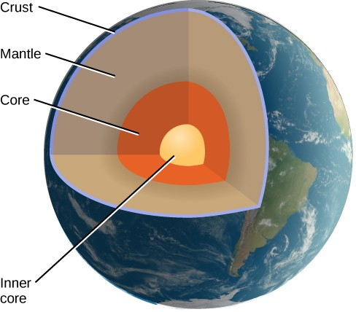
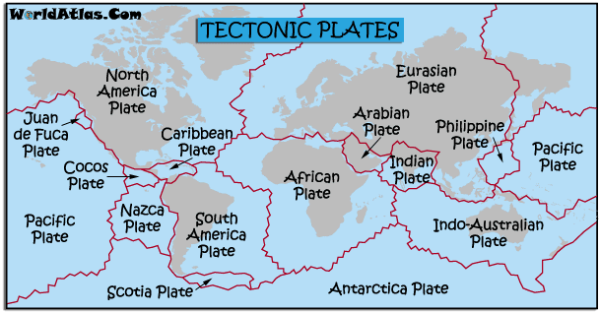
The Geology of the Nile
From natural changes to man made ones, the river Nile is always evolving. The Nile was formed at least 30 million years ago from the motion of the Earth’s mantle, a layer of magma underneath the crust.
Prior to 2019 scientists believed the Nile was 6 million years old however, Claudio Faccenna and his team of experts analysed sediment from the Nile and compared the age of the sediment to volcanic rock the team found on the Ethiopian plateau. Both were around 20 to 30 million years of age, causing them to believe that the Nile formed around the same time as the plateau.
After this Faccenna and his team were interested in finding how the aforementioned theory could be proved. His team created a simulation that repeated 40 million years of Earth’s tectonic plate movement (the theory that suggests Earth’s exterior is in pieces that move around and slide over the mantle). The experiment showed that the rise of hot rock in the mantle pushed up the ground, forming the Ethiopian highlands and pulled the ground down in the north. This created a north running slope which forms the river bed, the reason why the Nile flows south to north.

Slide 6
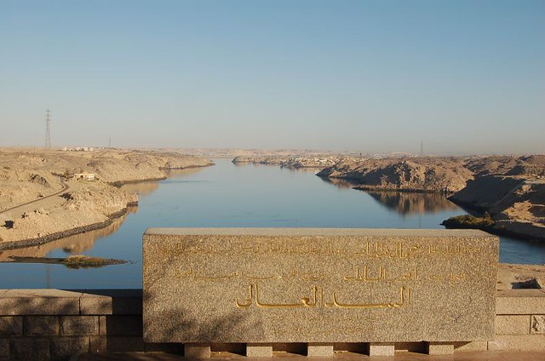
The Geography of the Nile
(and how it compares to the Amazon)
The mouth of the Nile is the Mediterranean sea.
The Nile is 7.5km at its widest point compared to the Amazon which is 11km.
The Nile is the longest river in the world at 6650km compared to the Amazon which is 6,400km (250km shorter).
The flow rate of the Nile is 2,830 cubic meters per second compared to the Amazon, which is much faster at 209,000 cubic meters per second.
The Nile’s depth is 8-11m while the Amazon is a staggering 100m deep.
The Amazon’s biggest man made dam is called Tucurui and is located adjacent to the Amazon basin in the north of Brazil, the largest rainforest dam ever built. The Nile’s, smaller but more famous, Aswan dam in the south of Egypt was built between 1960 and 1970 and meant that the annual Nile flood ceased, instead lake Nasser, the reservoir that was formed as a result of the dam, fills and provides irrigation for both Egypt and Sudan, generates hydroelectric power and helps improve navigation.

Slide 7
Nile Plants And Animals
There are thousands of species of animals and plants living in and around the Nile. At 6,650km in length, the Nile flows through a large number of habitats, ranging from the lush rainforests along the Nile-Congo divide to the dry deserts of Sudan, which results in a diverse range of species. To follow our 10 interesting examples:
Blue Egyptian Water Lily the ‘blue lotus’ – one of the Nile’s most famous plants with its green leaves, colourful petals and link to the Ancient Egyptians, being depicted in many hieroglyphs.
Banana Plants – found in the tropical rainforests upstream.
Hippopotamus – It used to be found throughout the Nile region, but now only lives in the swampy area in South Sudan.
Monitor Lizard – At up to nearly 2m in length the Nile River basin is home to one of the largest lizards in Africa.
Nile Crocodile – Most common creature to be found in the Nile. It is the second largest living reptile in the world (second to the Saltwater Crocodile) growing up to 6m in length. Crocodiles have inhabited the Nile since ancient times; Sobek had the head of a crocodile and was worshiped as the god of the Nile who brought fertility to the land.
Nile Perch – a huge fresh water fish found in the lower Nile river system.
Papyrus – famously used by the Ancient Egyptians to make paper from, this plant can still be found all along the Nile.
Softshell Turtle – also found in the Nile River basin, its flat shell means it can swim rapidly.
Tigerfish – with dagger like teeth this fish is known for being aggressive even toward its predators, another huge freshwater fish.
Osprey – one of the many birds found along the Nile, it is a medium sized raptor (bird of prey) which mainly eats fish.

Slide 8
Issues Facing The Nile Today
As the climate changes, populations rise, air becomes more polluted and the planet warms, the amount of problems facing the Nile are growing.
Humankind is getting more and more technologically advanced and are discovering things, including how to irrigate the Nile. This breakthrough is helping farmers in Sudan turn the Nile’s deserts green. With the massive supply of water the river has, the Sudanese created a massive irrigation system, with the intention to make a canal that could help feed the population of Sudan. With the water from the canal, scientists have created hose systems in some areas of Sudan. Now, as there is green along Sudan’s part of the Nile, The farms are growing, among other things, alfalfa, which is a crop that helps feed the cows in the farms. The Sudanese also worked out that European cows produce 3 times as much milk as their own, and so began importing European cows to Sudan. A 22,000 acre farm called Awaha (the oasis) in Sudan has 2500 cows from Europe but has an aim of 10,000. Despite living in much cooler climates, the European cows are able to stay in Sudan thanks to technology that helps farmers keep the temperature lower in the purpose built sheds the cows live in. They use cooling fans to lower the temperature by 20 degrees Celsius. All of this farming uses a colossal amount of water.
Another major project going on is the Great Renaissance Dam. Located on an isolated stretch of the Nile, the dam, once completed, will be the largest hydroelectric power plant in Africa. It is also one of the most controversial building projects, as Sudan but mainly Egypt, who have 85 million people relying on the Nile and its life-giving water, are worried that the Great Renaissance Dam will give Ethiopia the power to control the flow of the Nile.
Climate change and pollution will also have its toll on the Nile. As Carbon Dioxide builds up in the atmosphere, more rain will fall, flowing down the Nile system, causing the water level of the river to rise. The average volume of flow is likely to increase, if the flow variation from year to year shifts too much, by 50%. The Nile is also heavily polluted by oil, making the water murky and unsafe to drink from. With the number of people who rely on the Nile at over 300 million the effects could be catastrophic.

