Slide 1
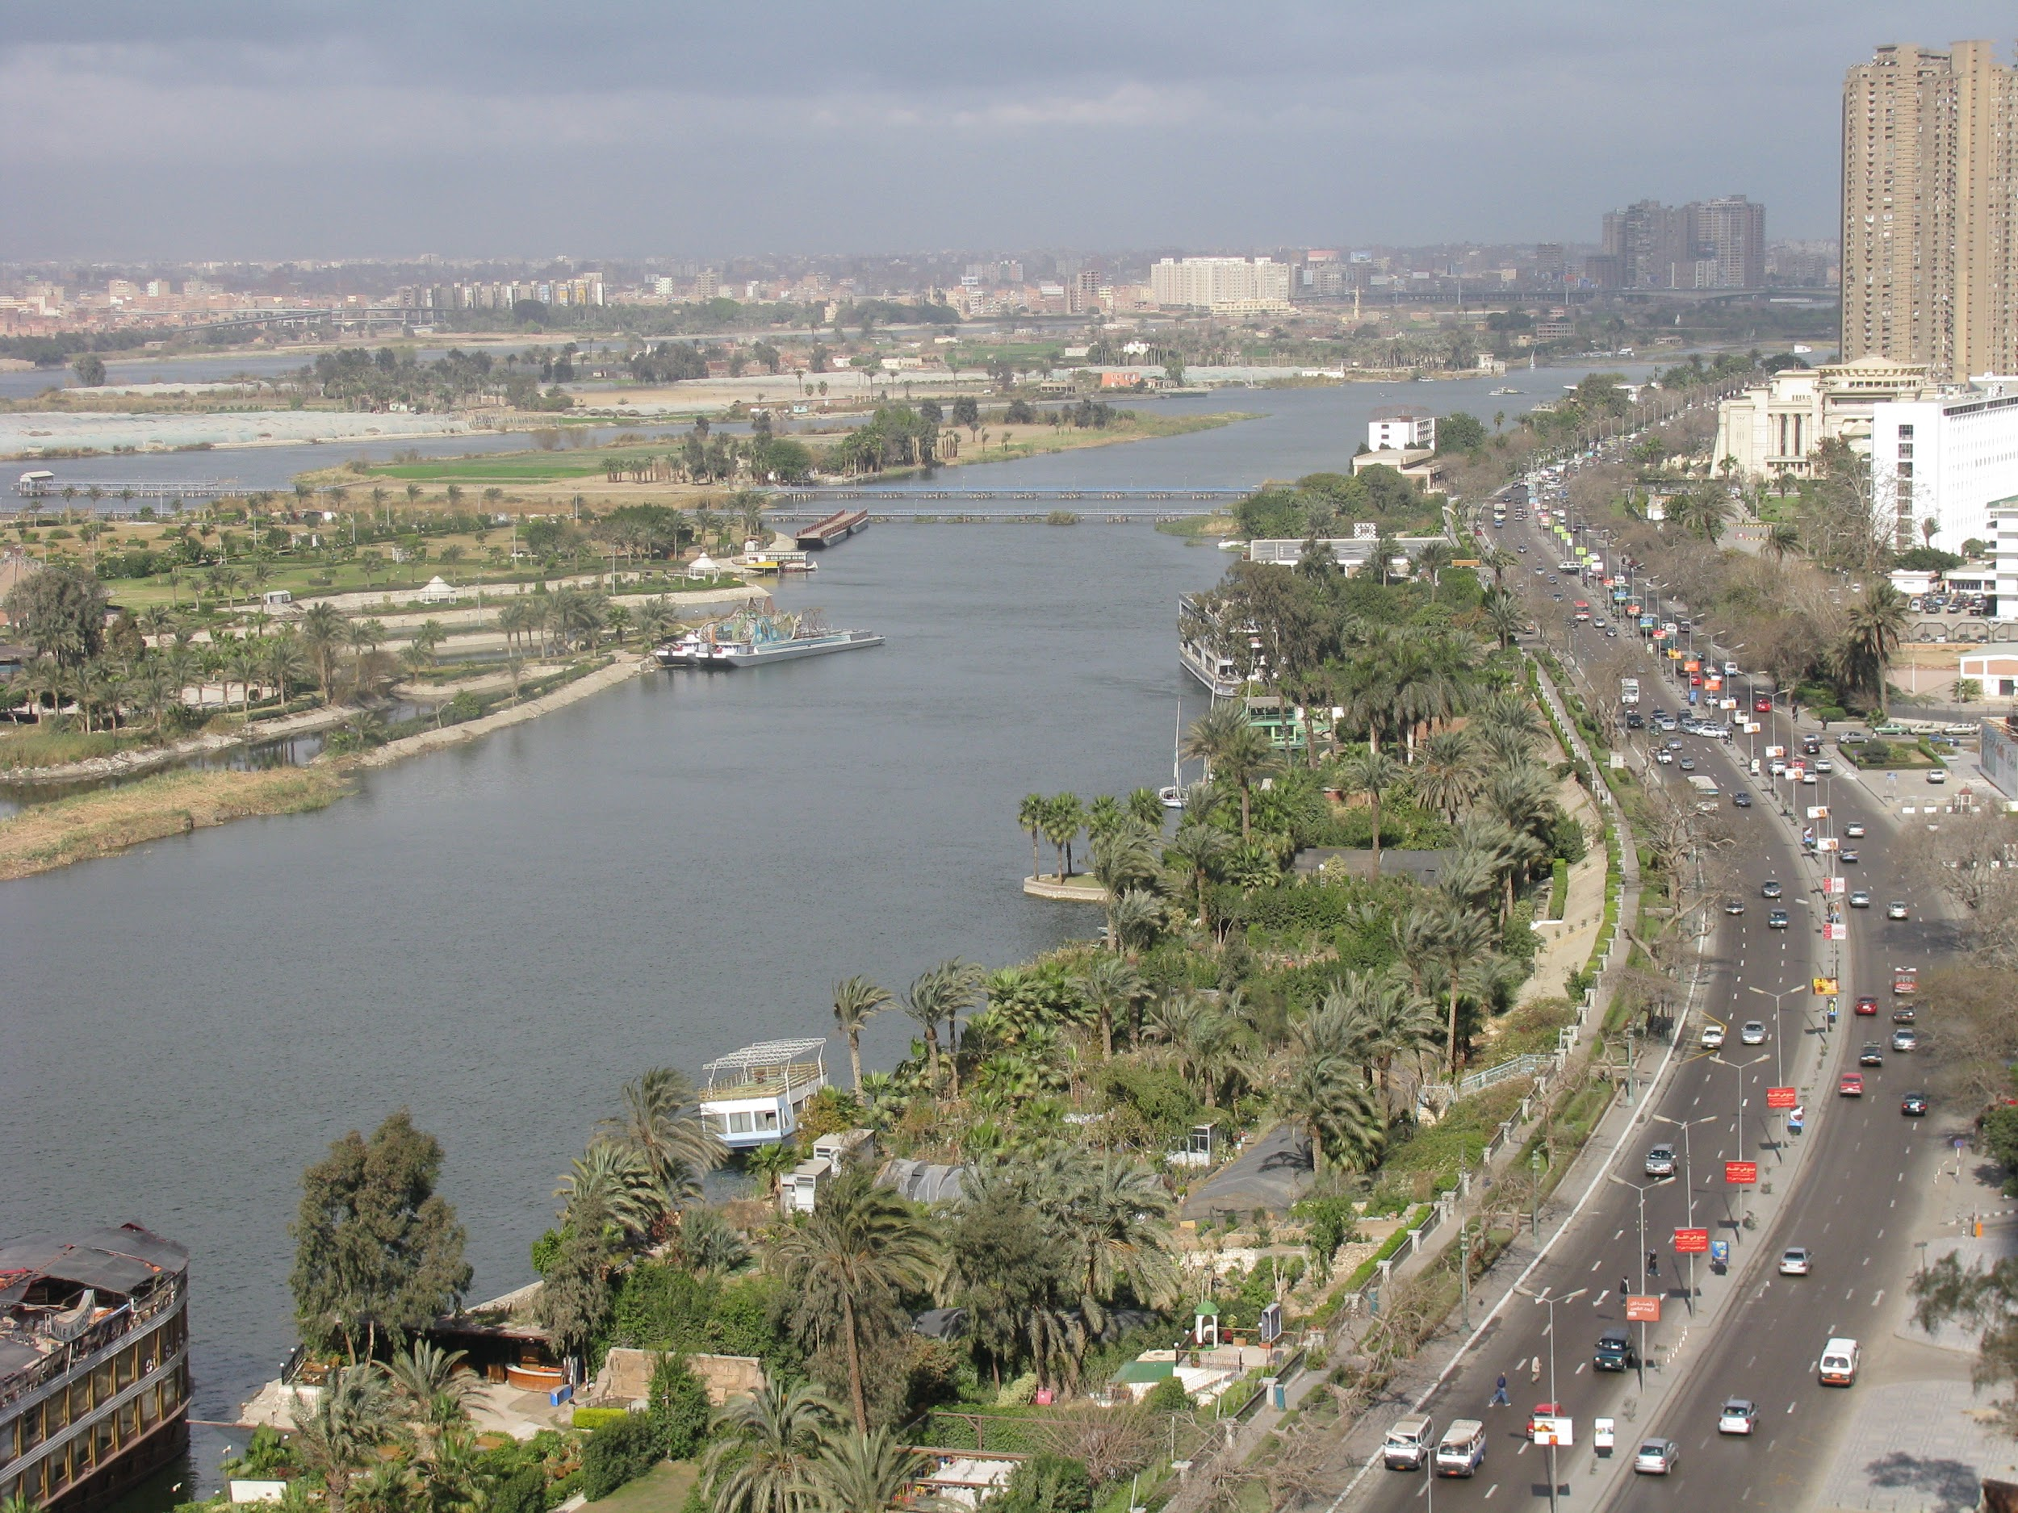
The River Nile
By Kitty Bull

Slide 2
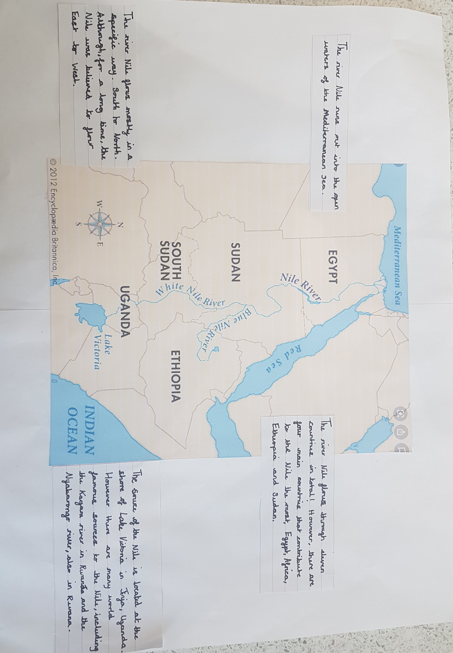
Key information about the River Nile

Slide 3
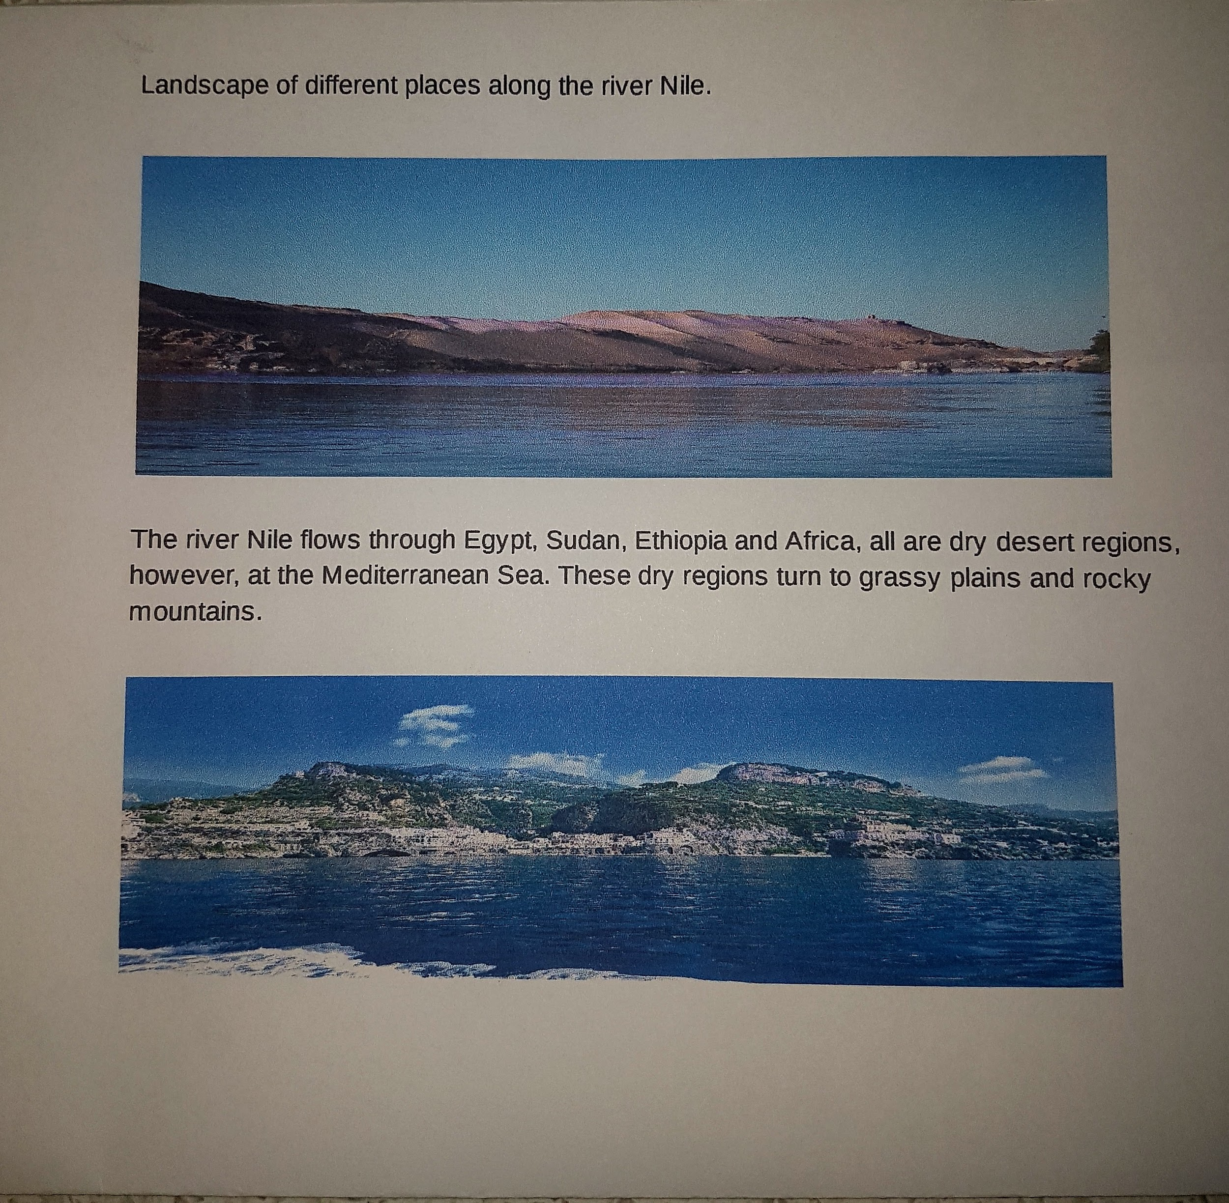

Slide 4
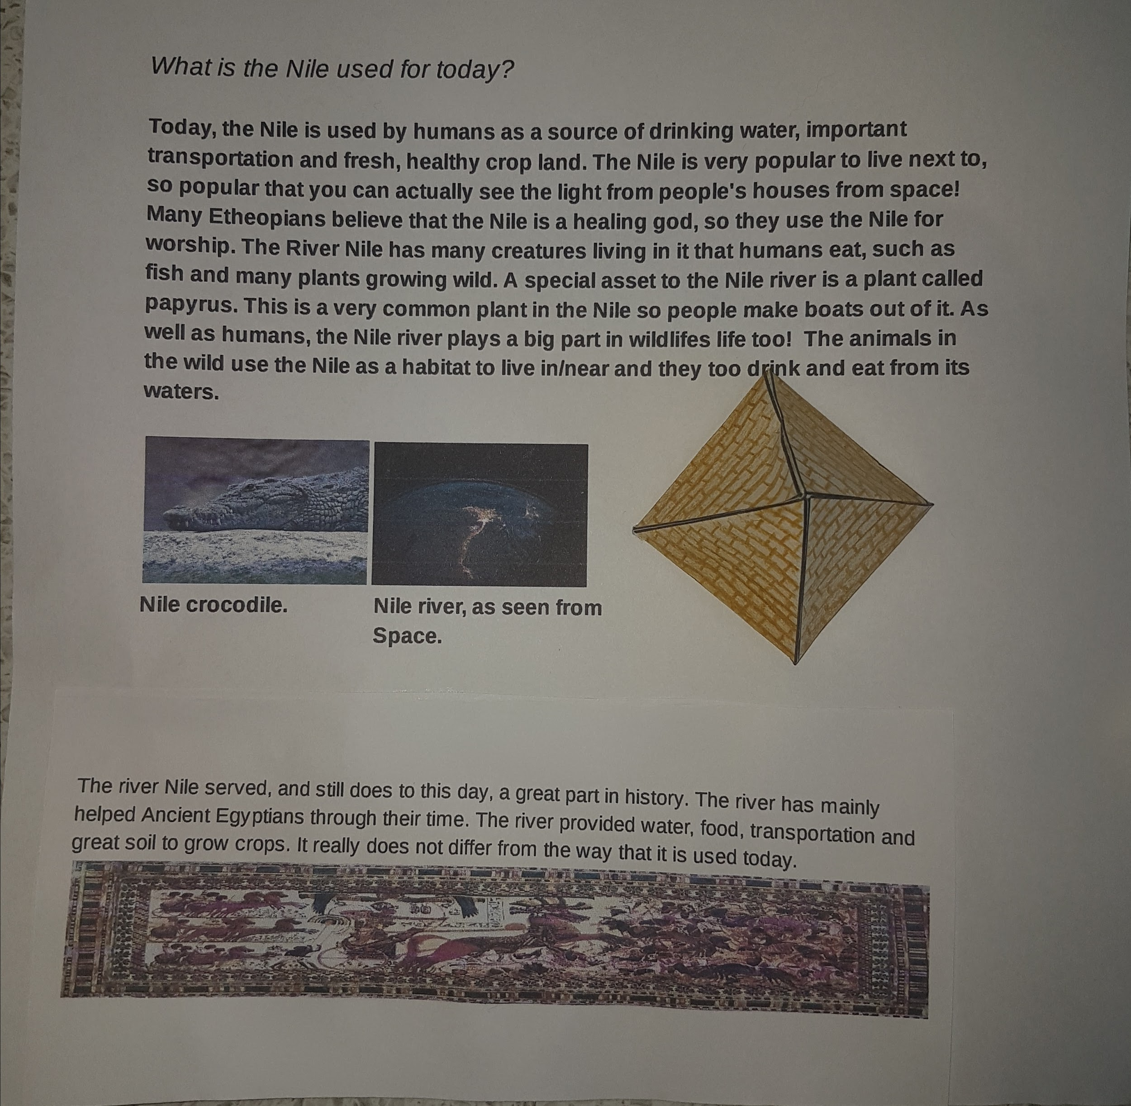
How does the Nile differ from when it was used in the Ancient times to how it is used today?

Slide 5
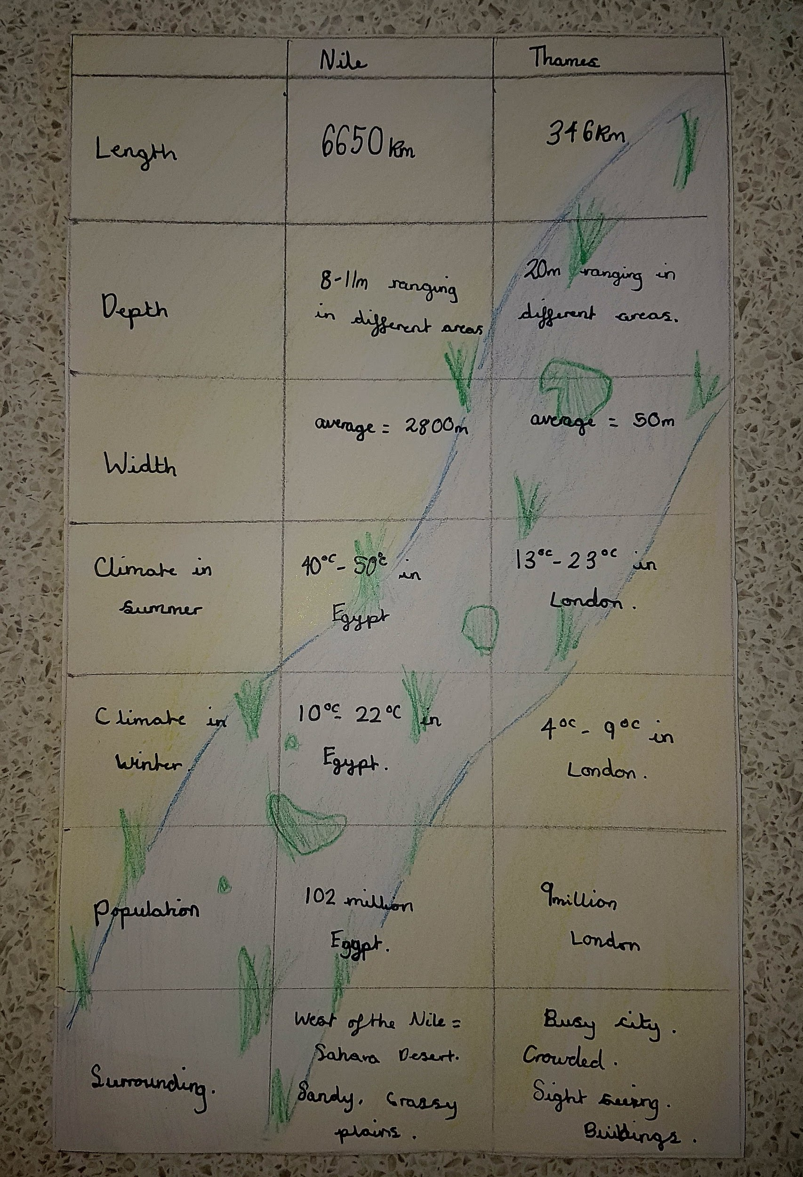
Comparing the River Thames with The Nile.

