Slide 1
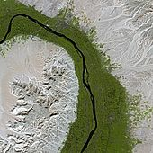
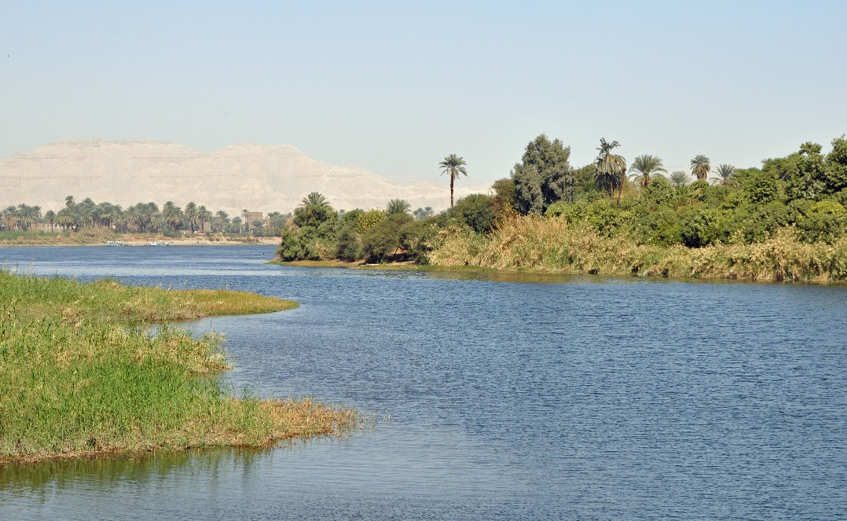
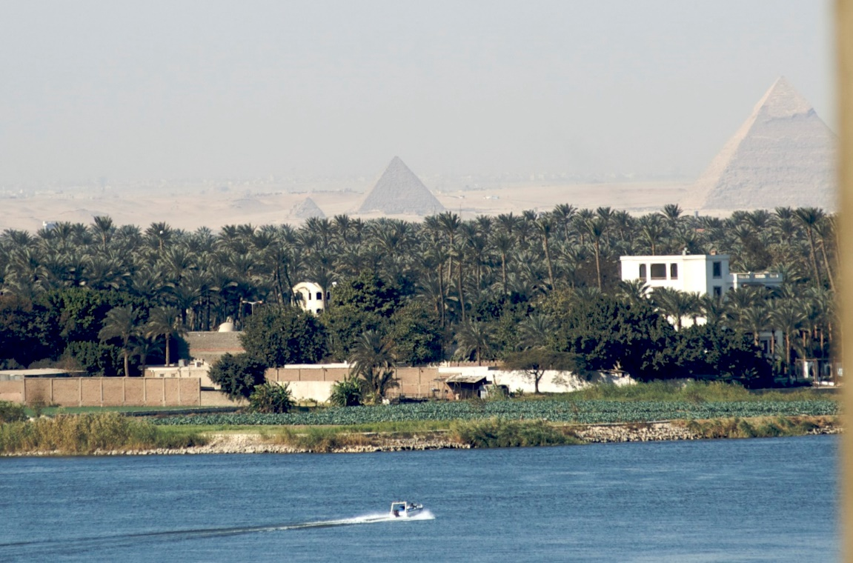
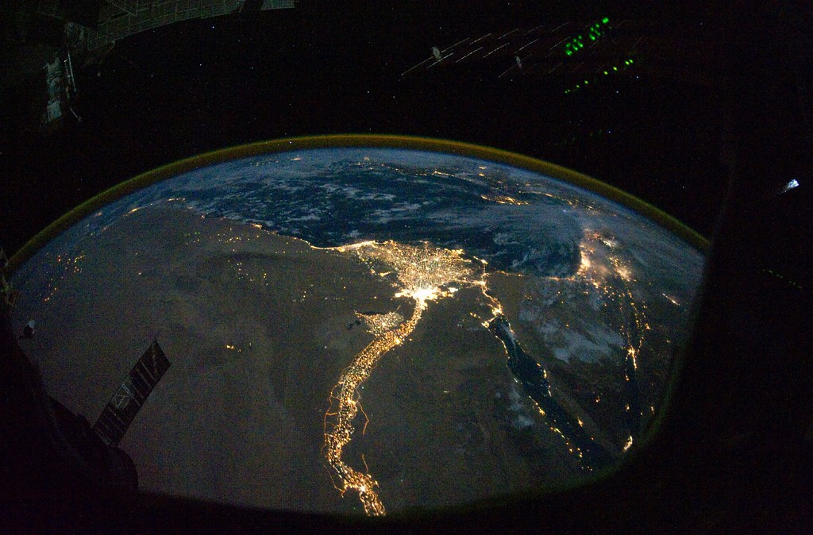
The River Nile
By Yasemen Savasci

Slide 2
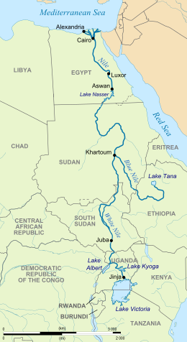
Where is the source of the Nile?
The River Nile has two main tributaries; the Blue Nile and the White Nile, lake Victoria flows into the White Nile and travels north until it joins the Blue Nile, near Khartoum, the capital of Sudan. The Blue Nile originates from springs in the highlands of Ethiopia.
The true source of the Nile has been debated for years as no one agrees exactly where the river begins.
It is difficult to decide which tributary is the main source of the Nile, on one hand the Blue Nile contributes most of the flow/ current however the White Nile is furthest away from the mouth of the Nile. In conclusion the evidence demonstrates that neither tributary is the main source of the Nile.

Slide 3
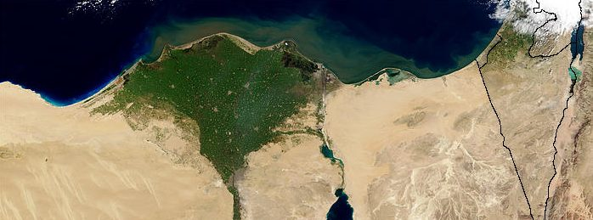
How many countries does the Nile run through and where is the mouth ?
The Nile is 6,650km long and is the longest river in the world. If you include the two tributaries, the main countries that the Nile runs through are: Egypt, Sudan, South Sudan, Ethiopia, and Uganda, but its drainage basin includes another six countries: Tanzania, Rwanda, Burundi, the Democratic Republic of the Congo, Kenya and Eritrea.
The river Nile flows, from South to North, at an average volume of 300 million cubic meters per day, it takes 3 months to travel from Jinja, Uganda (where Lake Victoria flows into the White Nile) to the Mediterranean Sea, a speed of 7mph.
As the river reaches the North of Egypt it slows and becomes the Nile Delta where it drains out into the Mediterranean Sea, the mouth of the Nile. The delta is one of the biggest in the world and covers 240km of the Mediterranean coastline.

Slide 4
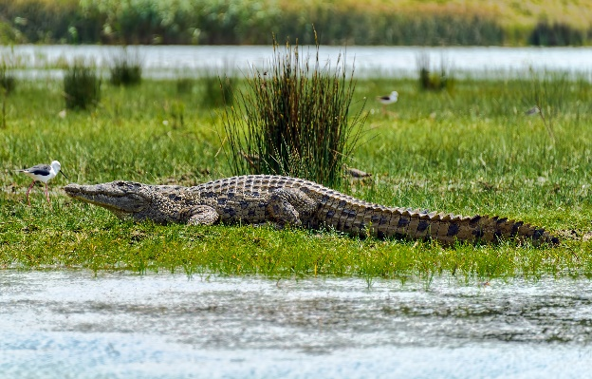
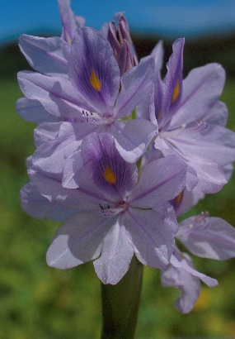
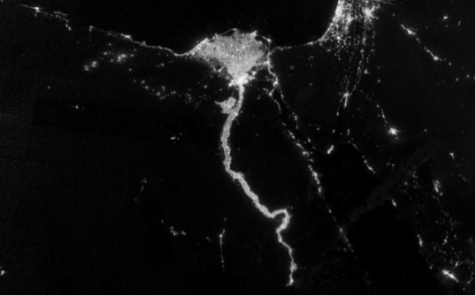
Which animals/ plants live around the Nile?
Animals:
Many animals live around the Nile such as: Hippos, soft-shelled Turtles, river snakes, Monitor Lizards, African Tigerfish and the Nile Crocodile which was around when the Pharaohs ruled Egypt thousands of years ago.
Plants:
Without the water provided by the Nile many plants could not survive for instance: Bamboo, Banana plants, Papyrus, and the Water Hyacinth which floats on top of water and sprouts purple flowers.
Humans:
People have been living round the Nile for many many years and because the population is so dense you can see the towns and cities that line the Nile from space!

Slide 5
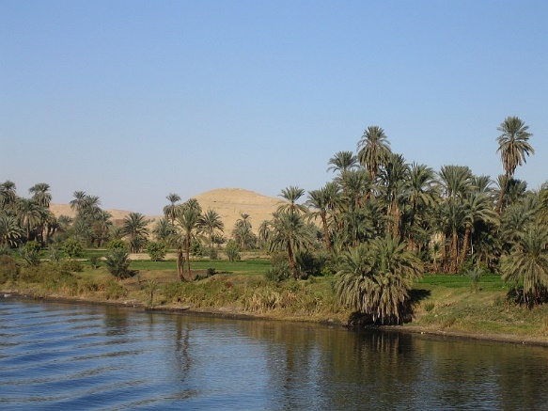
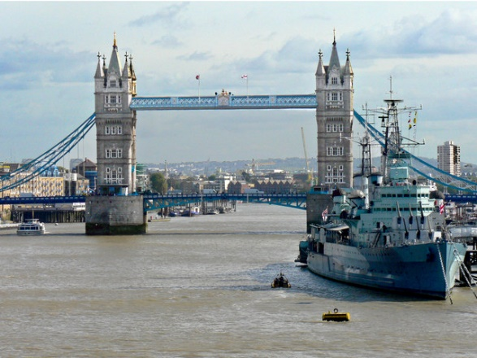
What are the similarities and differences between the Nile and the River Thames?
The Nile:
Length = 6,650 km long
Depth = 8 to 11 meters
Width = 2.8 km
Countries that it runs through = eleven
Used for = drinking water, fishing, farming, transportation and tourism. Generate electricity.
Climate = mild winters and boiling hot summers
How old = 30 million years old
The Thames:
Length = 346 km
Depth = 20 meters
Width = 18 meters
Countries that it runs through = one
Used for = cool the machines in power stations, transportation and tourism. Hydropower turbines creating electricity are being built/ proposed to replace the use of fossil fuels.
Climate = cold winters and mild summers
How old = 7,000 years ago

Slide 6
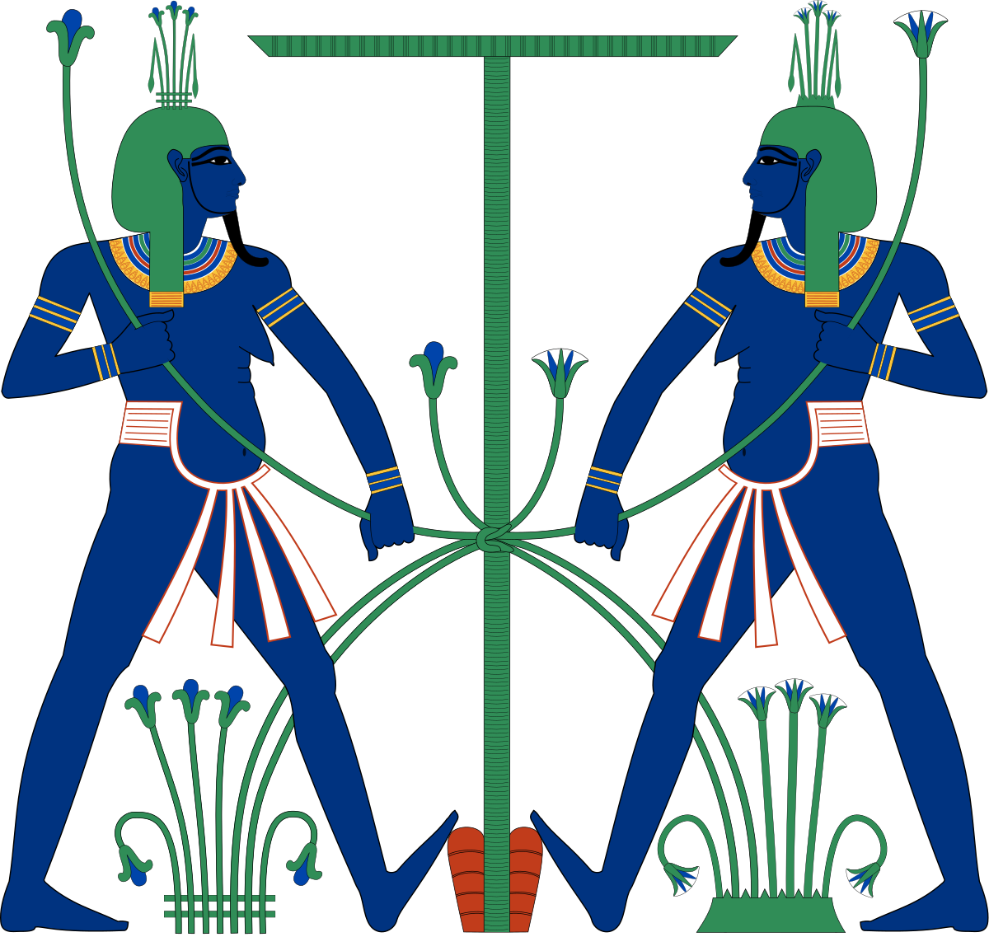
How did the ancient Egyptians benefit from the river?
When you mention the River Nile, most people think of Egypt and it’s fantastically preserved ancient civilisation and it is true that the ancient Egyptians could not have survived without the river.
Ancient Egyptians believed that the Nile was a gift from the heavens and even had a God, called Hapi, who was the God of the annual flooding of the Nile and was greatly celebrated among the people. He is generally depicted as having blue skin, a big belly, drooping breasts and a reed for his head piece. The fertility of the Nile was clearly evident in his appearance.

Slide 7
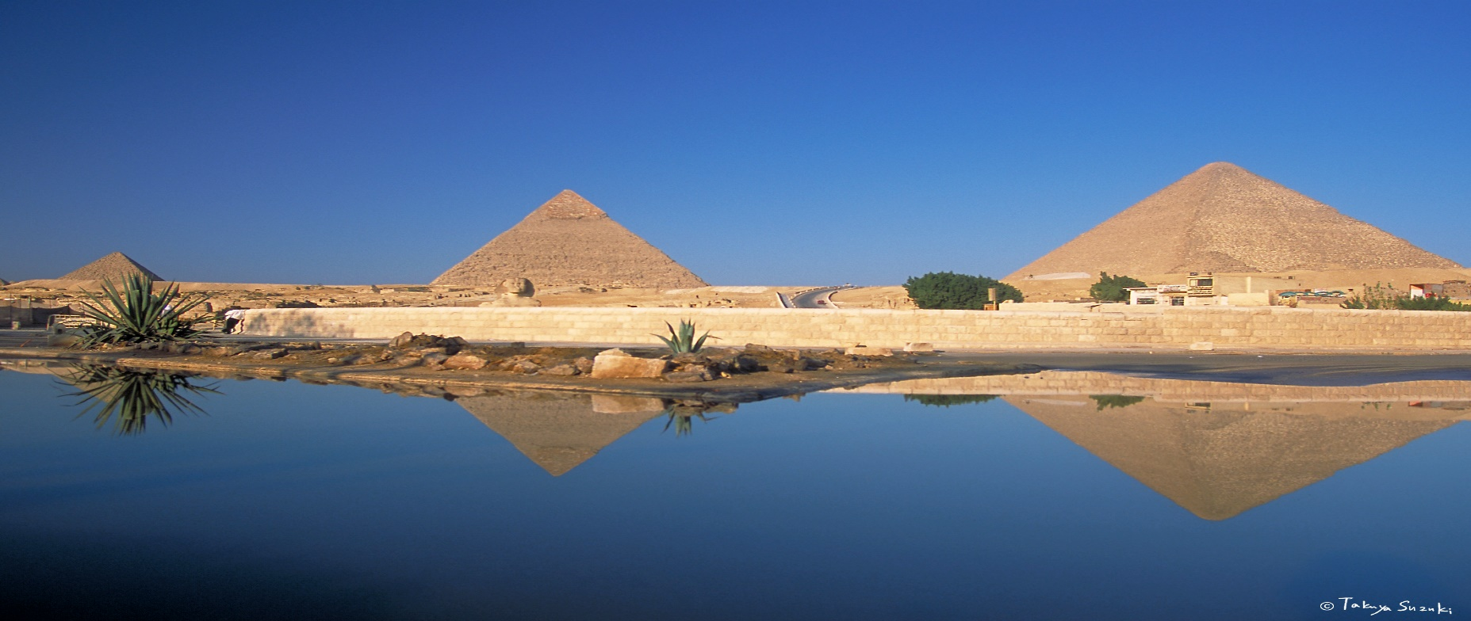
In ancient times the Nile flooded every year which made the soil along the banks and beyond perfect for farming.
The ancient Egyptians benefited from the river in many different ways, not only did it provide clean water for drinking and washing, they were also able to grow crops like wheat and barley, for food, as well as flax for clothes and papyrus for paper on the floodplain because the soil was packed with nutrients from the water.
Another important way they used the Nile was for transportation because it was a quick and efficient way to get from place to place. The 2.5 ton blocks of stone that were used to build the huge pyramids where quarried in Aswan, in the South of Egypt, and were transported to Giza (Cairo) in the North up the Nile, so without the river the pyramids may not have been built.

Slide 8
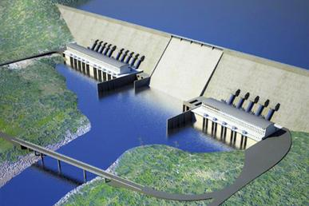
How is the river used today?
Because there are so many countries that the Nile runs through they dispute who has the rights to the Nile and who is able to harness its power. This has been going on for years and will carry on as long as humans inhabit the earth.
One of the biggest issues facing the Nile today is the construction of The Grand Renaissance dam which is being built in Northern Ethiopia to make electricity and when completed will be the biggest dam in Africa. Egypt and Ethiopia are in a heated debate with Sudan caught in the middle, the reason why Egypt does not like the idea is because it fears that the project will allow Ethiopia to control the flow of this mighty river.
In ancient times the Nile’s annual flood fertilised the land surrounding the river, however today, as a result of the building of the Aswan Dam, in the 1960’s, the flood no longer happens. Instead farmers use traditional methods (such as water wheels) or, more commonly, use modern technology to pump water onto their farmland.
The Nile Delta was traditionally the most popular place to farm rice, cotton and other crops, as water was plentiful and easy to access. However in recent years, sea levels in the Mediterranean have risen, increasing the amount of salt in underground water and soil, along with the pollution of irrigation canals and a rising population demanding more water has meant that this area had become increasingly difficult to farm.
Despite these problems the Nile still produces a wide variety of fruit, vegetables, grain, beans and fish to feed its people.
When finished the Grand Renaissance Dam will look like this:

Slide 9
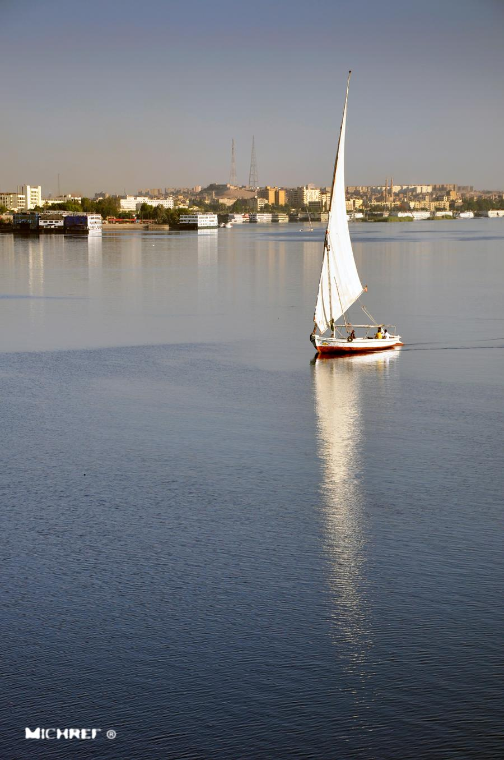
In Sudan the Nile is turning the dessert green, on a massive scale, they use 8 million gallons of water a day to water 22 thousand acres of land, that’s equivalent to 10,000 football pitches. Amongst other things, Sudan grows a plant called Alfalfa that is used to feed animals, which is mostly exported. Farmers in Sudan are rearing a European breed of cow and to keep them cool they use fans and water spray that reduce the temperature by 20 degrees Celsius so the cows can survive. They are breeding these cows in Sudan because they produce 3x as much milk as local cows. As the population increases along the Nile and farming intensifies, more water will be needed which will put a greater strain on the river.
The Nile is still used as a transport link, the river is a fast and convenient means of transport for millions of people living in the Nile River Basin countries, such as Uganda. In Egypt’s capital, Cairo, people use water taxis and ferries to avoid the crowded streets.
The Nile is also used for pleasure, Nile cruises and day trips are popular tourist attractions.

