Slide 1
The Nile
By Zac Lewis

Slide 2
Introduction
The River Nile is in Northeast Africa and is the longest river in the world; although some scientists argue that the Amazon is longer.
The Nile was, and still is, important. It was the cradle for the Ancient Egyptians and many more religions had The Nile playing an important part. It’s waters have brought life for centuries and shaped the way for building the great pyramids to trade routes like the Silk Road.
The Nile is also thought to be oldest river in the world, being at least 30 million years old.
This powerpoint should give you interesting information about The Amazing Nile!

Slide 3
Facts & Figures
The Nile is the longest river on Earth, at 6,695 km long!
95% of Egypt’s population live near the river!
Every second, The Nile discharges 3.1 million litres of water into The Mediterranean!
At its widest, The Nile is 7.5 km wide!

Slide 4
Geography
Most people associate The Nile with Egypt, but it flows through 11 countries: Tanzania, Uganda, Rwanda, Burundi, DRC, Kenya, Ethiopia, Eritrea, South Sudan, Sudan, and Egypt.
The Nile has two parts, the White Nile and the Blue Nile. The Blue Nile starts at Gish Abay in Ethiopia but the White Nile’s source is not completely known. It is also the White Nile that makes the length record.
The White Nile and the Blue Nile converge at Khartoum, the capital city of Sudan. In the middle course The Nile goes through desert land.
The river then flow northwards to it’s mouth at Alexandria where it meets the Mediterranean sea.
In the upper course, Tanzania and Kenya only have The Nile in them because of Lake Victoria (named after the British Queen).

Slide 5
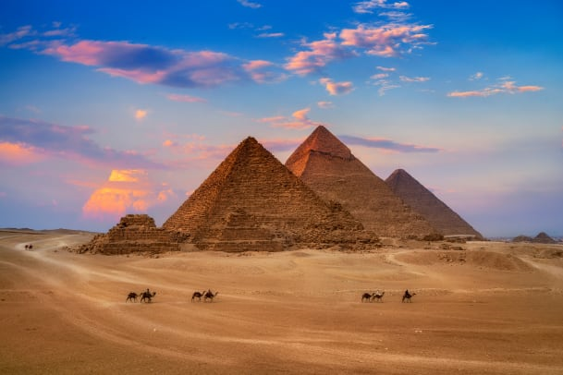
The
Ancient Egyptians
Farming
Building
The Pyramids
The Ancient Egyptians relied on the flooding of The Nile to grow their crops. They made their calendar around it:
Akhet the flooding season
Peret the growing season
Shemu the harvest season
They mainly grew wheat and barley, but, they also used flax to make clothing and papyrus to make paper.
Due to the scarcity of wood, the Ancient Egyptians built their houses out of sundried bricks and they quarried limestone and sandstone.
The Pyramids were built as tombs for the Pharaohs.
The largest, The Pyramid Of Khufu, is one of the Seven Wonders of the Ancient World. In fact, it was the tallest, the first built and it is the only one still standing.
The Pyramids were originally covered in marble but most of this has been stolen over the years leaving the stone ‘steps’ we see today.

Slide 6
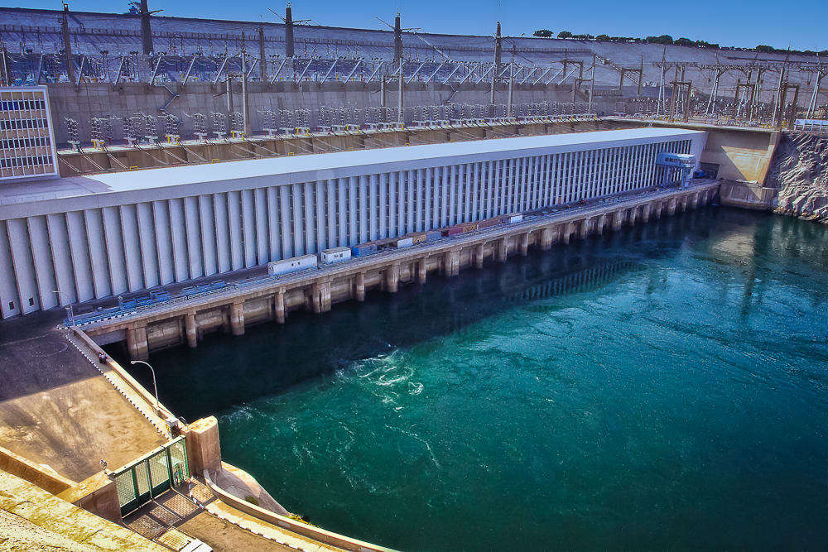
The Nile today
The Aswan High Dam
The Grand Renaissance Dam
Nowadays, the Nile doesn’t flood because of The Aswan High Dam, in Egypt. It has created Lake Nasser which is almost twice the size of Cairo!
The Aswan Dam is 364 feet high and makes enough electricity to run 1 million TVs for more than 20 years. PER HOUR!
In Ethiopia, the dam they are building is causing a row between them and Egypt. Egypt worries it will be able to ‘shut off’ the river but it will be better for Sudanese farmers and Ethiopia's economy and it will power most of Ethiopia with electricity that they don’t currently have.

Slide 7
Wildlife
The Nile is home to many types of reptiles, such as snakes, turtles and the ferocious Nile Crocodile!
The Nile Crocodile is one of the deadliest crocs. Roughly 200 people die per year to this claimed man-eater.
It can grow 20 feet long and live for 45 years and they can weigh as much as 2 grand pianos.
There are over 100 species of fish in The Nile some of which are indigenous including the Nile Perch.
The Nile Perch is a valuable food fish. It can grow to two metres long and is a fierce fishy predator.
The Red-Tailed Nile Catfish lives on the bottom of the Nile, eating things that filter down from above.
In ancient times, hippopotami were called ‘River Horses’ and worshipped. Nowadays, they can be rarely seen.
The Black Rhino is also endangered, because of poaching, and lives near the Nile.
Many other animals flock to The Nile because of it’s fertile waters.
Reptiles
Fish
Mammals

