Slide 1
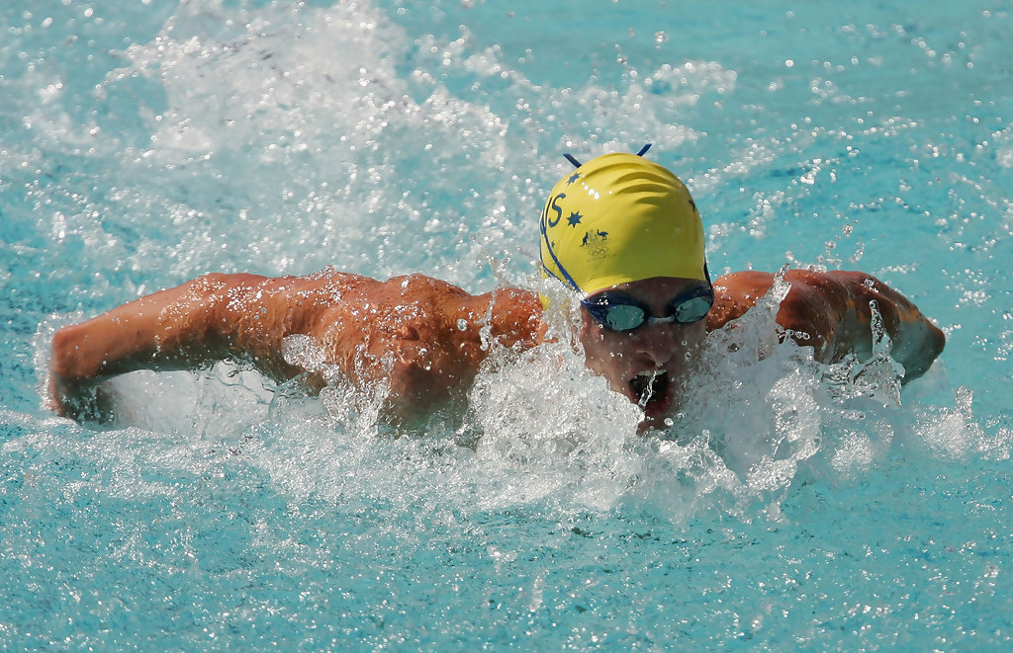
Swimming

Slide 2
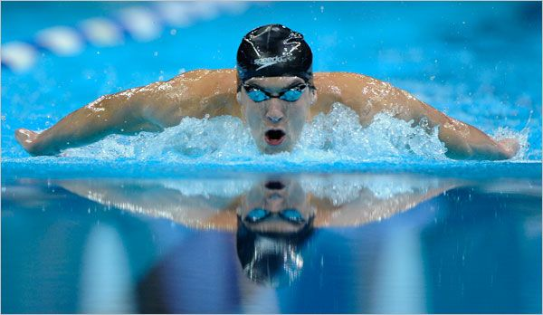
Swimming definition
Swimming is a sport that is carried out in the water. It can also be a method of travel. People often swim in pools, seas, lakes and even rivers .

Slide 3
Why it is important to learn how to swim?
It is important to learn how to swim in case you get into danger in the water and do not know how to keep yourself afloat. Each year there are many reports of people getting into danger whilst on holiday by the sea. Furthermore there have been incidents of ferries and cruise ships that have run into difficulty because of extreme weather conditions. Passengers have ended up fighting for their lives because they can not swim.

Slide 4
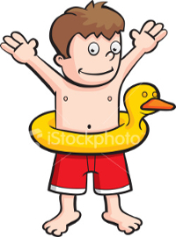
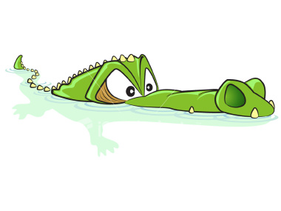


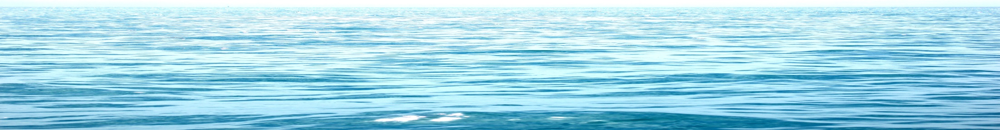
Swimming as a sport
When you do swimming as a sport you can do many different kinds such as races, synchro & diving [Some major events in the Olympics.]Some of the strokes you may know are front crawl, backstroke, breast stroke & butterfly.

Slide 5
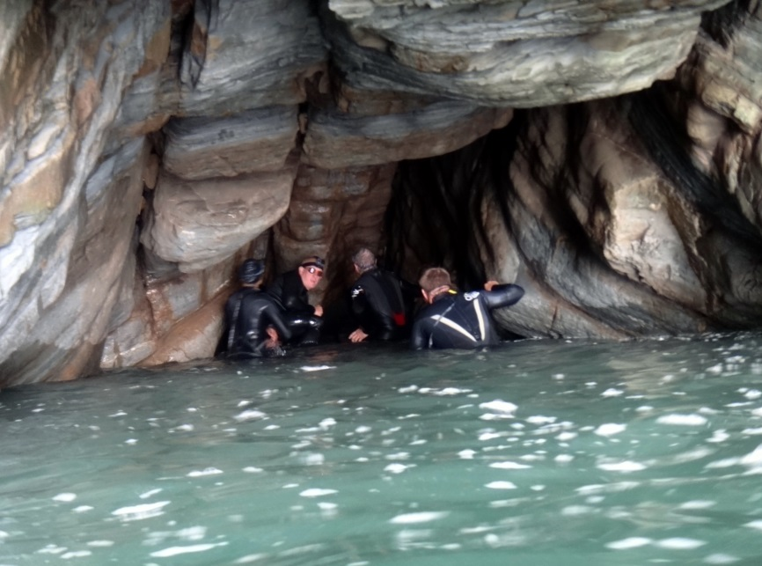
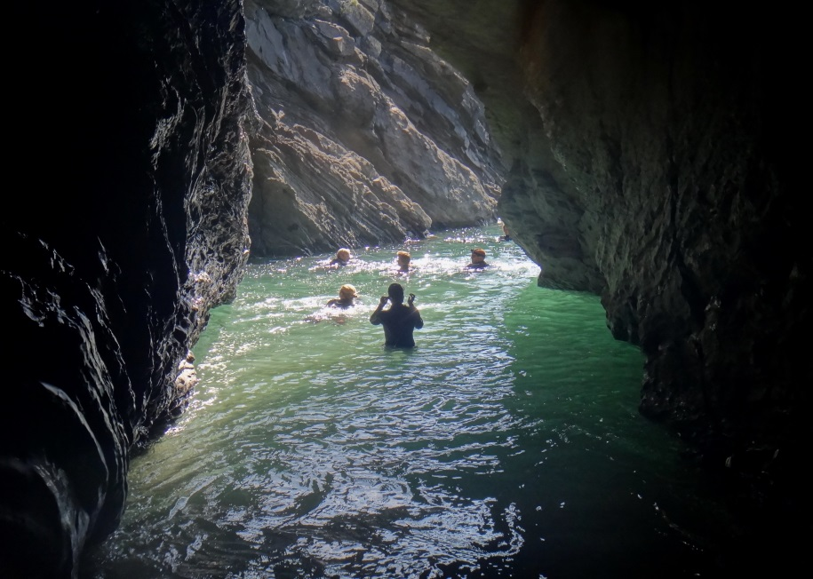
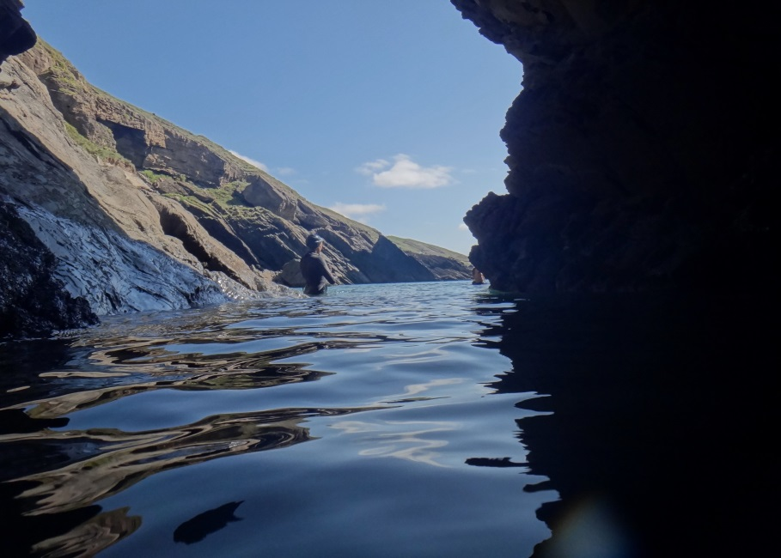
What is wild swimming?
Wild swimming is swimming in a natural body of water whether that is a lake, pond or the ocean. It provides the refreshments of a pool without having to look for one in the summer heat.

Slide 6
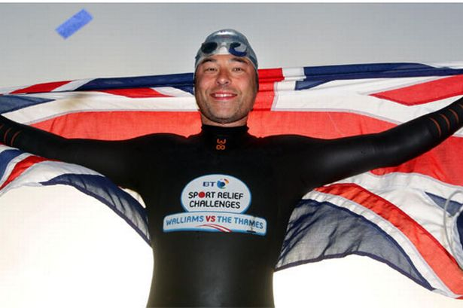
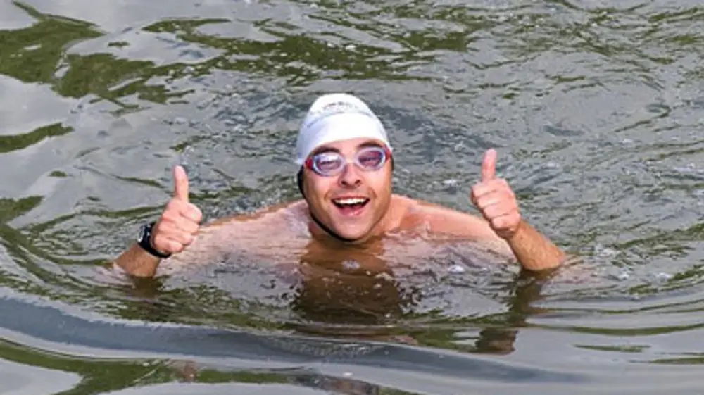
How to prepare to swim the English channel
To prepare to swim the English channel you need to train: Bl-l ateral breathing, swim in cold water. The fastest anyone has ever swam the channel is 6,57 minutes. Did you know David Walliams has swam the channel ?

Slide 7
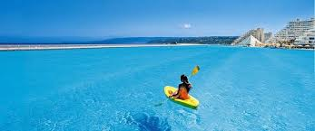
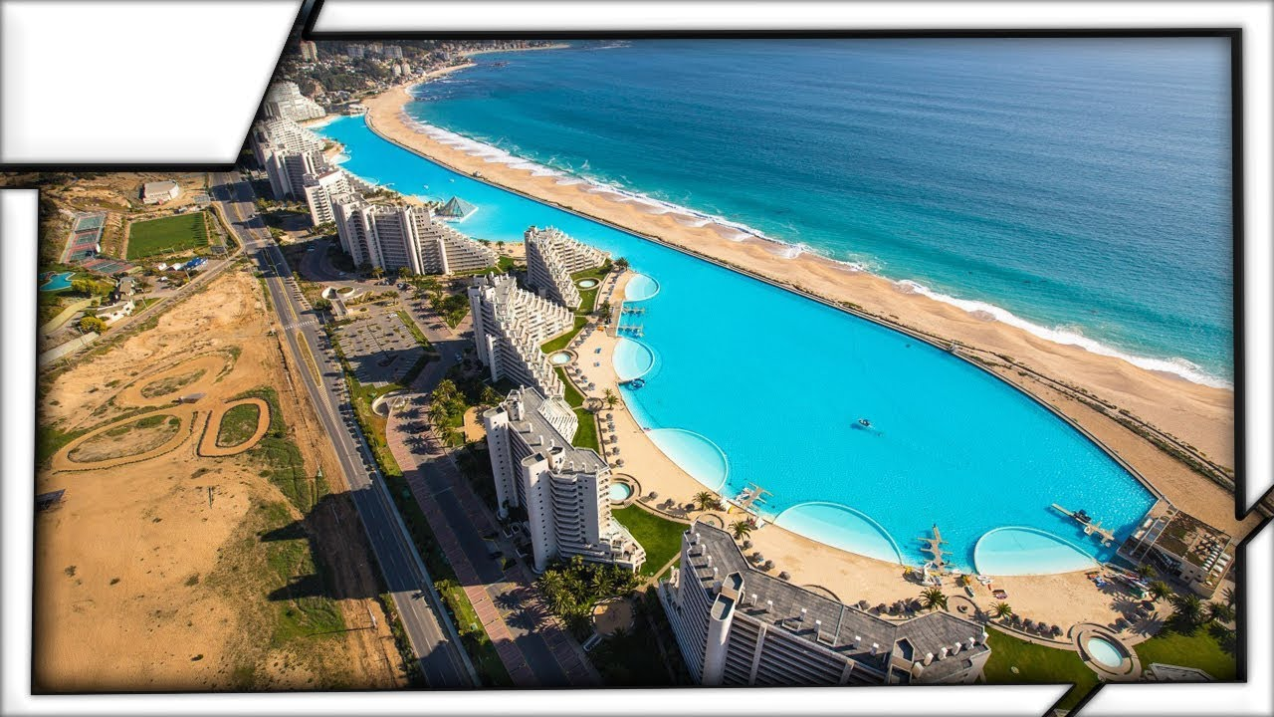
What is the largest pool?
The largest pool in the world is San Alfonso Del Mar Resort. In England, it is a legal requirement that every child should be able to swim 25m.

Slide 8
Stone age swimming.
As early as the stone age people swam. They learnt to swim in order to cross rivers and lakes. We know this because people have found cave paintings from the stone age [2000BC] depicting swimmers have been found in Egypt. Swimming became an organised sport in the early 19th century. Swimming was one of the only 5 sports competed in the first modern Olympic games.

