Slide 1


Geography
By Marianne Fares

Slide 2
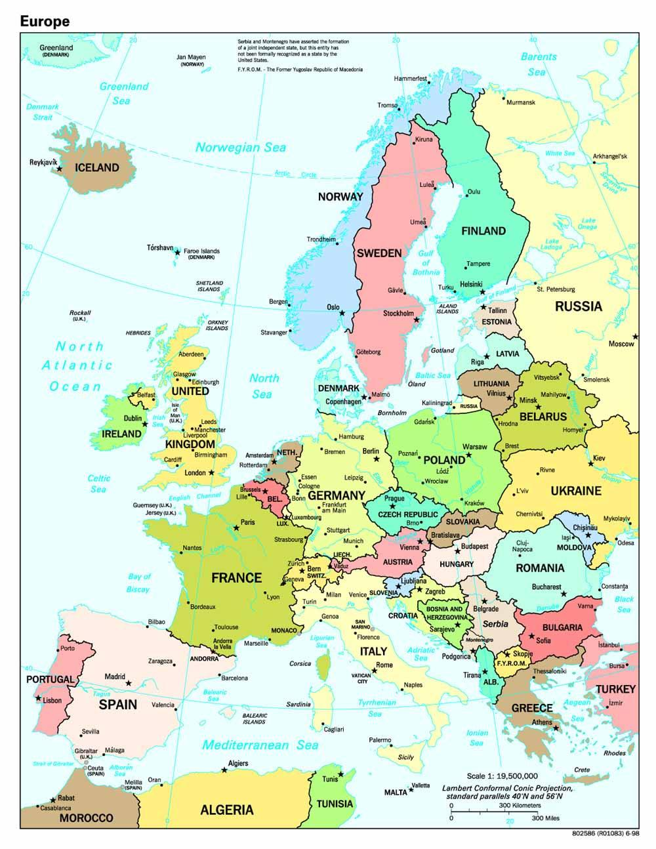
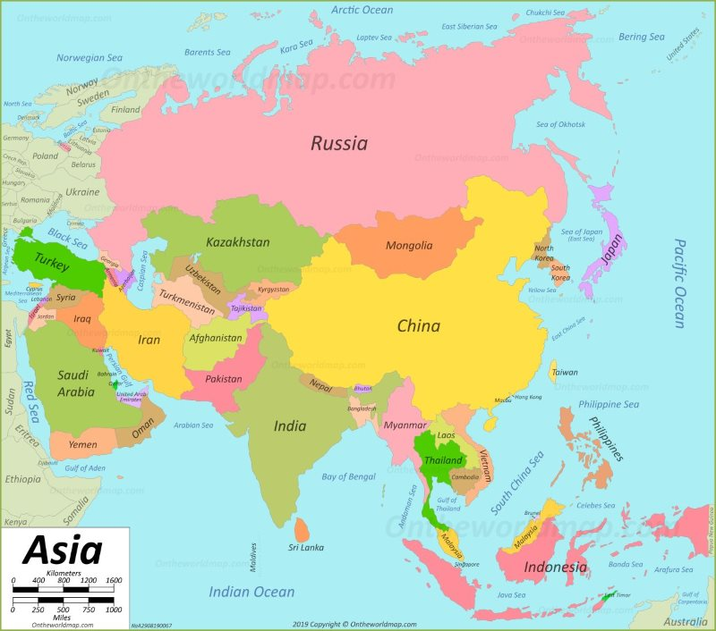
Countries
Did you know that there is 195 countries in the world.
Some of the main countries in Europe and Asia are …
Belgium
Denmark
Sweden
Norway
Finland
France
Germany
Ireland
Italy
Spain
Greece
Austria
Asia
China
Japan
North Korea
South Korea
India
Hong Kong
Taiwan
Singapore
Philippines
Iran & Iraq
Israel & Jordan
Nepal
Saudi Arabia
Syria
Kuwait
UAE

Slide 3
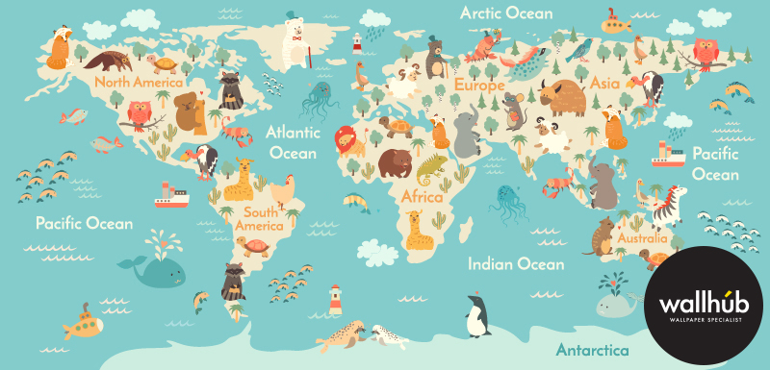
Maps
Did you know that
Age of the earth
4.6 billion years.
Water Area 139,434,000 sq mi
Total Countries 193
Escape Velocity 6.95 miles/s
Radius of Earth 3,959 miles
Surface Area 196,940,000 sq mi
Total Coastline 372,000 miles
Highest Point Mt. Everest
Circumference 24,901 miles
Orbit Speed 66,700 mph
Land Area 57,510,000 sq mi
World Population 7.346 bn (2015)
Lowest Point Dead Sea
Diameter of Earth 7,918 miles
Sun Orbit 365 days

Slide 4
Geographical Facts
Did you know that geography can be used in many exodinary ways !
Explores such as (Levenson Wood) travel and go on adventures by using maps and mastering their geography.
Geography can help people in many different ways there are two types of geography such as physical and human geography.
Over 1000 people use maps to learn and travel around the world!

Slide 5
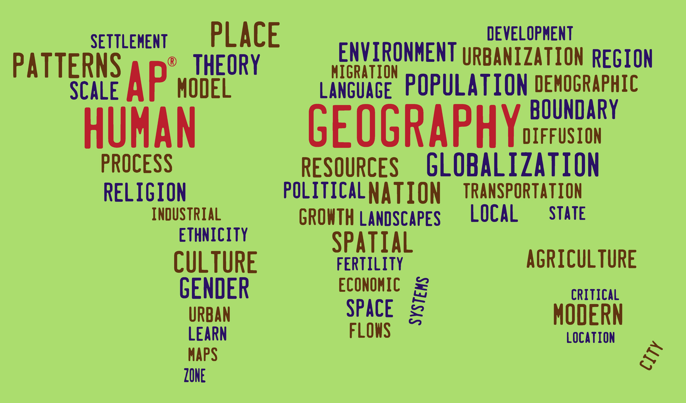
Human Geography
Human geography or anthropogeography is the branch of geography that deals with the study of people and their communities, cultures, economies, and interactions with the environment by studying their relations with and across space and place. Human geography attends to human patterns of social interaction, as well as spatial level interdependencies, and how they influence or affect the earth's environment. As an intellectual discipline, geography is divided into the sub-fields of physical geography and human geography, the latter concentrating upon the study of human activities, by the application of qualitative and quantitative research methods.

Slide 6
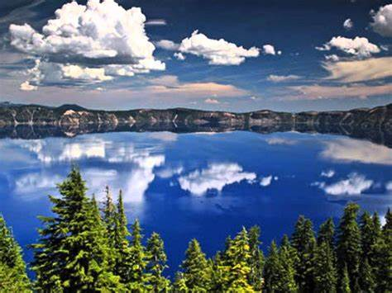
Physical Geography
Physical geography (also known as geosystems or physiography) is one of the two major sub-fields of geography. Physical geography is the branch of natural science which deals with the study of processes and patterns in the natural environment like the Tahy cryosphere, biosphere, and geosphere, as opposed to the cultural or built environment, the domain of human geography noosphere,

Slide 7






The
End

