Slide 1


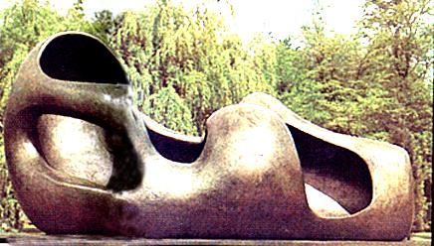
Year 6
Welcome Meeting

Slide 2

Staffing
Year Group Leader: Toni Martin-Flaven
Class Teachers:
Warhol - Toni Martin Flaven (Mon-Weds) and Polly Entwisle (Thurs-Fri)
Moore – Sharon Boulton and Katie Cochlin (Weds)
Additional Teacher: Mr Barns
Learning Support Assistants: Sarah Edlin, Jenny Field
1:1 Learning Support: Donna Syrett, Stacy Flack
Vikki Wake & Nathan Derrick – PPA Leads
Hannah Connolly/Carol Brett – Cover Supervisors

Slide 3
Staffing
Other Important Staff:
Rhiannon Kerry – Assistant Headteacher for Inclusion & Well-Being (also our SENDCo)
Lisa Withe - Headteacher
Paul Wyatt – Deputy Headteacher
Gill Williams & Odette Coe – Finance Team but also our main first aiders

Slide 4
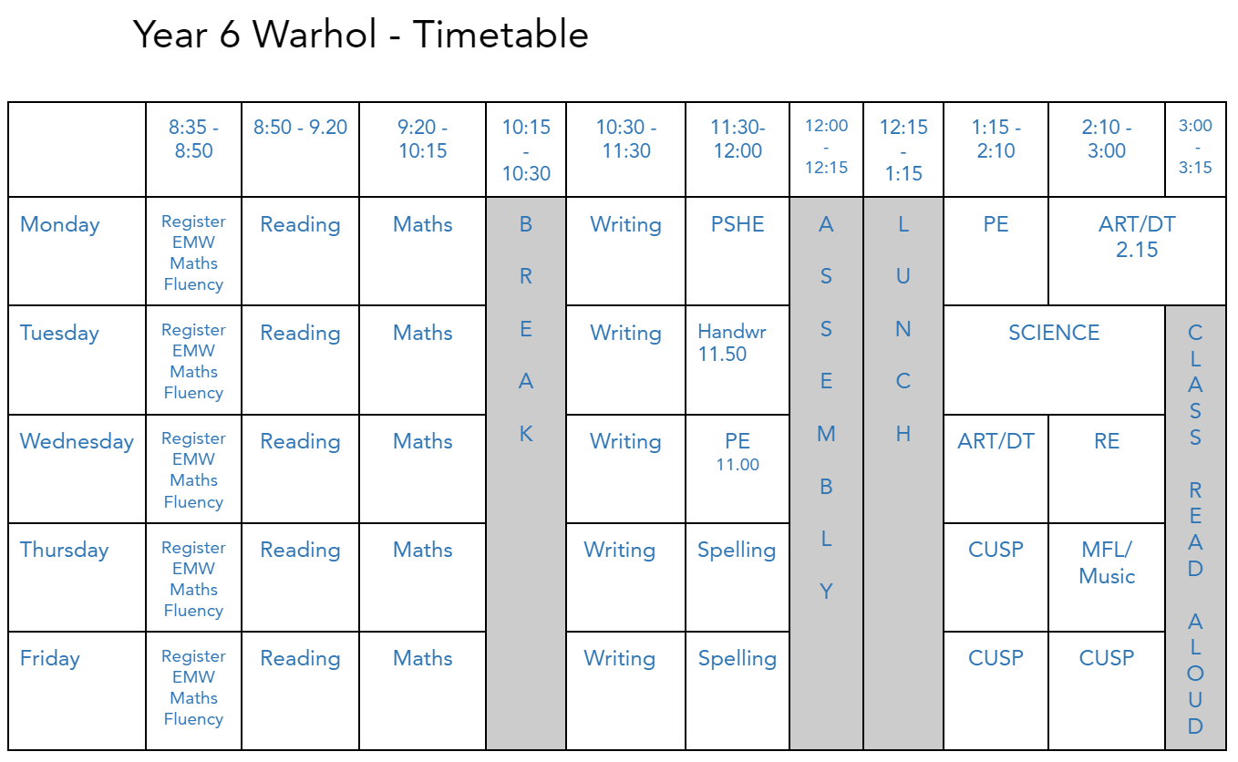
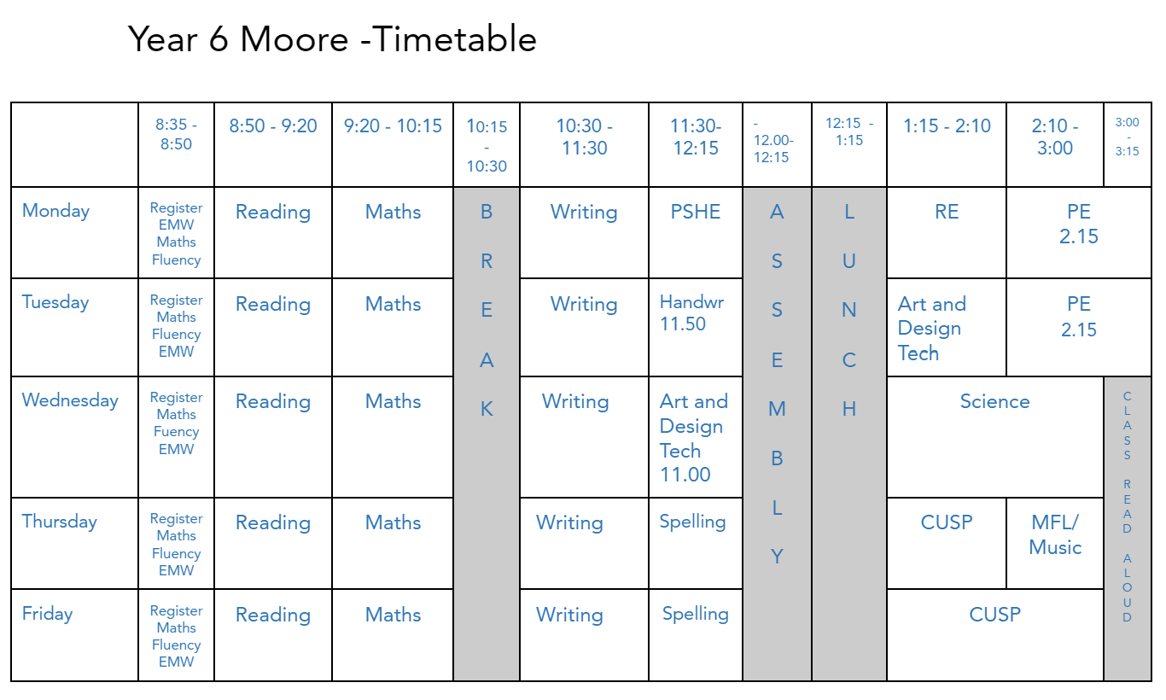
The School Day
Our timetables are on GC
Soft start: 8.35am Register: 8.45am Break: 10.15am – 10.30am
Lunch: 12.15pm - 1.15pm Home Time: 3.15pm

Slide 5

What are our priorities in Year 6?
This is a transition year where we will work together to make sure every child in Year 6 is as well prepared as possible for the next exciting step – secondary school.
We expect pupils to work hard, engage in their learning, ask questions and complete home learning tasks regularly. They will be encouraged to make the most of opportunities to contribute and learn, developing skills which will help them reach their potential.
We want pupils to enjoy their last year at Applecroft. Although there is much to learn and they will have important end of year assessments, we plan to provide a broad and rich curriculum. We hope we will continue to help make happy memories for all our pupils.
We want pupils to grow in confidence, develop leadership and become increasingly independent learners.

Slide 6
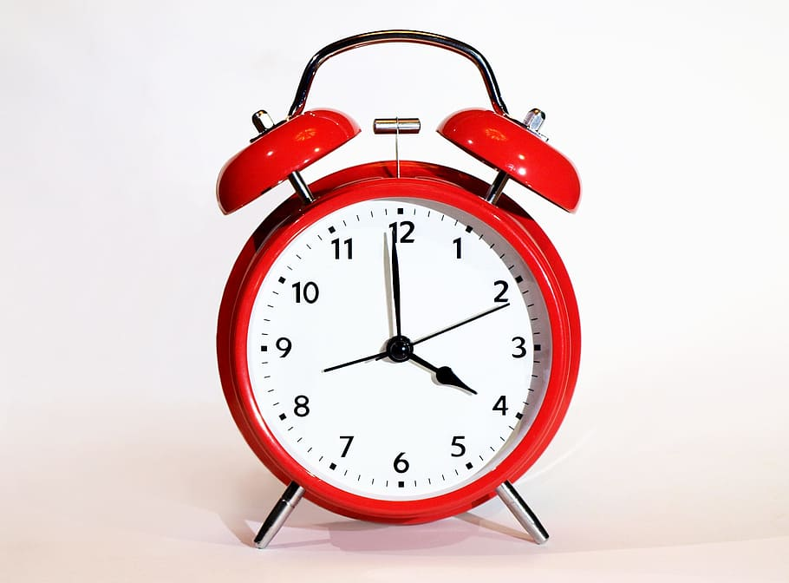
Supporting your child to be ‘ready to learn’
Punctuality - Please ensure your children are in school by 8.45am as they will miss early morning work if late.
Attendance – We aim for 100%. We don’t authorise holidays during the
term. We ask that routine dentist & doctor appointments take place out
of the school day whenever possible.

Slide 7
School Uniform
School Uniform – must be labelled. Long hair tied back and hair ties in school colours. Black school shoes, not trainers. No jewellery allowed other than a pair of small stud earrings.
P.E kit: Trainers should be in school every day for the Daily Mile. PE kits should be worn to school on Mondays for both classes and on Tuesday (Moore) and Wednesday (Warhol).
Art shirts: Please ensure your child has their own art shirt in school to be kept in their locker.

Slide 8
Year 6 Kit List
The children need the following items and all equipment and clothing must be named. Many of these items can be bought quite cheaply from our school shop (open daily) or uniform shop.
PE Kit:
White T-shirt
Black shorts
House T-shirt
Trainers
Black joggers (for cold weather)
Black hooded school sweatshirt (optional)
Kit bag
Art shirt
Pencil Case:
HB pencils
Sketching pencils (e.g. 3b)
Coloured pencils
Black handwriting pens
Rubber
Pencil sharpener
30cm transparent ruler
Scissors
Protractor
Calculator
Glue stick
Pair of compasses (optional)
Water colours (optional)
Highlighters (optional)

Slide 9

Reading for Pleasure
We are aiming for all children to be independent, fluent readers and daily reading at home is very much at the heart of this. Children can read books from school or from home with a focus on developing a love of reading. Reading is the gateway to learning and fluent readers become successful learners.
We use the Pie Corbett Book list as recommended reads. These are also listed on the website.
Please record books and pages children are reading at home via the Boost Reading (GoRead) app. We expect children to read for half an hour each day. These are monitored by class teachers and replace the planner records.
Class Library
School Library
Campus West Library

Slide 10

Communication Between Home and School
We will have 2 scheduled consultations, one in the autumn term and one in the spring term. These will be during the school day. You will have a choice to either do this face-to-face or via Google Classroom. We might contact you at other times if we have concerns about your child.
In an emergency, you can contact us via the school office.
You can use the Y6 email address if it is not an urgent matter - please note that we do not usually have time to read emails during the school teaching day.
If you would like to book an appointment to see us, we are usually free on Mondays after school.
We will also send messages via Google Classroom, Twitter and year group emails.

Slide 11
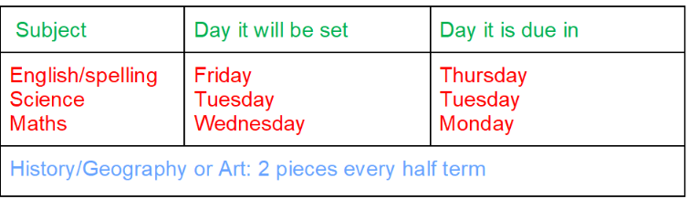
Home Learning
Home learning will be set on Google Classroom (see timetable below). The due date for each piece is clearly visible on the assignment and the children need to avoid work slipping into their missing list. If they check their ‘to do’ list on a regular basis, this should not happen. If a child has a number of pieces missing, we will ask them to complete some of their work on Chromebooks, possibly at break times.
If they have an issue with any assignment, then please encourage them to speak to us or write a comment to us and hand in the work. We can then reply, give advice or support, and return it for them to resubmit if appropriate.
Home learning in Y6 should last between 20 and 40 minutes depending on the task.

Slide 12
Behaviour and Discipline Policy
Applecroft School’s Expectations of Behaviour:
At Applecroft School we have clear ‘Expectations of Behaviour’ that we expect all members of our community to abide by. These expectations are:
∙ Be responsible for yourself and your actions
∙ Be honest, open and reflective
∙ Be kind and supportive
∙ Be respectful and well-mannered
In addition to the overarching school’s ‘Expectations of Behaviour’, individual classes create their own Class Mission Statement at the beginning of each academic year which is displayed in the classroom and on the classroom door and forms part of the children’s Leader in Me and PSHE curriculum in the first half-term.
This applies to our whole community.

Slide 13
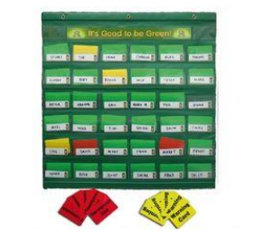
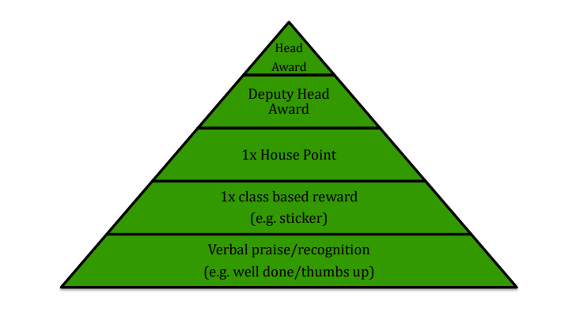

Good To Be Green
The green triangle shows the daily 5-point system used to recognise pro-social behaviour in school. The children are able to move up the triangle by showing pro-social behaviours and demonstrating the school’s shared values. If a child moves ‘up the green’ they do so by moving their name label onto the appropriate level of the triangle. At the end of each day all children are re-set to the bottom of the triangle again. Rewards for the class and the houses can be won and if the children reach level 4 or 5 of the triangle they can visit the Deputy Head or Headteacher for a special reward.
This all works in partnership with the ‘Good to be Green’ chart and the red triangle for anti-social behaviour. For more details, the Behaviour Policy is on the school website.

Slide 14

Parent Volunteers
We are hoping to be able to welcome back our wonderful parent volunteers this year. If you are interested in supporting the children in school you will need to attend one of the two planned volunteer meetings:
Friday 23rd September – Volunteer Safeguarding Meeting @ 9.00 a.m.
Monday 26th September– Volunteer Safeguarding Meeting @ 2.15 p.m

Slide 15
Secondary Transfer
Please visit the secondary school websites or contact their offices for details of visits.
If your child will not be in school due to a secondary visit please let the office know so absence can be authorised.
The Hertfordshire’s online application system is open now and closes on 31st October (see link below).
Secondary School Places

Slide 16
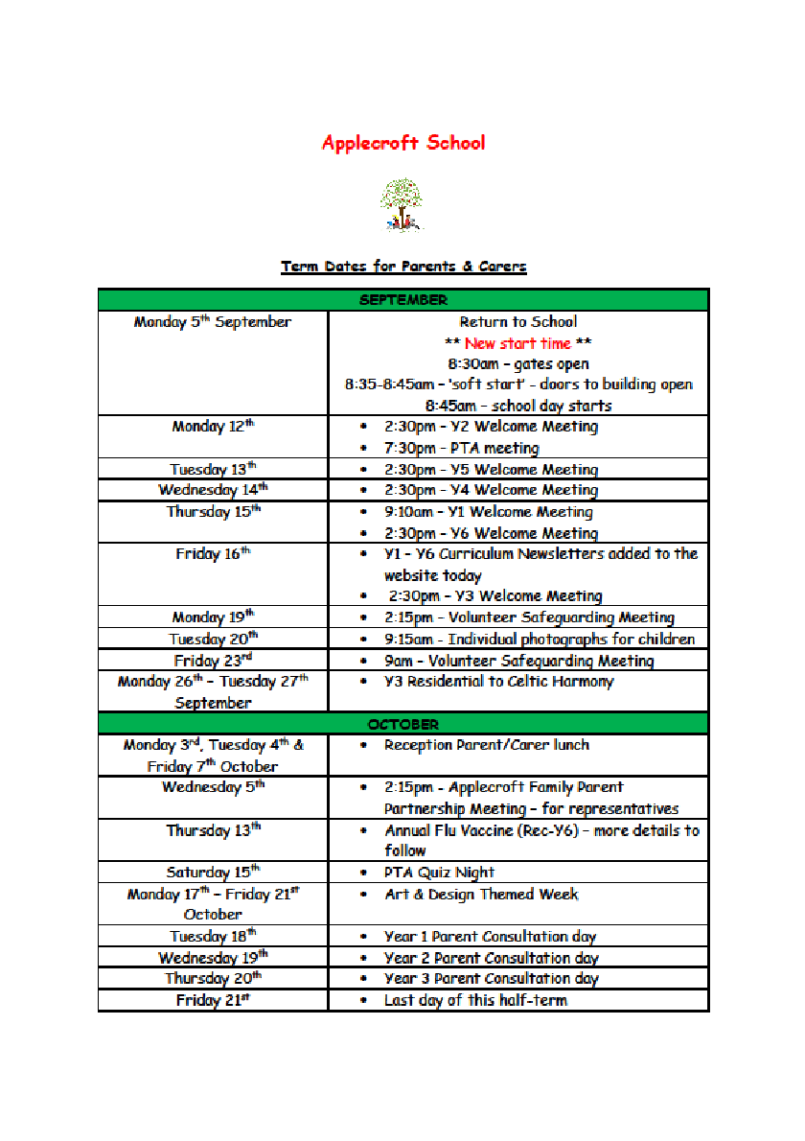
Key Dates Autumn
Key dates for parents and carers were sent out by email at the start of the autumn term.
31st October – Secondary transfer deadline
SATS week 8th May- 11th May
PGL 3rd July- 7th July

Slide 17
SATs
The key stage 2 tests take place from Monday 8th May to Thursday 11th May 2023.
Children will sit a tests in:
Reading
Grammar, Punctuation and Spelling
Arithmetic
Maths Problem Solving (2 papers)
Writing will be assessed using teacher assessment of pupils’ writing over the course of the year in a variety of forms.

Slide 18

PGL Trip to Brecon, Powys
Monday 3rd July-Friday 7th July
This is a much anticipated trip as children will have the opportunity to experience adventurous activities that they may not have tried before. More information, including medical forms and a kit list will be sent home early in the Summer Term. Please also see the following link:
Tregoyd House
We will take lots of photos which you will be shared with you later in the year.

Slide 19

Any Questions?

