Slide 1



Slide 2
A fantastic opportunity…

Slide 3
School Council
Lighthouse Team
Learning Council
Global Council
Sports Council
Eco-Council
Pupil Lighthouse Team
Pupil Curriculum Team
Pupil Well-Being Team

Slide 4
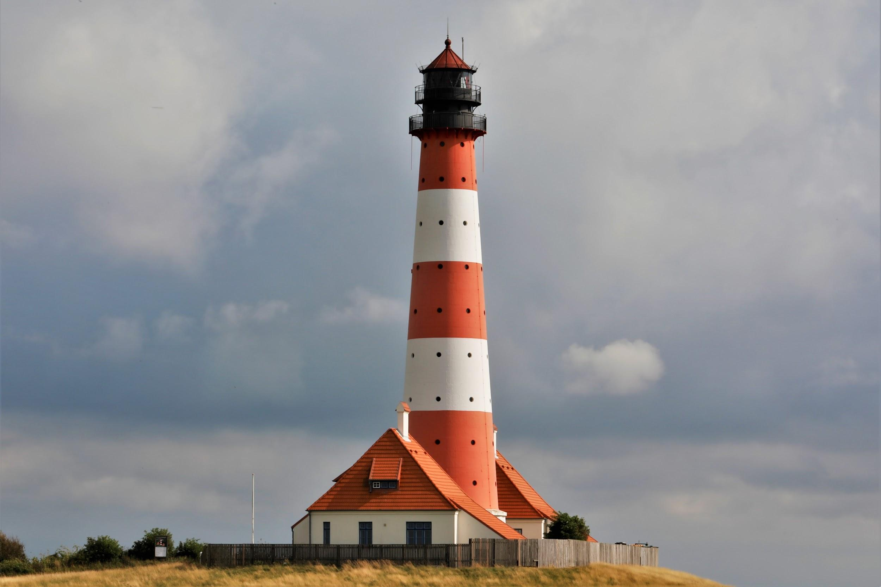
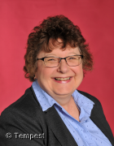
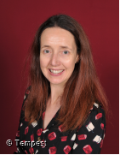
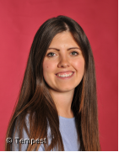
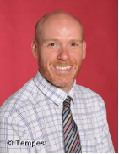
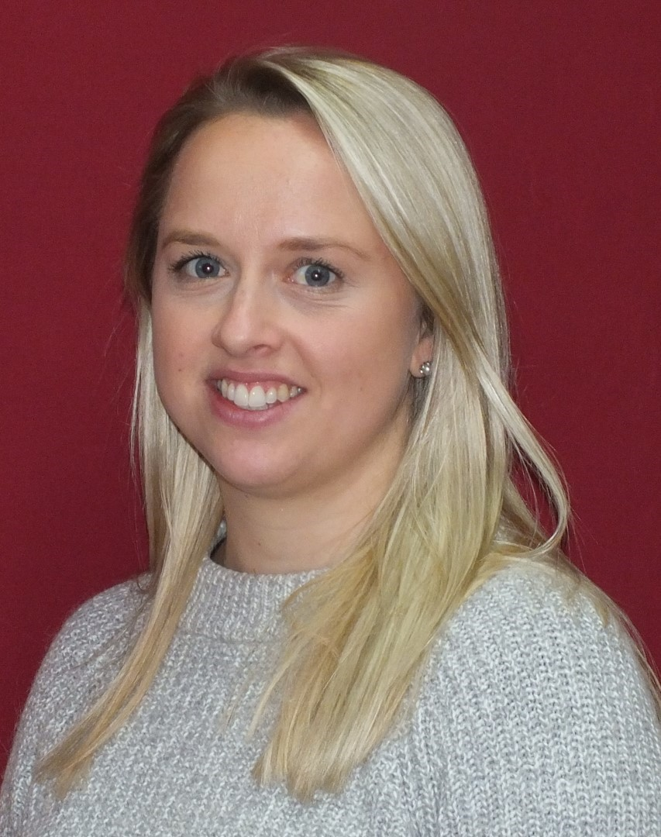
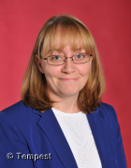
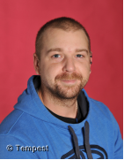
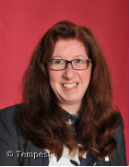
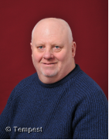
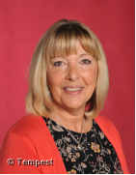
The Staff Lighthouse Team
Synergise!

Slide 5
School Council
Lighthouse Team
Who will join me on the Pupil Lighthouse Team?
Pupil Lighthouse Team

Slide 6
Learning Council
Global Council
Who will join me on the Pupil Curriculum Team?
Pupil Curriculum Team

Slide 7
Who will join me on the Pupil Well-Being Team?
Sports Council
Eco-Council
Pupil Well-Being Team

Slide 8

Do you want to get involved?
If you want to get involved in one of our Pupil Teams here are the next steps:
1) Decide which team your interests and passions most align with
2) Create a short video, no longer than 2 minutes, explaining why you would like to be on the pupil team and how you would make a difference
3) Submit your video by Friday 22nd October

