Slide 1
Trustee Profiles
March 2025

Slide 2
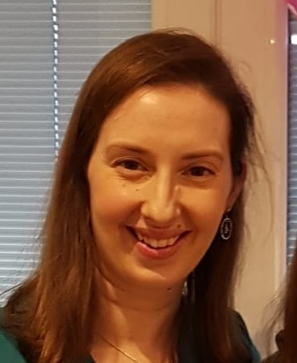
Louise Gardner
Profile
I joined as a parent Trustee in November 2019.
About me
I have lived in Welwyn Garden City all my life and attended Applecroft myself as a child ! I have a background in science and worked in the pharmaceutical industry for several years after I graduated from university, since having my 3 boys have been running our local family publishing business. Work and family keep me very busy, but in any spare time I love to bake! I have 2 boys currently at Applecroft.
Why did I become a TRUSTEE
My children have received such a lot of support and help in various ways from the school that I wanted to be able to contribute something back. Applecroft has played such an important role in my family over the years I wanted to help it to continue to do so for other families in the future!
What I love the most about Applecroft
I love the support and encouragement I have seen and experienced from all the staff, and watching my children grow and develop in the same familiar setting I have such happy memories of is really special.
ROLE
Chair of Trustees
Committee
  Vice Chair Finance & Premises Committee
  Chair Pay Committee
  Audit and Risk Committee
  Curriculum and Assessment Committee
  Health & Safety Link
Trustee Links
  English Faculty
  EYFS Faculty

Slide 3
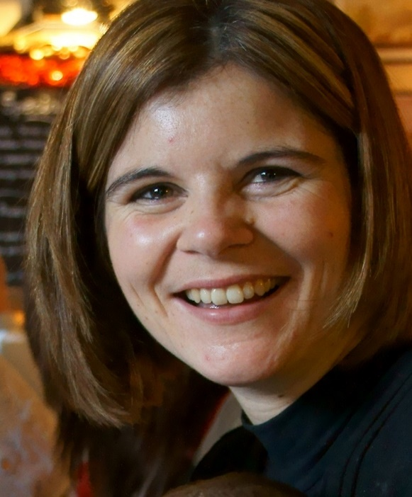
Claire Coe
PROFILE
I have been a Parent Trustee since May 2019.
About me
I am a self-employed mum of three, with two children currently at Applecroft. I attended Stanborough School and have lived in Welwyn Hatfield nearly all my life. I have been running my own business for the last 15 years, advising large global businesses on strategy development and working with them to improve their written communications. I work from home and am pleased to be able to balance frequent work meetings in London with spending quality time with family and friends locally.
Why did I become a TRUSTEE
With my children and my nieces having attended the school, I am passionate about supporting the staff and teachers to deliver the best outcomes for all our children. I also really enjoy learning new things and taking on new challenges, so the trustee role is really exciting.
What I love the most about Applecroft
I love the fact that my children have always walked into Applecroft with a smile on their faces and have been so happy to learn in such a friendly, welcoming and supportive environment.
ROLE
Vice Chair of Trustees
Committees
  Chair of Pupil & Personnel Welfare Committee
  Audit + Risk Committee
  Pupil Premium SEND and CLA Link
Trustee Links
  PE, RE and PSHE faculty

Slide 4
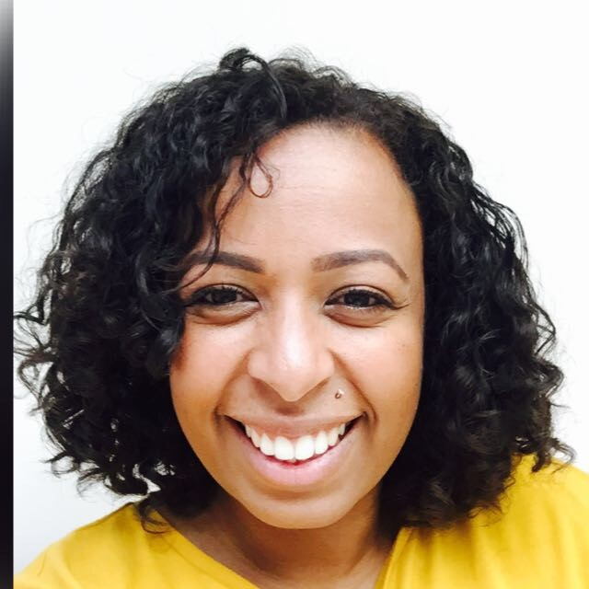
Charlene Theophile
PROFILE
I have been a Parent Trustee since 2021.
ABOUT ME
Having just moved to Welwyn Garden City in 2020, we can finally call it home. I am a mother to two beautiful children who attend the school. I graduated with a BA Honours Degree in Youth & Community Work and a PGCE in Post Compulsory Education to become a qualified Youth Worker and Lecturer. I am currently a qualified Leadership Coach through the Institute for Leadership and Management providing accredited training and coaching programmes in secondary schools across the UK. I am an enthusiastic music and festival-goer who loves dancing, be it in a field or our living room. I am passionate about equality and inclusion and creating a fairer society for all, especially for our children. I love to spend time connecting and laughing with family and friends.
Why did I become a TRUSTEE
I have a strong belief in the value of education and its role in creating equity and social mobility for all. I have the time and motivation to be an active member of the community and willing to volunteer at Applecroft to support staff and senior leaders in continuing to provide an outstanding education to the next generation.
What I love the most about Applecroft
I love that Applecroft nurtures children as a whole, creating opportunities to learn leadership skills, develop independence, and aspire beyond the classroom. The warmth and dedication of the school and its parent/carers make it a unique community, which I am proud to be part of.
ROLE
Committees
  Curriculum & Assessment Committee
Trustee Links
  English Faculty
  Equalities link

Slide 5
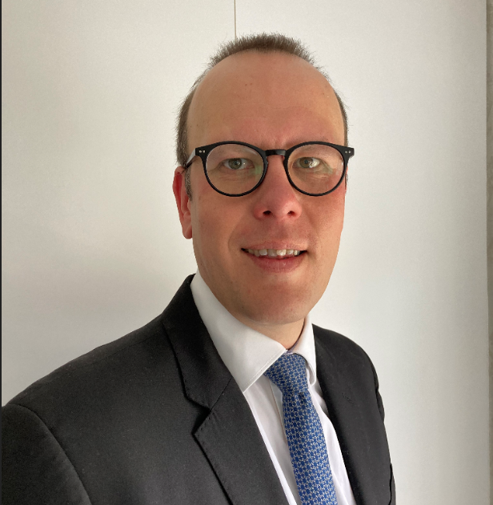
Toni Virtanen
PROFILE
I have been a Parent Trustee since 2021.
ABOUT ME
I am banker by trade and have worked for a Scandinavian Bank in the City of London for the last 20 years. The job in the City is why I moved to the UK as I am originally from Finland. The plan was to stay 12 months and here I am 18 years later! I am the father of 2 boys, both at Applecroft. One in Year 4 and the other in Year 2.
I think the sense of community and the passion people have at Applecroft is lovely. Outside of work I enjoy cooking, watching the occasional sporting event and listening to ‘daddy music’ as my boys would say which for everyone else is rock music!
Why did I become a TRUSTEE
I want to take part in the community I live in and I hope that my finance and management background will be of assistance to the school.
What I love the most about Applecroft
The school has wonderful facilities both inside and outside of the classroom. I feel it is a happy and safe place where you can grow which is a great start for all the children. .
ROLE
Committees
  Chair Finance& Premises Committee
  Audit and Risk Committee
  Trustee Links
  Humanities faculty

Slide 6
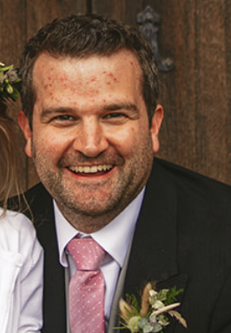
Chris Clarke
PROFILE
I have been a Parent Trustee since 2023.
ABOUT ME
I grew up in Northern Ireland and moved to England to study Mathematics at Imperial College in London. After graduating I started a job at an Investment Bank in the city and still work there almost 20 years later. In 2013, I moved out of London to Welwyn Garden City and it’s a decision I haven’t regretted once. My eldest daughter Rosalie is in Year 3, while my youngest Sophia is in Year 1.
Outside of work, I love to watch most sports, and played hockey for probably close to 30 years. However, seeing as my knees cant cope like they used to, I now direct that passion into following closely both Ulster and Irish Rugby teams.
Why did I become a TRUSTEE
Two-fold really - Firstly, with my family having really settled in the town, I have a strong passion to give back to the local community and secondly I truly believe that school can really help the children on so many levels and I really wanted to help ensure Applecroft continues to be an environment where they can thrive.
What I love the most about Applecroft
I love the strong sense of community that the students experience, but also, the parents through the many initiatives and activities hosted throughout the year.
ROLE
Committees
  Finance & Premises Committee
  Audit and Risk Committee
Trustee Links
  Creative Faculty

Slide 7
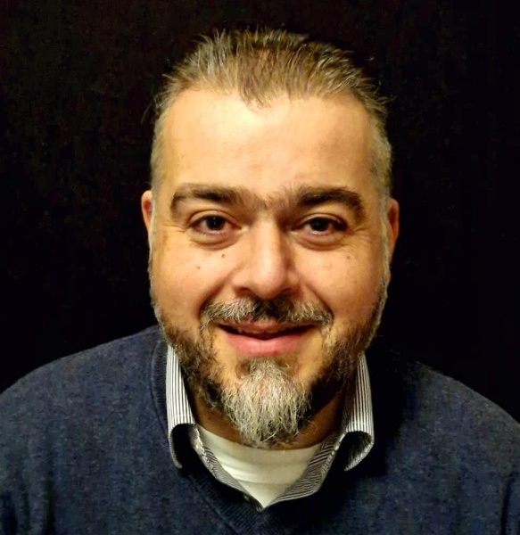
Antonios Kanellopoulos
PROFILE
I have been a Parent Trustee since April 2023.
ABOUT ME
I am the father to two children, Dimitris and Angelika. Dimitris is currently in Year 3 at Applecroft while Angelika is still in nursery. I am also an Associate Professor of Innovative Construction Materials at the University of Hertfordshire, where I head the division of Civil Engineering and Built Environment as well as the Centre for Engineering Research.
I have been involved in supporting the learning journeys of young people for more than 15 years at a variety of higher education environments, including local colleges and the University of Cambridge.
Outside work, I have a passion for cooking and enjoy anything related to history and space exploration.
Why did I become a TRUSTEE
Becoming a school trustee is an excellent opportunity for me to take active part in school life and support the school in the best way I can. I am especially passionate about STEM subjects and hope to contribute my knowledge and experience in the field of higher education towards our school’s needs.
What I love the most about Applecroft
As a new parent 4 years ago, I came to love the school’s vision and strategy. As an active member of the school, I love the strong sense of community and the excellent facilities.
ROLE
Committees
  Pupil & Personnel Welfare Committee
Trustee Links
  STEM faculty

Slide 8
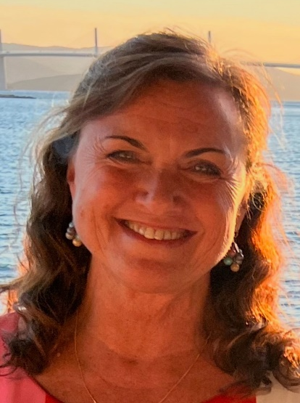
Caroline Buckley
PROFILE
I joined as a Member appointed Trustee in November 2024.
About me
I have lived in WGC for nearly 40 years and our four children, now all in their 30s attended Applecroft.
I am now retired after a career in nursing and setting up and managing a Home Care company based here in WGC.
Outside of work I enjoy dog walking, travelling, visiting friends and family and baking!
Why did I become A TRUSTEE
I am pleased to be able to help in any way I can, contributing and giving back to the school which served our family so well.
What I love the most about Applecroft
I love that for so many years the care and support shown to the children has been of utmost importance to the staff. The experiences outside of the curriculum are still very special and unique in today’s world of teaching.
ROLE
Committees
Finance and Premises
Trustee Links
Creative Faculty

Slide 9
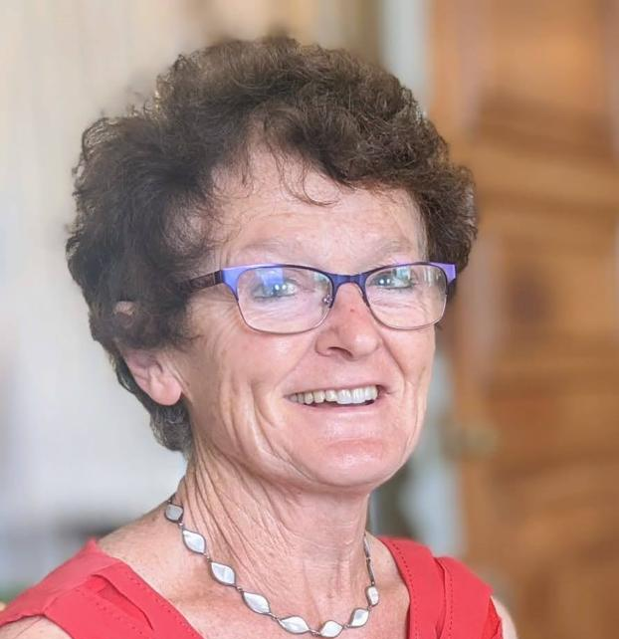
Barbara Crawford
PROFILE
I have been a Member appointed Trustee since November 2022.
ABOUT ME
I am now retired after 41 years of teaching in a Hertfordshire Secondary School.
I taught Science subjects & geography but my main passion was Environmental Science - learning IN, ABOUT and FOR the environment. Throughout my career the main focus of my job was Senior Pastoral Lead, SENCo and member of Senior Management - a very busy, varied and rewarding role. I spend much of my time looking after my 3 grandchildren. I am a Hertfordshire Health Walk leader and in between I try to fit in touring the great outdoors in our motorhome,
Why did I become a TRUSTEE
We know that the value of an exemplary education, the best we can provide, cannot be understated. ‘Every Child Matters’ and all children have the right to be happy, healthy & successful learners. We must enable all of our young people to maximise their potential by removing any barriers to learning and by making the experiences and opportunities challenging, accessible and fun. ‘Everybody Can be Somebody’ – I would like to support the trustees, Head teacher and staff in this endeavour.
What I love the most about Applecroft
Initially, just a feeling of a ‘nice place and people’ but as I have become more familiar with the school I see and meet polite, friendly dedicated staff and cheerful, happy and confident children working in large spacious, well resourced teaching areas – great vibes and a lovely place to be!
ROLE
Committees
  Pupil & Personnel Welfare Committee
  Pay Committee
  Joint Safeguarding link trustee
  Trustee Links
  PE, RE and PSHE faculty

Slide 10
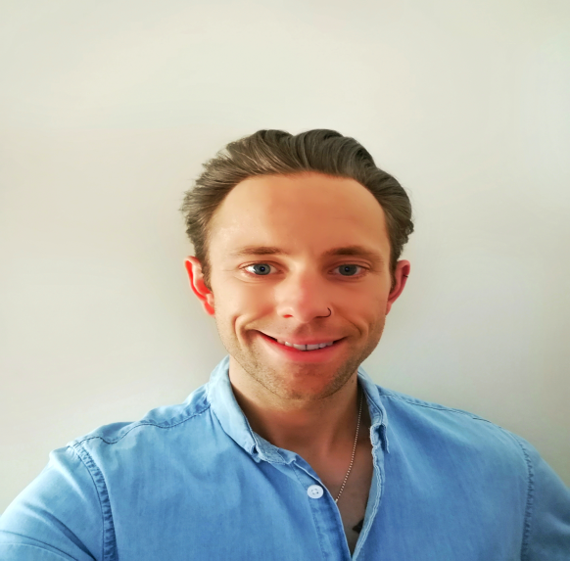

Ben Kirby
Photo
PROFILE
I have had the privilege of being a Parent Governor since June 2019 and am now a Member appointed Trustee.
About me
My educational background is in Geography and Oceanography, however I worked in both business and crime analysis after graduating. This led me towards becoming a police officer which I have been for the past 15 years. I love the excitement of my varied role, including helping vulnerable people and catching criminals. Outside of work I enjoy live music and many extreme sports including surfing and diving with sharks. I'm a proud dad to Grace who has now left the school and Jude who is in Year 5.
Why did I become a TRUSTEE
I work hard to support schools and the community in my job and I felt I wanted to help shape the school and future community where I live. I am passionate about fostering the talent of children and empowering them to go on and succeed in life regardless of their upbringing or personal circumstances.
What I love the most about Applecroft
I love that the school is inclusive and embraces the diverse characteristics and values of the local community. I am proud of the staff’s dedication and motivation driving the children’s desire to succeed and reach their full potential.
ROLE
Committees
  Pupil & Personnel Welfare Committee
  Joint Safeguarding Link
  Behaviour Link
Trustee Links
  Humanities Faculty

Slide 11
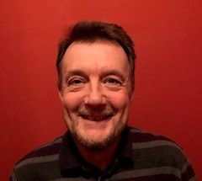
Steve Williams
Profile
I joined Applecroft School as a Member appointed Trustee in October 2019
About me
I spent 28 years working as a civil servant in Central Government mostly in Whitehall in a number of roles and departments which I look back on with a great deal of satisfaction. It was a varied and exciting place to work, particularly when working directly with Government Ministers/politicians and in the House of Commons. I have since moved back to working locally in Harpenden as a commissioning manager which avoids thankfully the long commute into central London. Outside of work I enjoy skiing, cycling, watching Saracens rugby football club, relaxing with members of my family and travelling abroad with my ‘children’ even though they are now independent young adults.
Why did I become a TRUSTEE
With a local job now I am more able to devote more time in being a volunteer in the community. I choose to become a school trustee here as I have had a long interest in education and have had experience of being a school governor in the past which I hope will be helpful to the board of trustees.
What I love the most about Applecroft
I like the inclusivity of Applecroft School which reflects the local community at large. I hope to learn more about this aspect of the school once I settle in as a trustee.
ROLE
Committee
  Co Chair of Curriculum & Assessment Committee
  Trustee Links
  Language and Communication Faculty

Slide 12
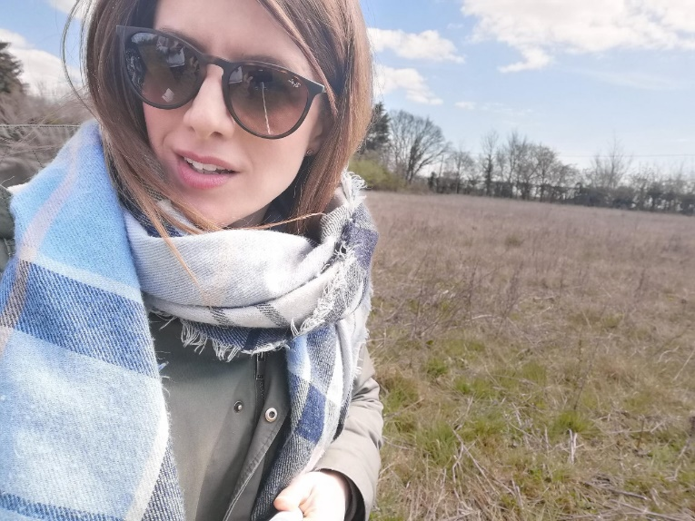
Liz Wilson
PROFILE
I have been a Member appointed Trustee since January 2023.
ABOUT ME
I am a policy writer for the Government and have led major policy portfolios in child maintenance, information sharing, childcare support and tax. I am an experienced civil servant and specialise in bringing people together to solve difficult and challenging issues, producing solutions which meet the needs of community and implementing them in an accessible and easy to understand way.
Both of my daughters attended Applecroft School and it gave them a great start to their education as well as key life and social skills which will help them navigate a rapidly changing world. I believe that every child deserves a good education and the opportunity to achieve their full potential regardless of where they live or what their background is; it is a right and not a privilege.
Why did I become a Trustee
I have been interested in Governance for a long time and am very happy that I am at a point in my life where I can make the commitment. I also hope that my ability to de-code and simplify government speak will be helpful!
What I love the most about Applecroft
I love the Applecroft community. The children and their affection for one another and the local community who really put their arms around the school and support it to succeed.
ROLE
Committees
  Curriculum and Assessment Committee
Trustee Links
  STEM Faculty

Slide 13
Paul Wyatt
PROFILE
I am a Staff Trustee having previously served as an Associate governor since September 2015.
About me
I have been teaching for a long time! Almost 30 years now, and I still can’t quite believe where the time has gone. I have been fortunate enough that those years have all been at Applecroft. It does seem rather strange that I meet parents who I taught when they were children here.
Being Deputy Headteacher is a very busy role, so family life is really important for me to unwind. As with any parent, juggling work with family is a challenge and so holidays are always very welcome. Visiting places of interest, going to concerts, reading crime novels, listening to music or playing sport are just some of the ways I try to relax.
Having coached cricket to youngsters and managed my son’s team from when they were 8 years old, it is with great pride that I now play alongside them as they have progressed to an adult side; it has been a privilege to see how he and his teammates are continuing to develop.
I’m a huge Manchester United fan and try to see them at least 5/6 times a season at Old Trafford, even when they are performing poorly! I’ve been running for a number of years and have taken part in numerous half marathons in this country and across Europe. I have run two marathons – never again, although didn’t Sir Steve Redgrave say that about not returning to a rowing boat!
What I love the most about Applecroft
I’ve seen so many changes over the years at Applecroft but it remains a pleasure to work at and I have been privileged to teach so many wonderful children and work with many fabulous colleagues. Applecroft, truly is a unique and special place and to be a part of its continuous drive to improve is a huge honour.
ROLE
Committees
  Finance & Premises Committee
  Curriculum & Assessment Committee

