Slide 1
Teach reading: change lives
Parent workshop: Phonics and early reading in Year 1, Phase 5
Notes:
For this presentation, you will need to download and print out the following resources and information for parents:
the parent handout ‘Your child’s reading journey – Year 1’
‘Grow the code’ chart/mat
‘Phase 5 tricky words: Year 1 – Information for parents and carers' – or parents can access this in the ‘For parents’ area of the Little Wandle website.
You will need also need:
a flipchart
word cards to show how children spot digraphs in words; use two words with the same digraph, e.g. ‘head’ and ‘bread’
access to the Little Wandle and Collins websites
a copy of the Little Wandle Glossary (in Getting started/Teaching).

Slide 2
A love of reading is the biggest indicator of future academic success.
OECD (The Organisation for Economic Co-operation and Development)
Notes:
Slide purpose:
To share the link that research has established between loving reading and being successful academically
Suggested script:
Let's start our session with a quote from the Organisation for Economic Co-operation and Development ...
Read the quote.
This quote reminds us of the importance not just of teaching children to read, but also of teaching them to love reading.
Today, we're going to talk about phonics, but we always see phonics as the route into reading and a love of reading as the ultimate goal of phonics teaching.

Slide 3

Little Wandle Letters and Sounds Revised
Our school has chosen
Little Wandle Letters and Sounds Revised as our systematic, synthetic phonics (SSP) programme to teach early reading and spelling.
Notes:
Slide purpose:
To inform that all schools must teach phonics but explain your school's choice of SSP
Suggested script:
As you now know, the National Curriculum specifies that all schools must teach children to read using phonics starting in Reception, carrying on into Year 1.
Read the slide.

Slide 4
Phonics is:
making connections between the sounds of our spoken words and the letters that are used to write them down.
Notes:
Slide purpose:
To give a a simple definition of phonics
Suggested script:
As you will remember from last year ...
Read the slide.
It sounds complicated but it really isn’t!
Let's review some of the important words that will help you understand phonics ...

Slide 5
Terminology
Phoneme
Blend
Grapheme
Segment
Digraph
Adjacent consonant
Trigraph
Split digraph
Notes:
Slide purpose:
To give simple definitions of key terminology
Suggested script:
Review what each word means – use the Glossary to help.
Children will have already learned most of these terms. In Year 1, split digraphs are introduced.

Slide 6
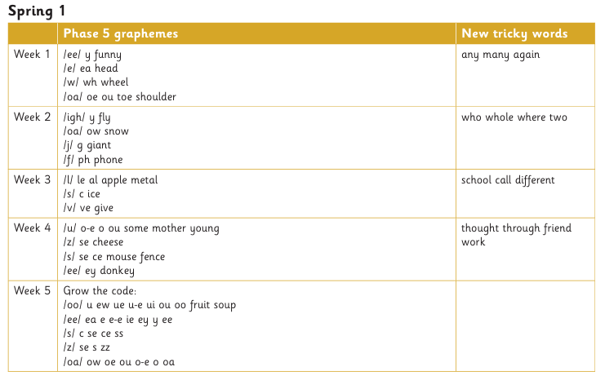
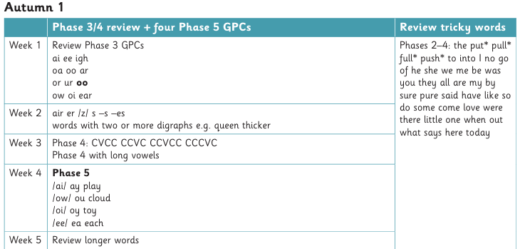
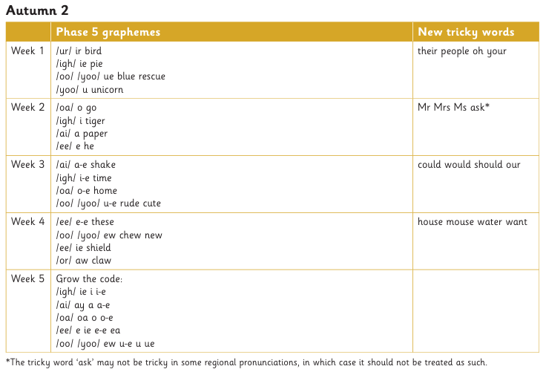
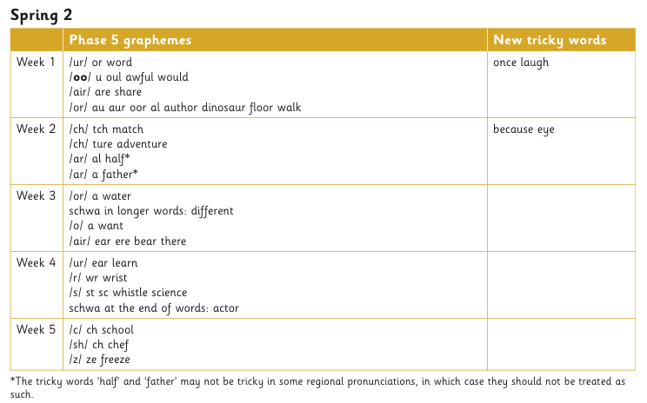
The progression
Notes:
Slide purpose:
To provide an overview of the progression children have followed from Reception, and into Year 1
Suggested script:
Your child has learned Phases 2, 3 and 4 in Reception (seen on the left).
Now they are in Year 1, they will have a brief review of Phases 3 and 4 and all of the Reception tricky words.
By week 4 of the first half term, they will begin phase 5.
Phase 5 covers the last remaining graphemes of the Little Wandle progression and alternative pronunciations and spellings of graphemes learned.

Slide 7
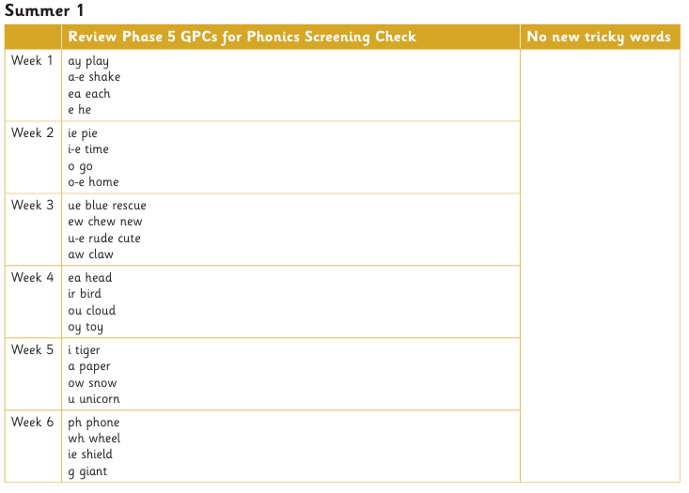
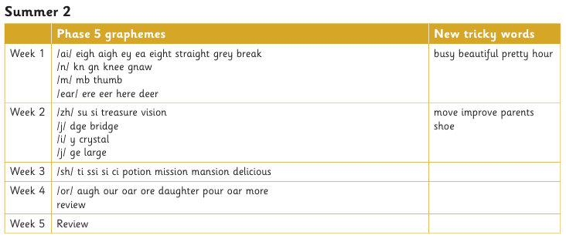
The progression
Phonics Screening Check -
Week Commencing 14th June
Parent Meeting Wednesday 28th April 8:45-9:15am
Notes:
Slide purpose:
To provide an overview of the progression children have followed from Reception, and into Year 1
Suggested script:
Your child has learned Phases 2, 3 and 4 in Reception (seen on the left).
Now they are in Year 1, they will have a brief review of Phases 3 and 4 and all of the Reception tricky words.
By week 4 of the first half term, they will begin phase 5.
Phase 5 covers the last remaining graphemes of the Little Wandle progression and alternative pronunciations and spellings of graphemes learned.

Slide 8
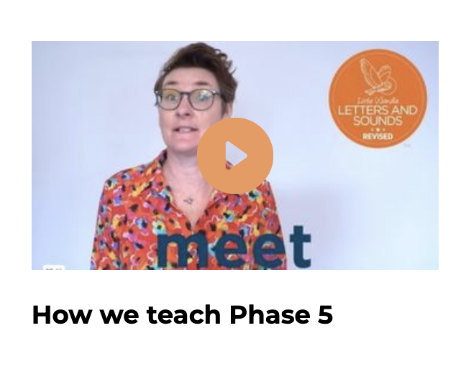
This term we will begin teaching Phase 5
In Phase 5 children learn:
new graphemes for the sounds they already know
that the same grapheme can have alternative pronunciations.
The ‘Grow the code’ lessons support children with reading and spelling these alternative spellings.
Notes:
Slide purpose:
To provide an overview of Phase 5 'Grow the code’
Suggested script:
The children learn the last set of graphemes, including ones with alternative pronunciations.
Play the video which explains how we teach Phase 5. (The first 20 seconds are a repeat of the ‘How to say the sounds’ video but then goes on to explain what the alternative graphemes are for the sound /ai/.)
They will also learn to ‘Grow the code’ where children will explore different ways of spelling the same phoneme and reading the same grapheme. This means that they are able to read increasingly challenging words and books.
Children learn strategies so that they can distinguish between the same grapheme, different phoneme and the same phoneme but different grapheme. ‘Growing the code’ will support children as they get older with accurate spelling.

Slide 9
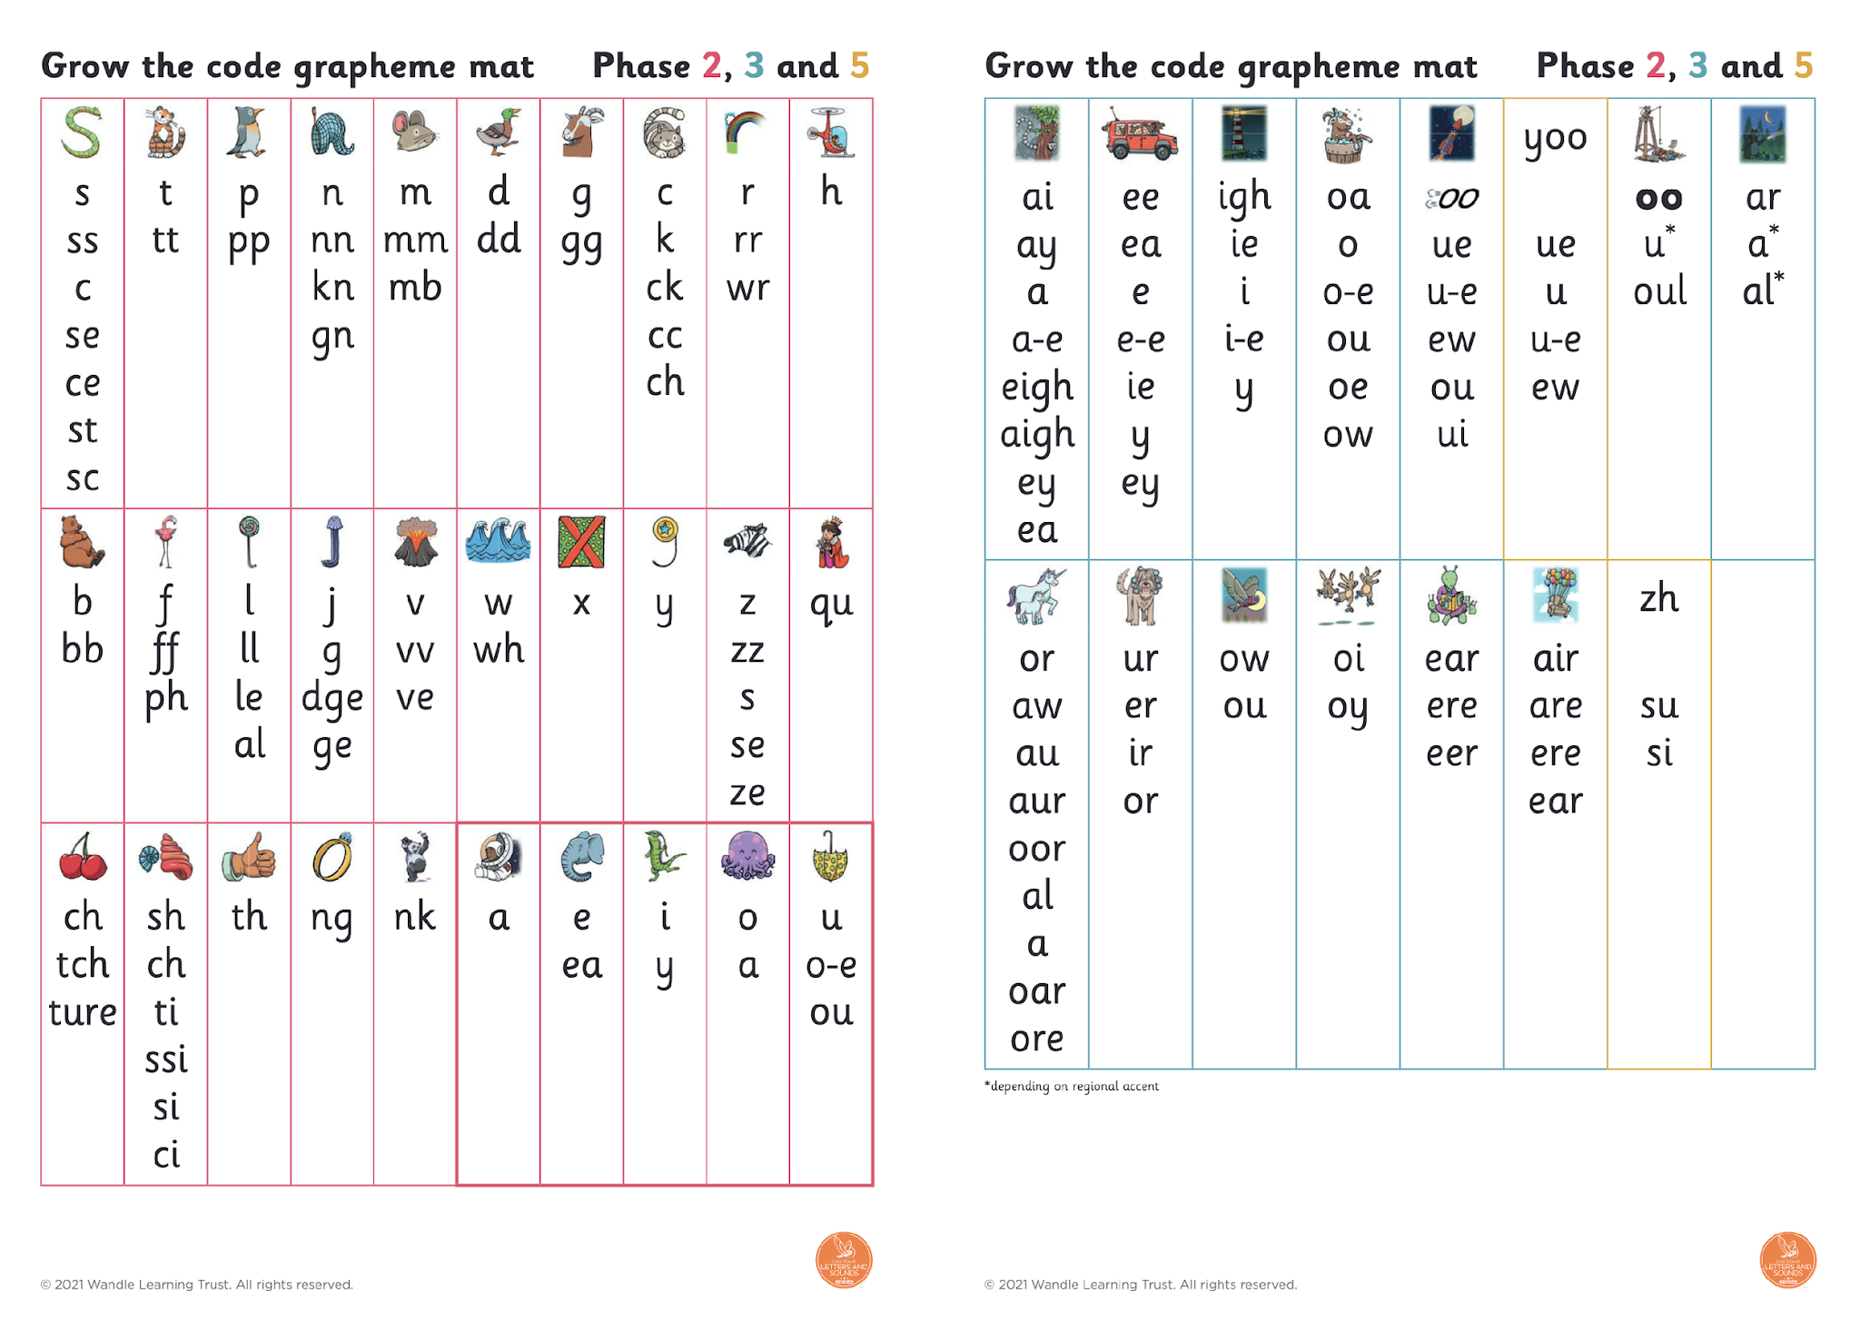
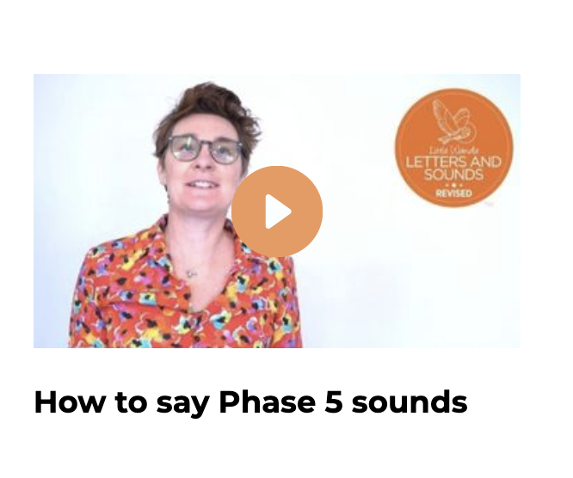
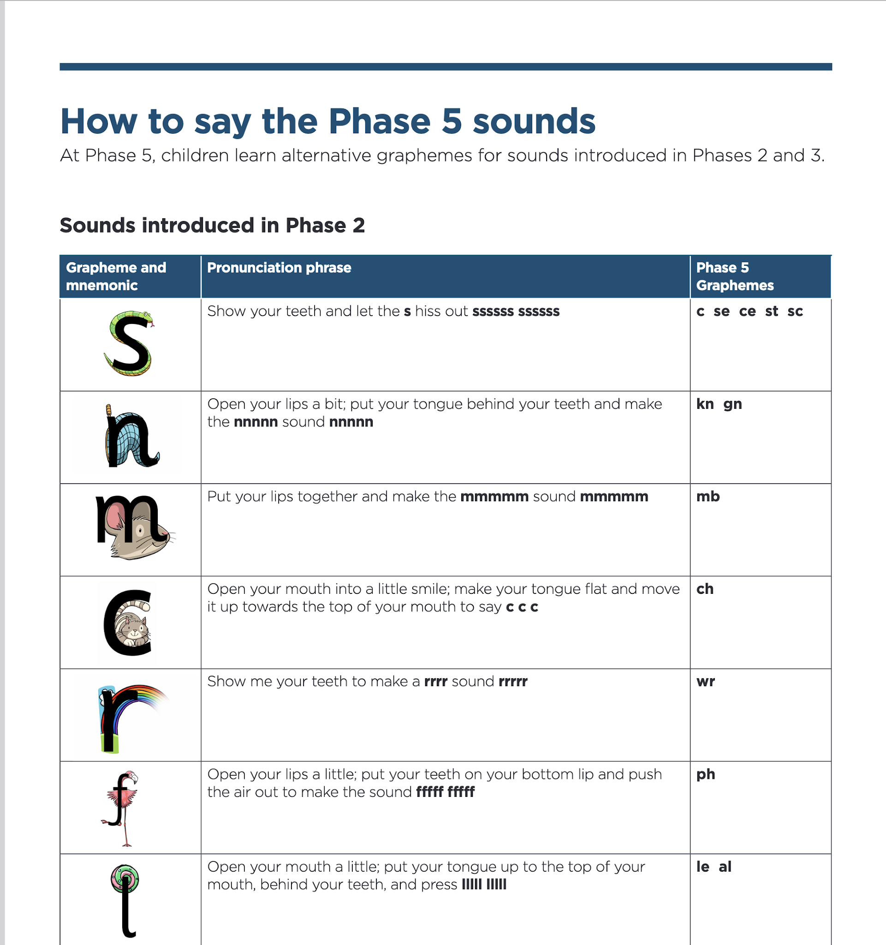
Let’s say the Phase 5 sounds
Notes:
Slide purpose:
To introduce the Phase 5 GPCs and how to say them
Suggested script:
Let's have a look at the Phase 5 sounds.
Hand out the Phase 5 handout and the ‘Grow the code’ mat.
Play the video and pause it so the parents can say the sounds if you wish.
Or display the ‘Grow the code’ chart and teach the parents the sounds.
Have a look at your handout and watch this video/look at the ‘Grow the code’ chart on the screen.
Now, let's have a practice!

Slide 10
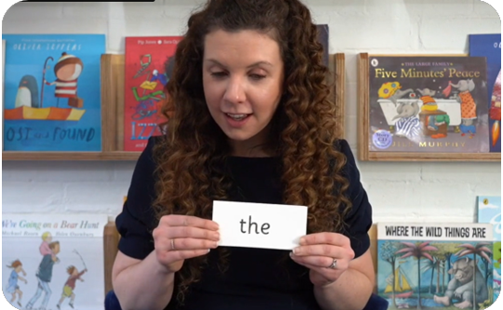
Tricky words:
have unusual spellings e.g. all, people
are taught in a systematic way.
Children are now learning to read Phase 5 tricky words.
Notes:
Slide purpose:
To provide an overview of Year 1 tricky words
Suggested script:
Tricky words have unusual spellings. For example ‘all' is tricky to children in Reception because the letter ‘a’ says /or/ in this word.
Tricky words are taught in a systematic way, following the clearly defined Little Wandle sequence of learning. We teach them because they are common words that children need to know.
As children 'Grow the code', some tricky words will no longer be tricky. For example, children learn in Year 1 that the letter ‘a’ can make the /or/ sound in words like ‘all’, ‘ball’ and ‘water’’. This means that the word ‘all’ is no longer tricky!

Slide 11
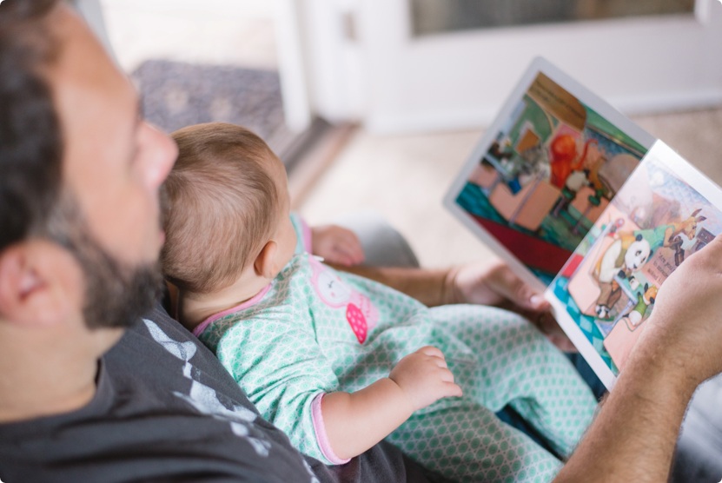
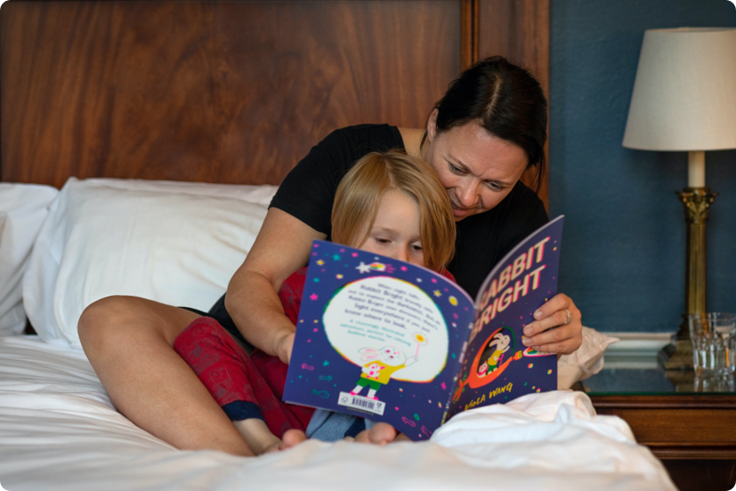
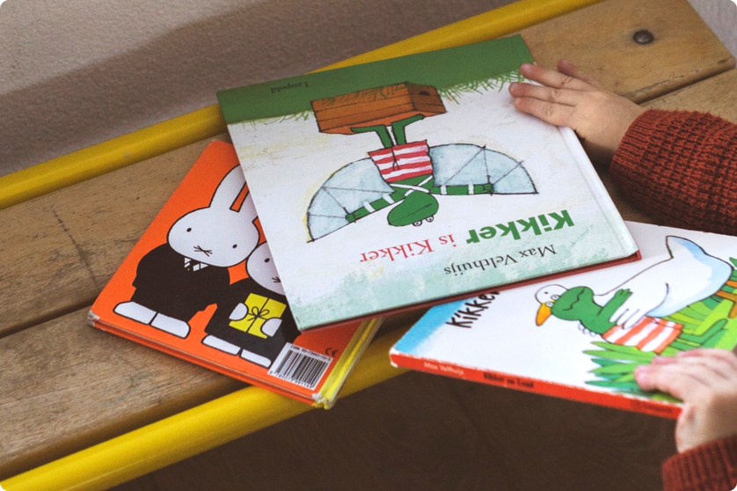
What Can we do at Home?
Read together, everywhere, everyday!
Comics, information books, magazines, story books, picture books, poems and leaflets are all great for sharing.
Catalogues are fun to share and talk about too.
Repeated reading of books is really beneficial for children. It helps them memorise parts of stories, words and phrases too.
Begin to explore chapter books, read or short novels (visit the library)
Volunteer in school, You are your child’s biggest role model
Let your child see you as a reader
Notes:
Slide purpose:
To provide an overview of Year 1 tricky words
Suggested script:
Tricky words have unusual spellings. For example ‘all' is tricky to children in Reception because the letter ‘a’ says /or/ in this word.
Tricky words are taught in a systematic way, following the clearly defined Little Wandle sequence of learning. We teach them because they are common words that children need to know.
As children 'Grow the code', some tricky words will no longer be tricky. For example, children learn in Year 1 that the letter ‘a’ can make the /or/ sound in words like ‘all’, ‘ball’ and ‘water’’. This means that the word ‘all’ is no longer tricky!

