Slide 1




5 Hockney
Year 5
Welcome Meeting
5 Gormley

Slide 2
Staffing
Year Group Leader: Mrs Juliet Keefe
Class Teachers:
Hockney: Mrs Juliet Keefe and Mrs Sharon Boulton
Gormley: Mr Ben Chemelal
Learning Support Assistants: Ms Syrett
Mrs Vikki Wake – PPA Lead for RE
Mr Bradley Passade - PPA Lead for PE

Slide 3
Staffing
Other Important Staff:
Mrs Carey O’Connor - Phase Leader
Mrs Lisa Withe - Headteacher
Mr Paul Wyatt – Deputy Headteacher
Ms Ruth Johnson – Assistant Headteacher for
Inclusion & Well-Being (also our SENDCo)
Ms Jale Apicella - Family Link Support Worker
Mrs Odette Coe & Mrs Gill Williams - Lead First Aiders

Slide 4
Safeguarding
Evacuation - when fire alarm sounds
Exit via nearest fire exit and walk calmly & silently to the Fire Evacuation Point at the bottom of the school field
____
Invacuation - procedures in place
Move calmly & silently to the nearest room, secure yourself inside (staff will undertake procedures) then wait until further instruction

Slide 5
Safeguarding
Safeguarding at Applecroft is everyone’s responsibility.
If you ever have any concerns regarding the safety and wellbeing of a member of the Applecroft community, please speak to one of our 7 Designated Safeguarding Leads or DSL.
If the matter is urgent, please phone the school and ask to speak urgently to a DSL (please consider if a phone call to the Police would be more appropriate in this case).
If the matter is non-urgent email our DSL team on: safeguarding@applecroft.herts.sch.uk
More information can be found on the safeguarding page of our school website

Slide 6

Safeguarding
Mobile Phones:
Mobile Phones on the School Site:
For safeguarding reasons, we kindly remind all adults that mobile phones should not be used whilst on the school site. Hands-free use is permitted where necessary, but phones should otherwise remain out of sight and not be actively used.
Smartwatches:
Children may wear smartwatches to school; however, they must be set to silent mode and all functions other than telling the time must be disabled during the school day. Many devices have a 'School Mode' feature that can enable this automatically.

Slide 7
Safeguarding
First Aid:
First Aid Reporting: Children occasionally sustain minor injuries while at school. For minor incidents, an email will be sent to parents/carers via Arbor, providing details of the injury and any first aid administered. For these there is no need to contact the school.
More Serious Incidents: If a child requires treatment for a more significant injury, parents/carers will be contacted by telephone and advised if their child needs to be collected from school.
Asthma: If your child uses their inhaler while at school, a green band will be issued detailing the date, time, and number of puffs administered. Parents/carers will be contacted by telephone. Please can parents/carers ensure they have removed the green band from their wrist before the start of the next school day.
Head Injuries: If your child receives a bump to the head, they will be given an orange wristband showing the date and time of the incident and parents/carers will be contacted by telephone to make you aware. Please can parents/carers ensure they have removed the orange band from their wrist before the start of the next school day.
Medical Risk Assessments: If a child is returning to school following an operation or accident, and medical professionals have suggested restrictions, or if the child is wearing a cast or using crutches, a medical risk assessment must be completed. This assessment will be carried out with Mrs Coe, the parents/carers and, where possible, the class teacher. Children will not be able to return to school until a risk assessment has been completed.

Slide 8

Safeguarding - Parking Considerately Around our School
As a school, we are proud to be part of our local community and ask all families to help us maintain positive relationships with our neighbours and other road users.
When dropping off or collecting your child, please:
Park legally, safely and considerately at all times
Avoid stopping or parking in a way that blocks the road or restricts the flow of traffic, even for a few moments
Do not park across driveways, dropped kerbs or access points
Be mindful of local residents and the impact that congestion can have on those living nearby
Allow extra time for your journey and, where possible, consider walking, scooting, bike riding or parking a little further away from school.
Remember, every family’s actions contribute to the safety of our children and the wellbeing of our local community.

Slide 9
Safeguarding
Invacuation & Evacuation:
We have termly practice drills for both invacuation and evacuation.
Invacuation - If you are in school and the invacuation alarm sounds move calmly & silently to the nearest room, secure yourself inside (staff will undertake procedures) then wait until further instruction
Evacuation - If you are in school and the fire alarm sounds (evacuation) exit via the nearest fire exit and walk calmly & silently to the Fire Evacuation Point at the bottom of the school field

Slide 10
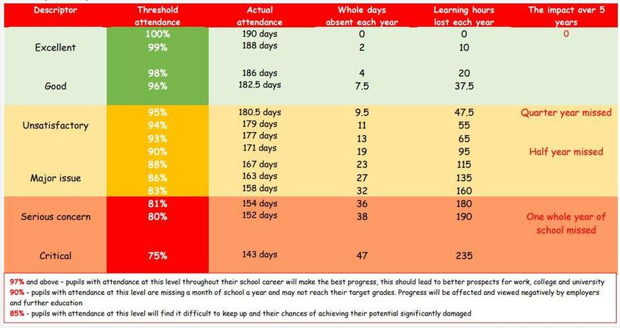
Attendance
Good Attendance = 96% or above
We won’t authorise holidays during the term. We ask that routine (non-emergency) dentist, opticians & doctor appointments take place out of the school day whenever possible.
We are here to support - contact Ms Jale Apicella (Family Link Support Worker) or your child’s class teacher.

Slide 11
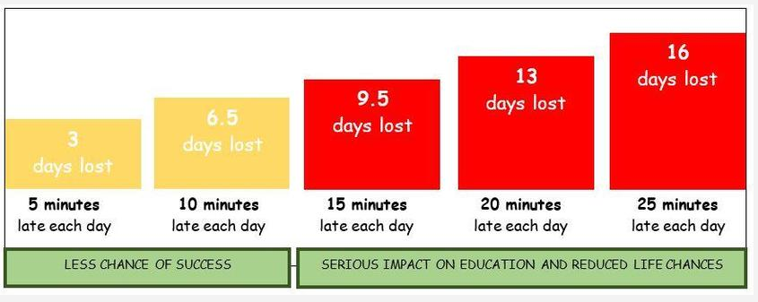
Punctuality
Lessons begin at 8:45am sharp - Gates open at 8:30am and doors to the school building at 8:35am
We strongly encourage children to arrive at school between 8:30-8:35am
The Registration period is 8:35-8:45am - children should be in their classroom by 8:45am when the register closes
Children don’t like arriving late - it’s embarrassing, interrupts the lesson and does not evoke positive emotions in your child - they also miss key messages and learning
We are here to support - contact Jale Apicella (Family Link Support Worker) or your child’s class teacher

Slide 12

Parent/Carers Volunteers
We are hoping to be able to welcome back our wonderful parent/carer volunteers this year. If you are interested in supporting the children in school you will need to attend one of the two planned volunteer meetings.
Please be aware that ALL volunteers must have a full DBS check (completed by the school) before they can commence volunteering.
Volunteer Meetings:
Friday 18th September @ 8:50am
or
Monday 21st September @ 2:10pm

Slide 13

Behaviour and Discipline Policy
A full copy of our Behaviour and Discipline Policy is available on the school website.
We are continuing to use our ‘Good to be Green’ system across the school
New School Rules:
This year, we have introduced 4 school rules which complement our school values.
They are:
Respectful,
Ready,
Safe,
Kind.
Children were introduced to these in assembly on the first day of the new school year.

Slide 14
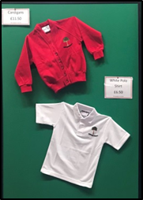


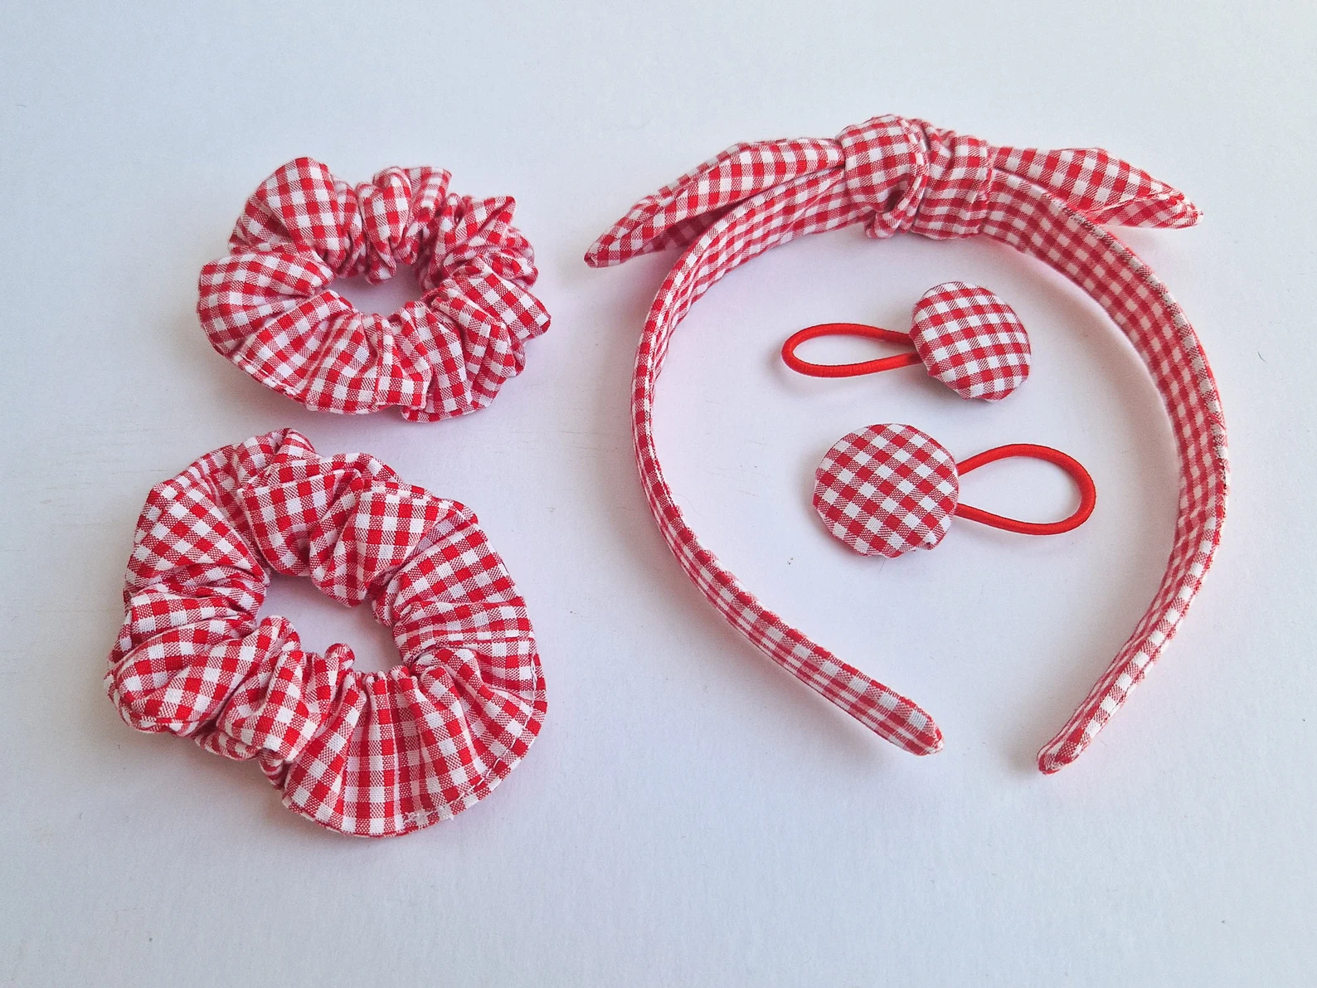
School Uniform Expectations:
White polo-shirt (with or without the school logo)
Smart grey skirt, trousers, shorts or pinafore
Red jumper or cardigan (with or without the school logo)
Smart, plain black shoes (boots are not permitted) - no trainers
Plain grey, white or red socks/tights
Hair:
Long hair must be tied back
Simple, red or white hair accessories only e.g. Alice band, hair band, clip
Motifs in hair are not permitted
Jewellery:
Necklaces are not allowed to be worn
Only stud earrings are permitted - no hoops
Nail varnish, skin tattoos and false eyelashes are not allowed

Slide 15
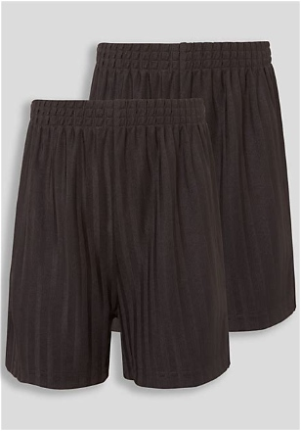

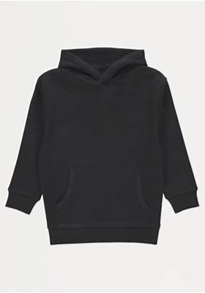
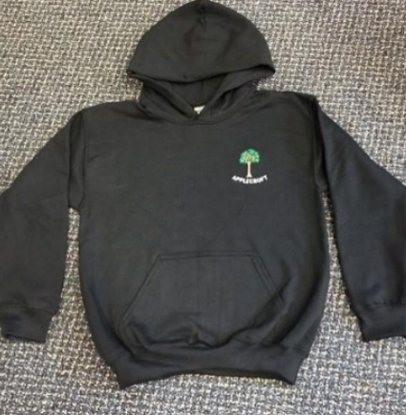

School Uniform Expectations - PE Kits:
Plain, white t-shirt (with or without school logo)
Plain, black shorts like the ones shown here →
Plain, black jogging bottoms (no branding or logos allowed)
Plain, black hoodie (with or without school logo)
Trainers
Please ensure all items are plain and do not include other branding or logos

Slide 16
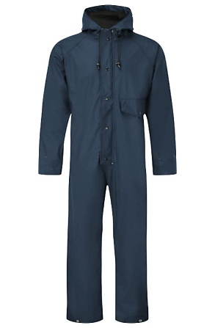
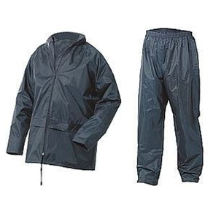
School Uniform Expectations - OPAL:
As part of the school’s Outdoor Play and Learning (OPAL) initiative, all children must have in school:
A pair of wellie boots &
A set of waterproofs to cover the whole body
(this can be a full suit or 2 separate items)
Please be aware that all children will be going outside at break and lunchtime even if it is raining therefore these items are vital

Slide 17


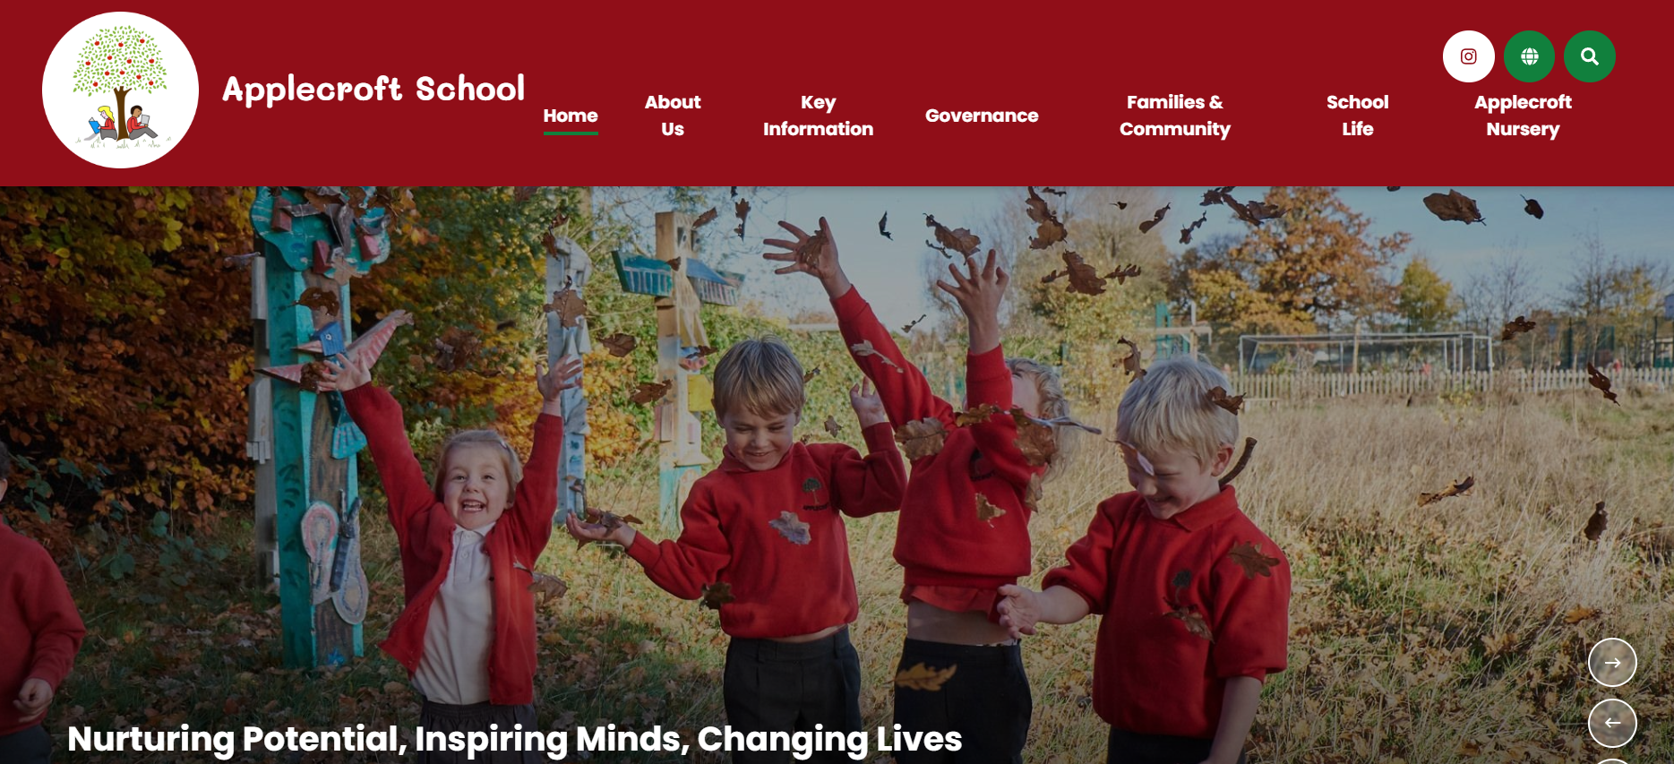



How we communicate with you
Access to useful information including:
Term Dates
School Calendar
Curriculum Information
Staffing
Year Group Pages
Emails and Letters from school
First-Aid messages
Half-termly School Newsletter
PTA News and Events
Instagram
Special events & celebrations
Home Learning
Task will be set every Friday and are due back the following Friday
admin@applecroft.herts.sch.uk - Mrs Lamaison (Office)
Notes:
Paul

Slide 18

Communication between Home and School
School Admin Email
For general enquiries, attendance information and administrative matters, please contact the school office via the admin email address.
Who Should I Contact?
If you have any questions or concerns, please follow the communication pathway below so that matters can be addressed as quickly and effectively as possible:
Class Teacher → Phase Leader → Assistant Headteacher → Deputy Headteacher → Headteacher
In most cases, your child's class teacher should always be the first point of contact, including queries or concerns regarding Special Education Needs
Logins and Access Information
Individual and whole-school login details for relevant online platforms will be provided to children at the start of the school year and whenever access to new resources is required.
If your child has lost their log-in or has an issues accessing any school based websites, please contact our IT Admin Assistant, Claire Playford via the admin email.

Slide 19
SEND at Applecroft
How do we support children with additional needs:
All Teachers:
All teachers are teachers of SEND and have regular training and access to resources to meet the needs of all learners
Are the first point of contact for any questions or concerns about your child's learning, wellbeing or additional needs
Regularly monitor children's progress to identify strengths, barriers to learning and any additional needs
Work with parents/carers to support each child's individual needs and development
Provide appropriate support, strategies and resources to ensure children can access the learning and achieve success
SENDCO (Special Educational Needs and Disabilities Coordinator):
Coordinates the provision and support for children with special educational needs and disabilities across the school.
Works closely with parents and carers, school staff and external agencies to ensure children receive the support they need.
Provides guidance and advice to staff on effective strategies and best practice for supporting pupils with additional needs.
Helps families access further support and signposts them to relevant services and organisations where appropriate.
Monitors the impact of support and interventions to help ensure children make the best possible progress.
At Applecroft, the SENDCO is our Assistant Headteacher for Inclusion and Wellbeing - Ms Ruth Johnson
senco@applecroft.herts.sch.uk
Notes:
Ruth
Everyone is a teacher of SEND
First port of call is the class teacher
Signposting

Slide 20
SEND at Applecroft
How do we support children with additional needs:
Individual Support Plans (ISPs):
Some children with SEND will have an ISP that includes individual targets that are being worked towards.
When children move classes at the end of each academic year, we ensure a thorough handover takes place between teachers. This handover includes all EHCPs, ISPs and individual provision ensuring a smooth transition for all pupils.
Therefore, your child’s new teacher already has this information and where relevant will be working towards the targets identified on their current ISP.
ISP Reviews:
ISP reviews take place termly as follows:
Week before the half-term holiday, the Class Teacher and SENDCo meet to discuss child’s progress, next steps and provision
Week after half-term, the Class Teacher will meet with parents/carers to discuss the child’s progress and together identify next steps/targets to work towards
Notes:
Ruth
Everyone is a teacher of SEND
First port of call is the class teacher
Signposting

Slide 21

Important Reminders
Mobile Phones:
If you provide your child with a mobile phone on their independent journey to school please be aware of the following:
Children must switch their phone off as they arrive at school and before they enter the school site i.e. walk through the gates
As soon as they arrive in their classroom they must hand their phone to the class teacher and sign it in
They should not access this phone throughout the school day until they then sign it out at 3:15pm
The phone must remain switched off until they are out the school site i.e. outside the school gates

Slide 22
Important Reminders
School Lunches
Thank you for your support in ensuring children have healthy, balanced lunches that support their wellbeing and learning throughout the day.
Healthy Snacks
If your child brings a snack to school, please ensure it is a healthy option such as fruit, vegetables or a cereal bar.
Stationery
A gentle reminder that donations of glue sticks are always gratefully received and help us keep classroom resources well stocked.
Feedback and Suggestions
We value the views of our families. Positive feedback and suggestions can be shared through our feedback boxes or by email, and we always welcome constructive ideas for how we can continue to improve.
Bikes and Scooters
If your child travels to school by bike or scooter, please help us keep everyone safe by being considerate of other families. Children should dismount and wait with their bike or scooter outside the school gates until they are opened. Thank you for your cooperation.

Slide 23

Important Dates
Monday 14th September: Welcome meeting recordings sent to parents
Friday 18th September at 8.50am and Monday 21st September at 2.10pm: Volunteer Meeting & Safeguarding Training
Wednesday 23rd September: School individual and sibling photos
W/C Monday 28th September: Book Fair
Wednesday 30th September from 1.00-2.45pm: Y5 Fun Run/Cross Country heats, Stanborough Lakes
Thursday 8th October from 3.45-5.00pm: Cross Country Finals, Stanborough Lakes
Friday 16th October: Y5 Assembly
W/C 19th October: Arts Week
Thursday 22nd October from 3.30-6.00pm: Parent consultations in school
W/C Monday 26th October: Half Term Break
Wednesday 4th November from 3.30-6.00pm: Parent consultations in school
Friday 6th November: PTA Fireworks
Tuesday 17th November: The Young Shakespeare Company (Macbeth)
Friday 27th November: INSET day, school closed
Monday 30th November: Occasional day, school closed
Tuesday 8th December at 1.30pm and 5.30pm: Christmas Show x2
Thursday 10th December at 5.30pm: Christmas Show
Tuesday 15th December at 3.00pm: Carols on the Playground
Wednesday 16th December: Gordon Craig Theatre Panto Trip
Thursday 17th December: Christmas Lunch/Christmas Jumper Day
Friday 18th December at 2.00pm: End of Term
Tuesday 27th April - Thursday 29th April: Residential Aylmerton Trip (more information to follow)

Slide 24
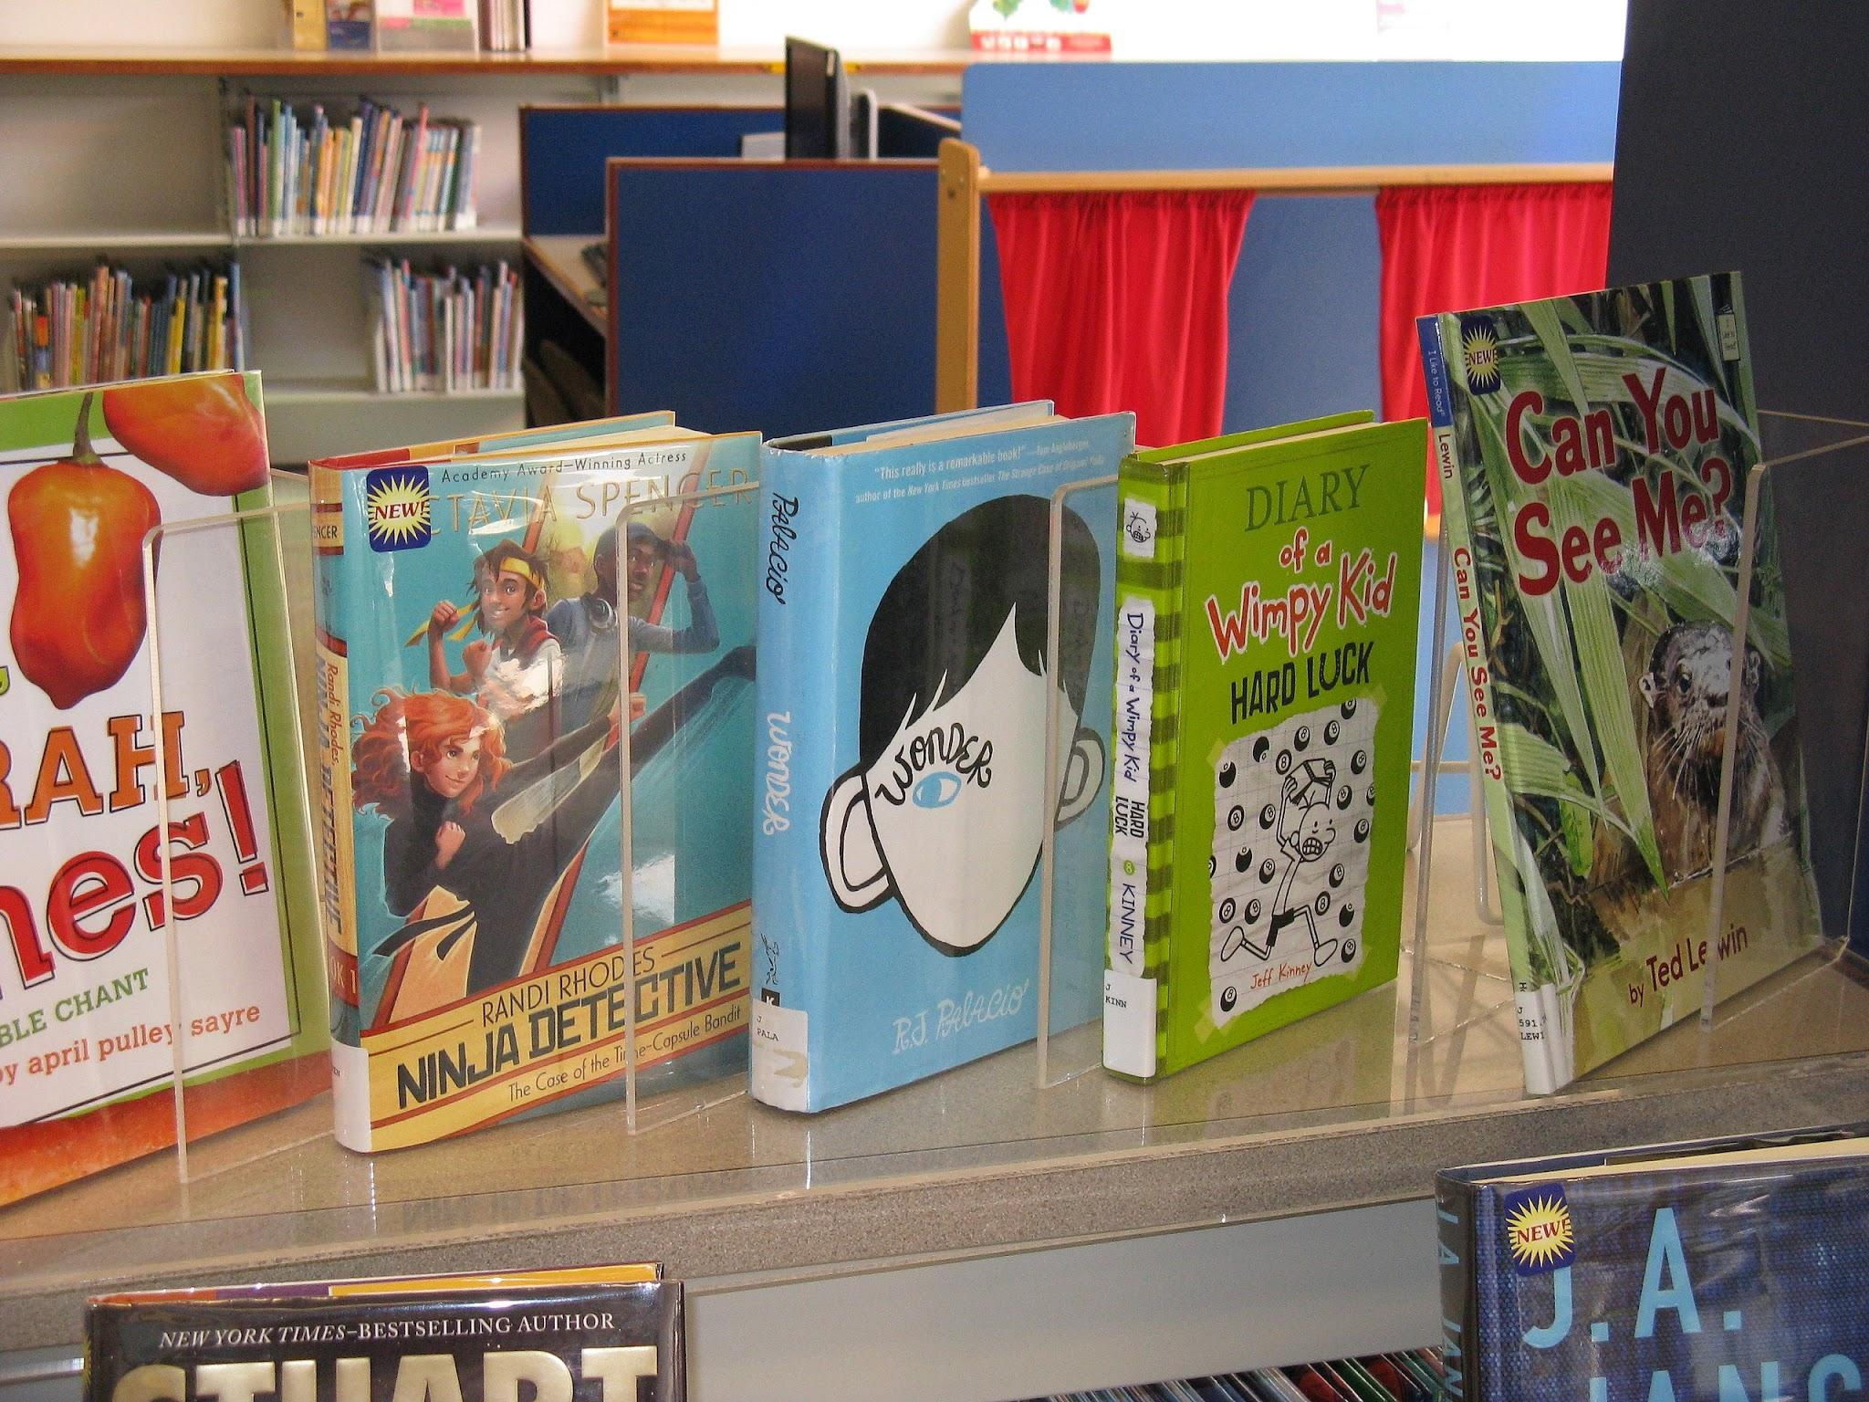
Books
Over the past few years, the school has invested significantly in high-quality reading resources, including the ‘Little Wandle’ phonics scheme, reading curriculum materials and books for our class and school libraries.
To help us maintain these resources for all children, we ask that books are looked after carefully at home. If a book is lost, not returned, or returned in a condition that means it cannot be used again, the school may contact parents/carers to request a contribution towards the cost of a replacement.
Thank you for your continued support in helping us provide excellent reading resources for all our children.

Slide 25
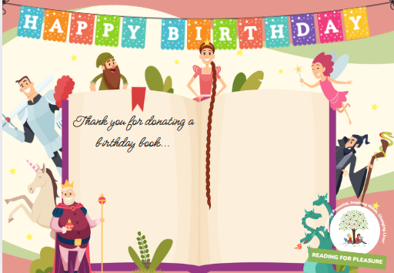
Birthday Books:
To celebrate children's birthdays in a special way at school, families are invited to donate a book for their child's class library.
There is no expectation for families to purchase a book. However, if you would like your child to celebrate their birthday in this way, each class has a Birthday Book Wishlist, which can be found on Google Classroom.
Every donated Birthday Book will receive a special sticker inside the front cover, recognising the child who donated it and the birthday being celebrated. The book will then become part of the class library for all children to enjoy.
Why a book makes the perfect gift…

Slide 26
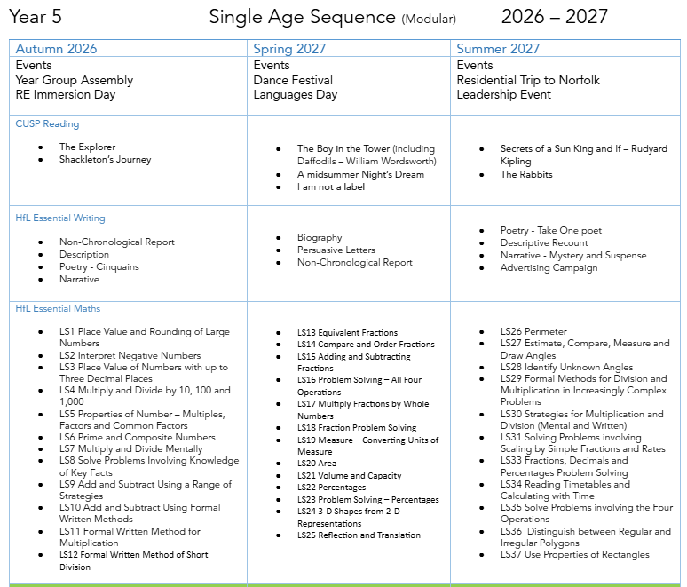
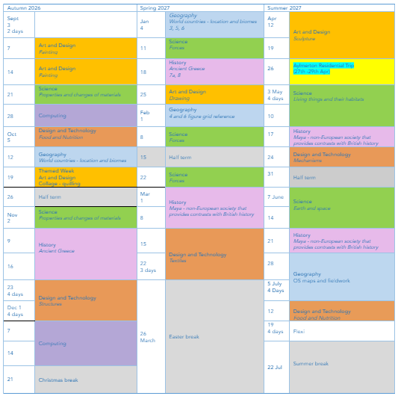
The Curriculum
A copy of the Year on a Page and Curriculum Letter will be available on the school website

Slide 27
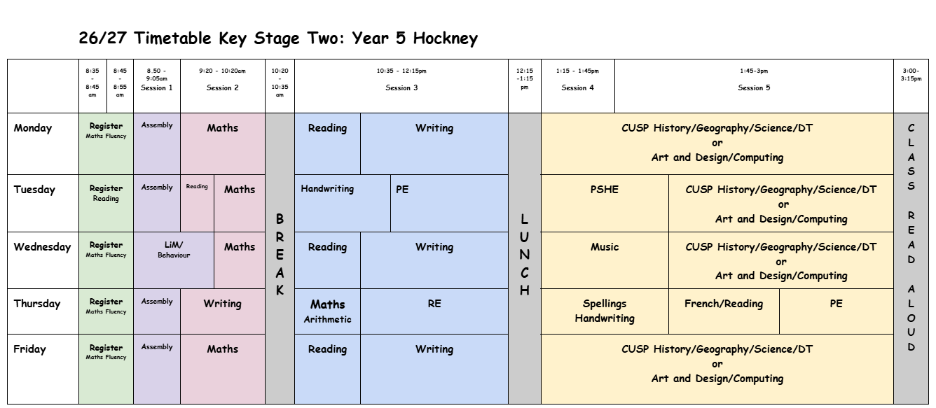
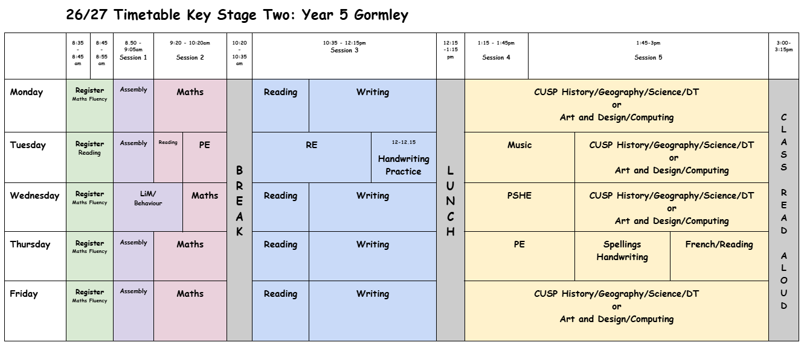
The School Day – On Overview

Slide 28
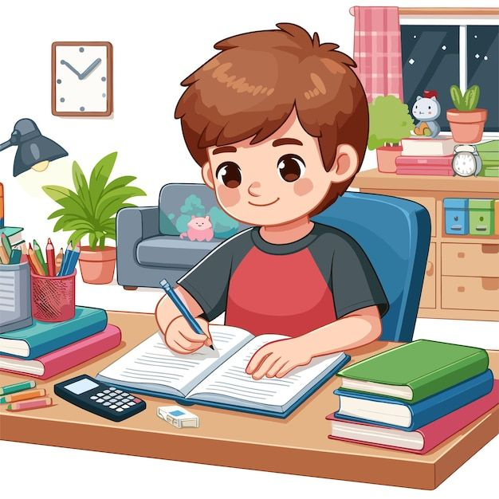
Home Learning
Home learning will continue to be set every Friday and should be completed and returned by the following Friday
Home learning will be set and communicated on Google Classroom for children in Years 1-6. Clear information will be provided about what needs to be completed, when it is due, and how it should be submitted. All home learning will build on learning that has already taken place in class, ensuring that children feel confident and well supported when completing tasks at home
We will review our home learning arrangements during the autumn term and will keep parents and carers informed of any updates or changes

Slide 29


The Importance of Reading
It is important that children read at home every day. This can include reading and re-reading their school reading scheme books, as repeated reading helps to build fluency, confidence and comprehension. Children are also encouraged to enjoy a wide range of other books at home, with the overall aim of developing a lifelong love of reading and fostering positive reading habits.

Slide 30


Slide 31
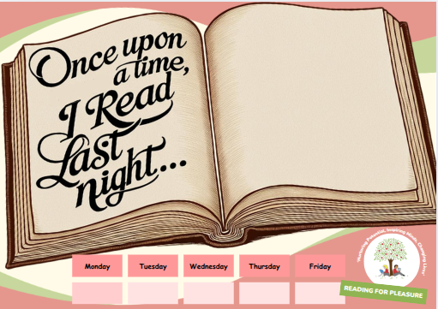
Reading:
We continue to encourage every child to read for pleasure at home each day.
We are continuing an in-house, child-led approach that promotes leadership skills.
Using the document displayed on the left, children will self-register by adding their name to the open book if they have read the previous evening.
Reading Society members will total the scores each day, and weekly class totals will be displayed in the main corridor at the end of each week.
A love of reading is the single biggest indicator of future academic success (OECD)

