Slide 1

Nursery Welcome Meeting
Notes:
Welcome
Exciting new beginnings - nursery families continuing their journey / Others welcome to the AF and the start of our journey together
Purpose of evening is to give you key information that will be useful at this point in the year - including key staff, info about attendance & punctuality, class timetable etc as well as a visit to the classrooms so you can see where your children will be and how it is organised

Slide 2
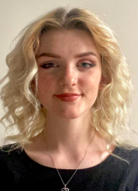
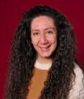
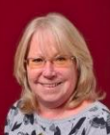
Staffing
Nursery Staff
›
Miss Anya Garratt Nursery Class Teacher | Miss Eleni Georgiou Early Years Practitioner | Mrs Deborah Bonner Learning Support Assistant

Slide 3
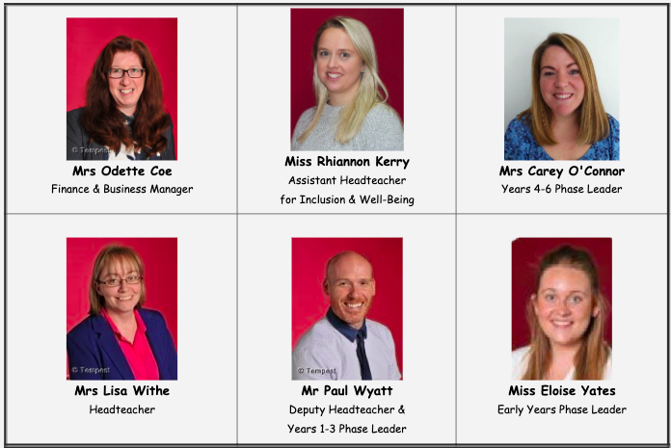
Staffing
Senior Leadership Team

Slide 4
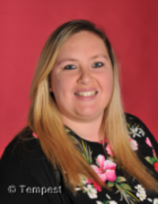
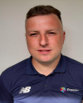
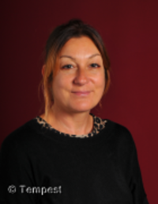
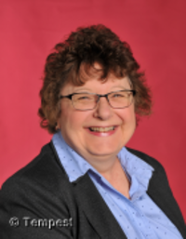
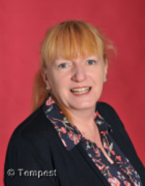
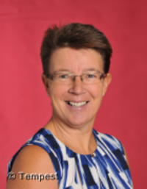
Staffing
Mrs Vikki Wake PPA Lead - RE | Mr Nathan Derrick Sports Coach | Ms Jale Apicella Family Link Support Worker
Mrs Lyn Lamaison | Mrs Helen Van Hek | Mrs Gill Williams

Slide 5

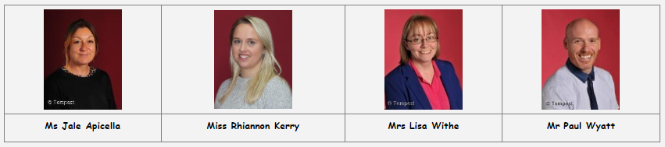
Safeguarding
safeguarding@applecroft.herts.sch.uk
Designated Safeguarding Leads - DSLs

Slide 6
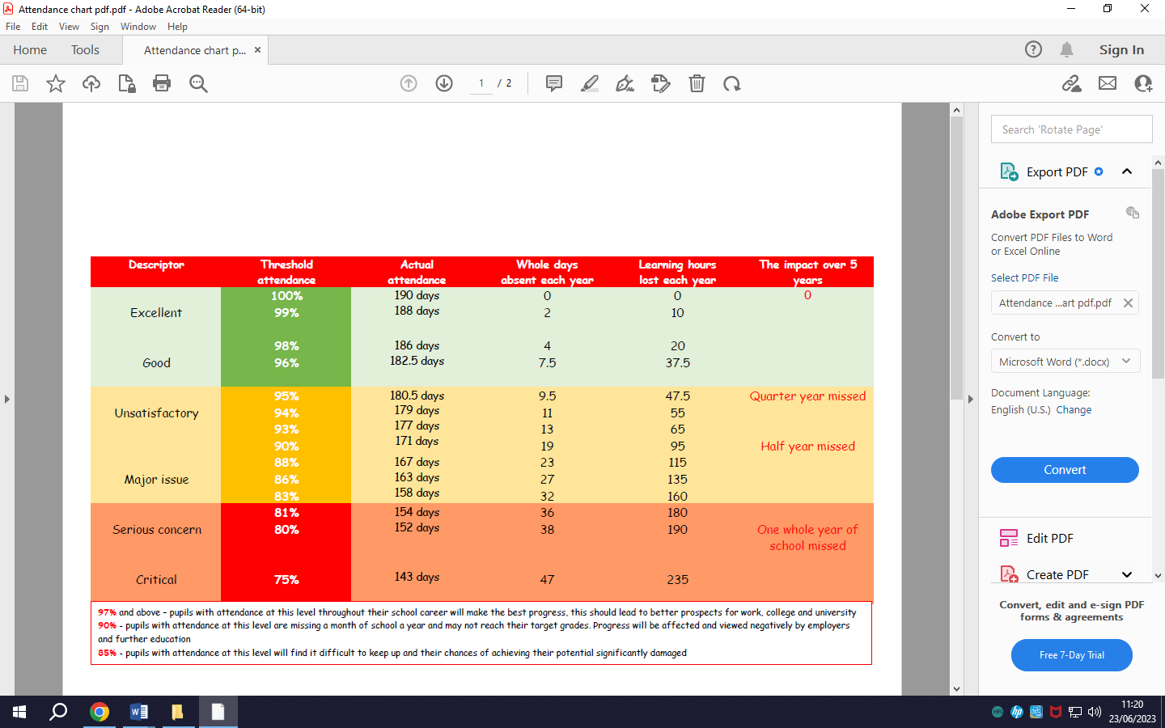
Attendance
Attendance – 96% or above
We won’t authorise holidays during the term. We ask that routine dentist & doctor appointments take place out of the school day whenever possible
We are here to support - contact Jale Apicella (Family Link Support Worker) or your child’s class teacher

Slide 7

Punctuality
The school day begins at either:
8:30am / 9am or 12:30am (depending on hours)
Gates open at 8:30am / 12:30pm
Children don’t like arriving late - it’s embarrassing, interrupts the lesson and does not evoke positive emotions in your child - they also miss key messages and learning
We are here to support - contact Jale Apicella
(Family Link Support Worker) or your child’s class teacher

Slide 8


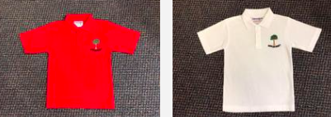
School Uniform
There is no school uniform expectations in nursery however, we do recommend that you consider purchasing the school polo shirts (with or without the logo)
Information about our uniform is available on the school website
School colours
School logo
White or red polo shirts (red only for children in EYFS)
Sturdy shoes or trainers with velcro
(sandals/crocs/boots/flip-flops/open-toed shoes are not permitted)
PE
There is no set uniform for PE but please ensure children are dressed in suitable clothing/footwear on their PE days - Tuesday & Friday

Slide 9

Other Important Information
Long hair should always be tied back when at school
Simple, hair accessories only e.g. clips, Alice bands, hair ties (no large bows please)
Stud earrings only (must come out on PE days or be covered)
No nail varnish or motifs in hair
Sturdy school shoes - not boots/flip-flops/open-toed shoes/crocs/sandals
Wellies
Small rucksack containing a named, change of clothes
Refillable water bottle
School provide snacks - we are a NUT-FREE school

Slide 10

Behaviour and Discipline
We have high expectations of Behaviour and Discipline at Applecroft and expect all families to support us in promoting the same message.
When discussing behaviour in school we use the terms ‘prosocial’ and ‘antisocial’.
We look to recognise, reward and reinforce prosocial behaviours.
Pro-social behaviour is behaviour which is positive, helpful and intended to promote social acceptance - it is the behaviour that helps everyone to learn and to feel safe.

Slide 11
Behaviour and Discipline
We have clear ‘Expectations of Behaviour’ that we expect all members of our community to abide by in order to act prosocially.
These expectations are:
• Be responsible for yourself and your actions
• Be honest, open and reflective
• Be kind and supportive
• Be respectful and well-mannered
We encourage children to be honest and responsible about their behaviour to enable them to learn from any mistakes - they are children after all!

Slide 12
Behaviour and Discipline
Our ‘Expectations of Behaviour’ extend to all members of the ‘Applecroft Family’.
However, depending on a child’s maturity, current level of development and/or any special education needs/disability, these expectations may be unachievable.
We are proud to be an inclusive school and in this situation we will work with parents and key staff to put a more personalised approach to behaviour management and support.

Slide 13

Behaviour and Discipline
We aim to ‘catch children doing the right thing’ and recognise this through our ‘sun, rainbow, cloud’ system in Nursery and Reception.
All children start on the sun
Pro-social behaviours can result in children moving onto the rainbow which has 5 levels that they can aim to move up
(Level 3 = class reward e.g. a sticker, Level 4 = Deputy Headteacher reward,Level 5 = Headteacher’s Award)

Slide 14
Behaviour and Discipline
In the EYFS, every child is still learning to recognise, name and regulate their emotions.
Therefore, there will be incidents that occur and disagreements between children - it’s part of their development and socialisation
We have a layered approach to anti-social behaviours with the cloud and its layers being used as a visual aide - not a threat
At level 1, the child will be given a verbal warning including them being told, using pro-social language what they need to be doing rather than focusing on what they are not doing. The child’s image will not be displayed on the cloud itself but will be taken off the sun
At level 3, the staff member will indicate that the child’s behavior is now a further layer up the cloud and this will lead to a 5 minute time out of class to support the child to self-regulate
On rare occasions, if behaviour continues to escalate, this can lead to levels 4 & 5 which will involve the EYFS Phase Leader (at L4) and Deputy/Headteacher (at L5)

Slide 15
The Learning Environment – An Overview
Inside:
Reading Corner
Construction Area
Small world play
Home-corner
Graphics Area
Malleable Area - including Paint and Playdough
Sand tray
Water
Outside:
Sand pit
Water
Large construction
Book nook
Wood work bench
Stage
Garden
Climbing frame and Physical Literacy equipment

Slide 16

Tapestry
Tapestry keeps you in touch with your child’s day wherever you are.
As parents, the first day of handing over your child to the care of another can be an emotional time. As your child adjusts to experiences without you at their school, most parents/carers want to share these times.
Tapestry facilitates this, by enabling a personal journal, or diary, to build over time. Photographs, videos and notes of special moments are not only recorded, but can be made available regularly and often immediately to you.
Tapestry uploads include celebrating their achievements and exciting activities, individually or with their new friends and the staff looking after them. As parents/carers, you can contribute to this growing journal by commenting on the journal entries, or even adding your own.
Let your child’s teachers know what your child loves doing at home by sending photos and videos back, helping them understand their development at home.
In addition to the simple pleasure of seeing your child’s enthusiasm in describing their day, talking together about the pictures and video clips in their journal helps to develop your child’s language skills and build their self-esteem.
At the end of the academic year, we will provide you with a copy of your child’s Tapestry learning journal to keep and treasure.

Slide 17
Communication between home and school
Focus child meetings (observations) - will take place weekly
Tapestry - logins to follow
Google Classroom
Year Group email - nursery@applecroft.herts.sch.uk - for non-urgent matters
Twitter (or ‘X’) - @applecroftwgc
Website - www.applecroft.herts.sch.uk

Slide 18
Important Dates
Friday 15th September - Curriculum Letter published on website
Volunteer meetings -Mon 18th Sept @ 2:15pm or Fri 22nd Sept @ 9am
Tuesday 26th September - school photographs

Slide 19
Parent Volunteers
We are hoping to be able to welcome back our wonderful parent volunteers this year. If you are interested in supporting the children in school you will need to attend one of the two planned volunteer meetings
Monday 18th September @ 2:15pm
or
Friday 22nd September @ 9am

Slide 20
Parent-Teacher Association (PTA)

Slide 21
Visit to Classrooms

